Slide 1
H2020 CSA project
OGC Health Domain Working Group May 5th 2015
Support for the European Innovation Partnership on Active and Healthy Ageing - PROEIPAHA
By Birgit Blaabjerg Bisgaard, Central Denmark Region
Notes:
CSA – Coordination & Support Action

Slide 2
European Innovation Partnership on Active and Healthy Ageing
OGC Health Domain Working Group May 5th 2015
Action Groups:
A1 Prescription and adherence to medical plans
A2 Personalized health management and falls prevention
A3 Prevention and early diagnosis of frailty and functional decline
B3 Replicating and tutoring integrated care for chronic diseases including remote monitoring at regional level
C2 Development of interoperative independent living solutions
D4 Innovations for agefriendly buildings, cities and environments
By Birgit Blaabjerg Bisgaard, Central Denmark Region
Notes:
EIPAHA – has 6 action groups – listed
D4 includes spatial context, which we would rather have as a ”support” for all groups. That we are working on.
The number of participants is A1 = 76, C2 = 177 and the rest I do not have a number for.

Slide 3
CDR is responsible for Work Package 4
OGC Health Domain Working Group May 5th 2015
Policy analysis and monitoring:
Framework for mapping evidence from commitments – CDR
Mapping of relevant policies for Good Practises in the EIPAHA at national and regional level – CDR
Measuring progress of EIPAHA commitments – OE
Policy and strategy recommendations – ERRIN
By Birgit Blaabjerg Bisgaard, Central Denmark Region
Notes:
CSA – Coordination & Support Action – has 9 Work Packages

Slide 4
Work Package 4
OGC Health Domain Working Group May 5th 2015
Timeline:
All ready delayed 3 to 4 month due to late or poor data delivery.
 | Q1 | Q2 | Q3 | Q4 | Q5 | Q6 | Q7 | Q8
4.1 | XXX | X
4.2 |  | XXX | XXX | XXX
4.3 | XXX | XXX | XXX | XXX | XXX
4.4 |  |  |  |  | XXX | XXX | XXX | XXX
By Birgit Blaabjerg Bisgaard, Central Denmark Region

Slide 5
4.1 Framework for mapping evidence from commitments
OGC Health Domain Working Group May 5th 2015
Open data and open governance
Indicators across commitments
Different indicators from: World Bank, OECD, WHO, EU, UN
Evaluation and decision between indicators
OGC Health DWG ???
Analysing commitments and propose a framework for mapping evidence
By Birgit Blaabjerg Bisgaard, Central Denmark Region

Slide 6
4.2 Mapping of relevant policies for EIPAHA at national and regional level
OGC Health Domain Working Group May 5th 2015
Mapping relevant policies from good practices
Classification of information inspired from DIGST
Visualization and dashboards like in BI systems
Standardised metadata collection clustered like INSPIRE
To extract data from existing data we can for example use:
Machine learning or
Pattern recognition
By Birgit Blaabjerg Bisgaard, Central Denmark Region

Slide 7
Danish Digitalization Agency Strategy (digst) and status on health
Fully digital clinical workplace by 2013
Total perspective over the patients health information
Safe and interconnected digital communication by 2013
Action plan for pene-tration of telemedicine
Telemedical treatment for chronical patients

Slide 8
OGC Health Domain Working Group May 5th 2015
Roles of the OGC Health Domain Working Group include but are not limited to, activities to:
Convene OGC members and non-members across the health domain
Build Capacity for technical solutions, knowledge exchange, requirements gathering and prioritization
Assimilate Inputs toward geospatial standards development, including data definitions, formats, and services for publishing, discovery, exchange, and query ability of geospatial information
Help to focus on sub-sets of health where geospatial data and interoperability are required
Spawn Demonstration Projects, Interoperability Experiments, and Interoperability Pilots
Educate and Inform Health communities-of-practice
By Birgit Blaabjerg Bisgaard, Central Denmark Region

Slide 9
OGC Health Domain Working Group May 5th 2015
Status on the CSA work
Bad and poor data makes the proposed task impossible
CDR decides which information is needed to be able to carry out the policy analysis
CDR will participate in the collaborative process of defining of a tool for submitting and tracking commitments
By Birgit Blaabjerg Bisgaard, Central Denmark Region

Slide 10
Opportunities for OGC in participating in the CSA
OGC Health Domain Working Group May 5th 2015
Geospatial standards development incl. data definition and formats
Spawn demonstration projects – the CSA?
Danish overview of projects (in municipalities and regions)
DIGST – standards on health data systems
By Birgit Blaabjerg Bisgaard, Central Denmark Region

Slide 11
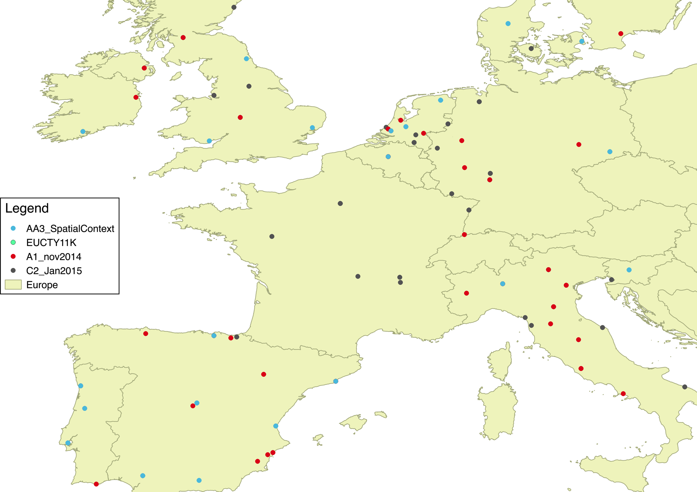
Status on mapping commitments
OGC Health Domain Working Group May 5th 2015
By Birgit Blaabjerg Bisgaard, Central Denmark Region

Slide 12
Proposal to OGC
OGC Health Domain Working Group May 5th 2015
Europe has through the EIPAHA recognized the issue of a growing elderly population. US and Canada will, as for the rest of the world, be dealing with the same issue.
OGC has the power to participate and to influence the work.
Work fully on promoting OGC as ”player” in EU in EIPAHA
Support the CSA through CDR by determine geospatial standards, data definitions and formats
Support the CSA work by promoting OGC in INSPIRE – in Lisboa in week 22
Cooperate with other international organisations in dealing with the above issue by standardising information
By Birgit Blaabjerg Bisgaard, Central Denmark Region

