Slide 1
Citizen Science DWG
110th OGC Technical Committee
Singapore
Joan Masó
25 February 2019

Slide 2
Agenda
Progress on the Citizen Science Interoperability experiment
http://external.opengeospatial.org/twiki_public/CitSciIE/2019_04_EGU
Earth Challenge 2020: Research Questions to Help Citizen Science Scale
https://portal.opengeospatial.org/files/?artifact_id=82880

Slide 3
Cit Sci IE

Slide 4
Innovation: the enabler of Citizen Science
Social Innovation:
societal progress in new ideas, activities or
services concerned with
improving the quality of life,
nature and public good in a consensus process
Technical Innovation: progress in computer networks, web 2.0, mobile phones, low cost sensors, social media, interoperability
Citizen Science
Source: Uta Wehn; modified

Slide 5
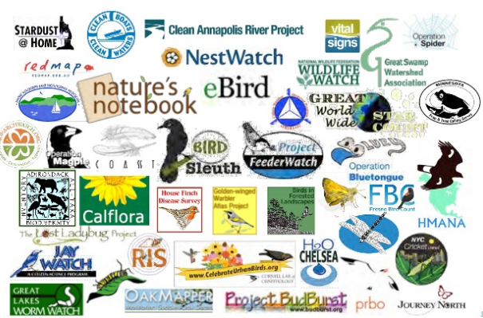
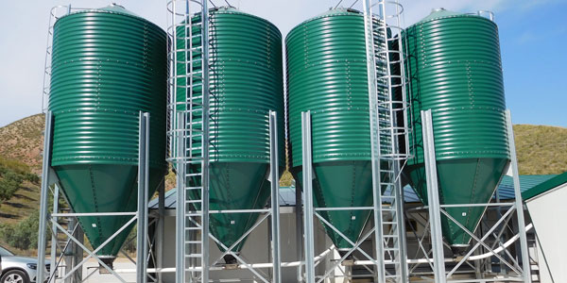
Citizen Science. The new silo?
The administration is opening data in portals
e.g. the INSPIRE directive makes official this obligation in the EU,
The projects of citizen science give priority to other aspects.
There are excellent exceptions like OSM and GBIF
Need for action!
Notes:
https://www.slideshare.net/AniKarenina/free-as-in-puppies-compensating-for-ict-constraints-in-citizen-science

Slide 6
The EU financing Cit Sci projects
From citizen-based data collection to knowledge sharing for joint decision-making, cooperative planning and environmental stewardship
Considers the social and the technical dimensions
Six demo cases
Crowdsourcing platform used to collect images and text from citizens
Calibration and validation of satellite imagery using the crowdsourcing
Annotate images with serious gaming and machine learning
Two demo cases Kifisos river, Greece (urban) and Danube Delta, Romania (rural)
Inventory of citizen observatories and sustainability
Facilitate update and adoption in EO communities
Create 3 Communities of Practice
#3 on interoperabiity
Landsense
Sustainable custodianship of land and soil
Meet the demands of food production
Calibrate/validate satellite-based soil moisture products with CS in-situ sensors
Campaign-based approach for engaging
Builds a engagement platform
Emphasis on services
Photoquest (pictures in 4 directions), change detection in alerting about bird habitat risks, single sign-on
Three demo cases on landscape changes, agriculture and habitat monitoring

Slide 7
The four CoPs of WeObserve
CoP Engage
Co-creating citizen observatories and engaging citizens
addressing incentives and barriers for participation, engagement strategies and citizen-science ethics (led by IHE Delft)
CoP Impact
Impact and value of citizen observatories for governance
defining socio-economic and environmental impacts of community-based environmental monitoring for public authorities and decision makers including risk evaluation (led by IHE Delft)
CoP Interop
Interoperability and standards for citizen observatories
adopting data quality, curation and preservation of citizen-science data, and addressing privacy and licensing for CO sustainability (led by CREAF).
CoP SDGs
UN Sustainable Development Goals and Citizen Observatories
new innovative approaches to data collection make use of Earth observation (EO) to address some of the SDG data needs (led by IIASA).

Slide 8
Thanks to the initiators and supporters
CoP3
Support
Initiators

Slide 9
Resources to work
The external twiki:
http://external.opengeospatial.org/twiki_public/CitSciIE/WebHome
The OGC portal (it requires a OGC username)
https://portal.opengeospatial.org/?m=projects&a=view&project_id=580
A GitHub repo
https://github.com/opengeospatial/CitSciIE
We can conduct some discussion in “issues” if needed
A open email list:
interop-cop3@weobserve.eu.
Is everybody subscribed?

Slide 10
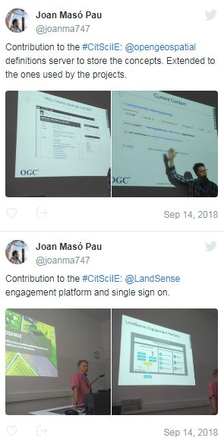
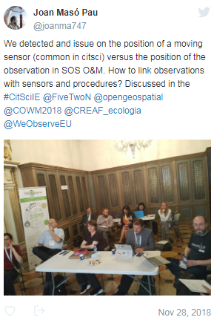
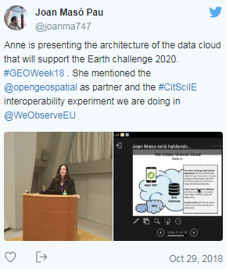
Previous meetings
Stuttgart
Kyoto
Venice
and 7 telecons

Slide 11
Citizen Science Interoperability Experiment (CitSciIE)
9-15h Kick-off in Stuttgart
Vocabularies for Citizen Science in particular project metadata standards implementation in catalogues of CitSci projects.
The use of OGC standards or (e.g. Sensor Web Enablement (SWE)) to support data sharing and integration among CS projects, and with other sources, esp. authoritative data (e.g by following SWE4CS);
The integration of CS projects/campaigns in Single Sign-On system (SSO) federation;
How to document critical metadata, including data quality aspects, and generate a data quality label.
Initiators
CoP-Interop
Support

Slide 12
V: Vocabularies for organizing Citizen Science projects.
There was a discussion on essential variables but also on other kind of practices that can be associated to vocabularies.
Extraction of a common set of variables for the Earth Challenge (air and water quality, pollution, human health and eventually biodiversity)
Responsible: Anne Bowser
Analysis of data models that contributors in the project can bring in: Air quality (HackAir), Biodiversity (Peter Brenton & Natusfera), Mosquito (CREAF), Land Use (IIASA), Phenology (CREAF), Invasive Alien Species (JRC).
Responsible: Rob Atkinson
COST action project metadata model
Responsible: Sven Schade
Chair: Rob Atkinson

Slide 13
D: Data sharing using OGC standards such as O&M and SOS
We have 4 instances of SOS services
GROW Hydrologic SOS
istSOS (http://istsos.org/) in DLR hackAir
52North SOS
MiraMon SOS
We have a client the MiraMon Javascript client and the Hergoland client from 52 North.
WE would like to produces a set of instruction on how a CS project can easily setup a SOS service
Integration of SOS in GEOSS discussion
Chair: Simon Jirka

Slide 14
Preliminary conclusions
CitSci tend to produce several observations in different places
This creates many FeaturesOfInterest (many points) and many individual Observations generating very verbose files.
Issue in real implementations: XML encoding is difficult to parse and JavaScript libraries are slow. A file containing 8000 observations and 10 variables can easily generate a 30Mb file that is huge for the DOM parsers.
This results in about 500000 individual calls to XML libraries (to navigate for each field extract the properties of the features) that can take from 20 seconds up to 5 minutes depending on implementations. The use of canvas to represent does 8000 points in the screen is far much faster.
There is an urgent need for making a JSON encoding for SOS and O&M officialand popular
Meanwhile we are switching to WFS-GeoJSON to test the change in speed
We are going to explore how to use JSON encoding in SOS.

Slide 15
XML Single observation
<sos:observationData>
<om:OM_Observation gml:id="meet-mee-mechelen_2_13">
<om:type xlink:href="http://www.opengis.net/def/observationType/OGC-OM/2.0/OM_ComplexObservation"/>
<om:phenomenonTime>
<gml:TimeInstant gml:id="phenomenonTime_meet-mee-mechelen_2_1">
<gml:timePosition>2017-11-19 17:20:06+01</gml:timePosition>
</gml:TimeInstant>
</om:phenomenonTime>
<om:resultTime xlink:href="#phenomenonTime_meet-mee-mechelen_2_1"/>
<om:procedure xlink:href="http://www.opengis.uab.cat/meet-mee-mechelen/procedure/5"/>
<om:observedProperty xlink:href="http://www.opengis.uab.cat/meet-mee-mechelen/observedProperty"/>
<om:featureOfInterest xlink:href="http://www.opengis.uab.cat/meet-mee-mechelen/featureOfInterest/2"/>
<om:result xsi:type="swe:DataRecordPropertyType">
<swe:DataRecord>
<swe:field name="CAMPAIGN">
<swe:Text definition="http://www.opengis.uab.cat/meet-mee-mechelen/field/">
<swe:value>Oct-Nov2017</swe:value>
</swe:Text>
</swe:field>
<swe:field name="time_first">
<swe:Text definition="http://www.opengis.uab.cat/meet-mee-mechelen/field/">
<swe:value>2017-11-06 08:00:18+01</swe:value>
</swe:Text>
</swe:field>
<swe:field name="bc_aggr">
<swe:Quantity definition="http://www.opengis.uab.cat/meet-mee-mechelen/variable/bc_aggr">
<swe:uom code="?"/>
<swe:value> 3382</swe:value>
</swe:Quantity>
</swe:field>
<swe:field name="bc_aggr_mi">
<swe:Quantity definition="http://www.opengis.uab.cat/meet-mee-mechelen/variable/bc_aggr_mi">
<swe:uom code="?"/>
<swe:value> 80</swe:value>
</swe:Quantity>
</swe:field>
<swe:field name="bc_aggr_ma">
<swe:Quantity definition="http://www.opengis.uab.cat/meet-mee-mechelen/variable/bc_aggr_ma">
<swe:uom code="?"/>
<swe:value>17256</swe:value>
</swe:Quantity>
</swe:field>
<swe:field name="bc_aggr_st">
<swe:Quantity definition="http://www.opengis.uab.cat/meet-mee-mechelen/variable/bc_aggr_st">
<swe:uom code="?"/>
<swe:value> 3663</swe:value>
</swe:Quantity>
</swe:field>
<swe:field name="number_of_">
<swe:Quantity definition="http://www.opengis.uab.cat/meet-mee-mechelen/variable/number_of_">
<swe:uom code="?"/>
<swe:value>25</swe:value>
</swe:Quantity>
</swe:field>
<swe:field name="number_o_1">
<swe:Quantity definition="http://www.opengis.uab.cat/meet-mee-mechelen/variable/number_o_1">
<swe:uom code="?"/>
<swe:value>13</swe:value>
</swe:Quantity>
</swe:field>
<swe:field name="mean_numbe">
<swe:Quantity definition="http://www.opengis.uab.cat/meet-mee-mechelen/variable/mean_numbe">
<swe:uom code="?"/>
<swe:value> 7</swe:value>
</swe:Quantity>
</swe:field>
<swe:field name="uncertaint">
<swe:Quantity definition="http://www.opengis.uab.cat/meet-mee-mechelen/variable/uncertaint">
<swe:uom code="?"/>
<swe:value>0.50</swe:value>
</swe:Quantity>
</swe:field>
</swe:DataRecord>
</om:result>
</om:OM_Observation>
</sos:observationData>

Slide 16
XML simgle property
</swe:field>
<swe:field name="time_first">
<swe:Text definition="http://www.opengis.uab.cat/meet-mee-mechelen/field/date">
<swe:value>2017-11-06 08:00:18+01</swe:value>
</swe:Text>
</swe:field>
<swe:field name="bc_aggr">
<swe:Quantity definition="http://www.opengis.uab.cat/meet-mee-mechelen/variable/bc_aggr">
<swe:uom code="ng/m^3"/>
<swe:value> 3382</swe:value>
</swe:Quantity>
</swe:field>

Slide 17
Q: Data quality
Refine the QualityML vocabulary with new entries considering the work done in Australia (https://github.com/tdwg/bdq)
Responsible: Joan Masó
Connection with: D.3
This is work in progress.

Slide 18
Timeline
Activity | Timing
Startup
Draft activity plan presented to CS DWG: | Mar 19th, 2018
OAB revision and approval: | June 4th, 2018
Call for participation: | June 5th, 2018
Pre-kickoff event ECSA conference in Geneva: | June 6th, 2018
Execution
Official Kickoff after the Stuttgart TC (adding participation of the non present in ECSA conference) (TBC): | September 14th, 2018
Development, testing and bug fixing | September to February 2016
Presentation at GEO plenary in Tokyo | Oct 31st – Nov 11th 2018
Meeting at the Citizen Observatories for Natural Hazards and Water management Conference (Venece) | Nov 27th– Nov 30th 2018
Meeting at EGU | April 11th 2019
Planned end date: | June 2019
Wrap-up and Reporting
Technology Demonstration in a OGC TC | June 2019 (Leuven)
Final report submission | September 2019

Slide 19
EGU 2019
First meeting
We have secured the splinter session SMP20 for Thursday April 11th, 14:00-15:45 & 16:15-18:00.
https://meetingorganizer.copernicus.org/EGU2019/session/33659
This open session will serve a a regular meeting of this CoP as well as a preparation for a more focused activities that could take place during the weekend (see above) with the other CoPs(e.g. writting a draft of the Engineering report of the IE)
Second meeting
In addition there will be an event during the weekend: Friday 12 April until the afternoon of the Monday 15 April
We are not sure we are going for it yet

Slide 20
Leuven TC
We need to start thinking about final event in the next TC.
24-28 June, 2019
Leuven, Belgium

Slide 21
Earth Challange research questions

Slide 22
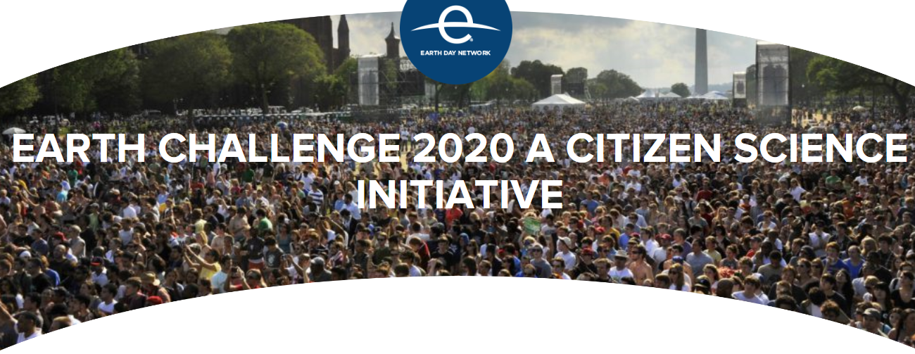
Earth Challange 2020
Goal of engaging millions of global citizens in collecting one billion data points in areas including air and water quality, pollution and human health.
Citizen science volunteers around the world, working with professional scientists, will collect and share earth science data of their local communities on an unprecedented scale.
There is a sensibility for data quality in the integration of many citizen science project in a single initiative

