Slide 1
The Canada Forum on Geospatial Standards Whitehorse, Yukon October 2nd, 2018
Trevor Taylor, Facilitator, OGC Canada Forum
ttaylor@opengeospatial.org

Slide 2
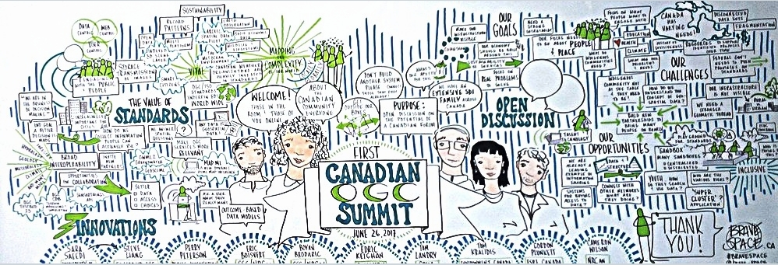
Canada Forum - Background
Created based on consultation with the Canadian community, beginning with a summit held in St. John's, Newfoundland and Labrador, in June of 2017.
The community identified a series of high level requirements, agreed to create a Charter, which was formally approved by the global OGC membership in April of 2018.
Charter approved ; Charter for the Canada Forum on Geospatial Standards,
Soft Launch June 2018, during OGC Meetings in Colorado
Graphic Summarizing the St. John’s, 2017, Summit

Slide 3
What is a Forum ?
Member led and managed, approved by the global OGC community
Open to non-members
Provides OGC infrastructure and staff support to support regional/country based activities, and OGC’s open, neutral, consensus based process
The goals and objectives of regional organizations vary based on regional requirements. Example Activities;
Assist in capacity building in the region/country
Promote policies, cooperative business development initiatives and public/private partnerships that support open standards to, for example, enable open data policies.
Coordinate participation in the OGC,
Provide a platform for all stakeholders
Notes:
MSC data and products are geospatial
Public warnings and public forecasts
Numerical weather prediction models
Weather observations
Satellite imagery
Image source: https://wutqfm.com/fire-herkimer-leaves-homeless/

Slide 4
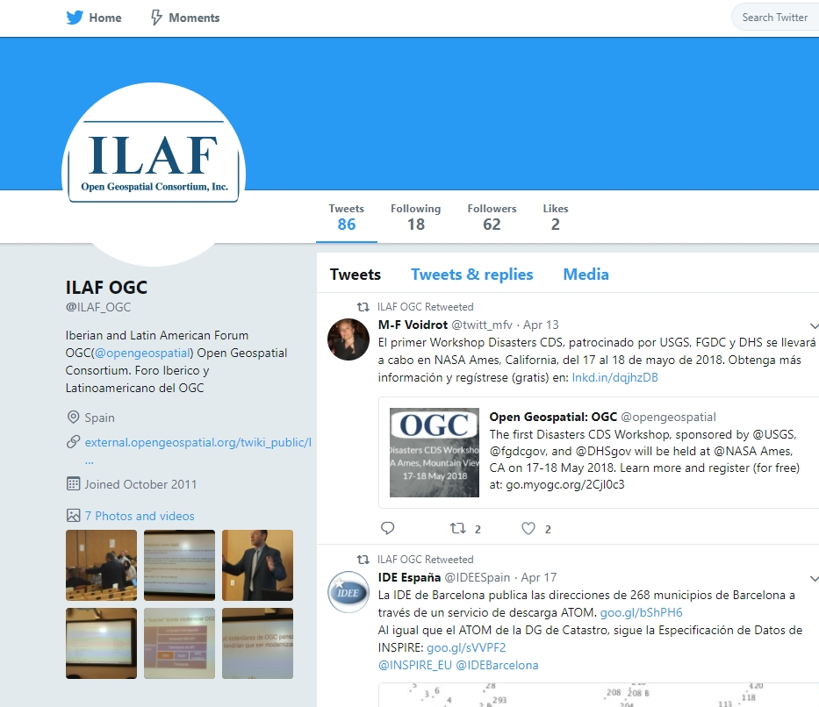
Global Forums
Asia
Australia and New Zealand
Canada
China
Europe
France
Iberian and Latin-American
India
Korea
Middle East and North Africa
Nordic
North American
UK & Ireland

Slide 5
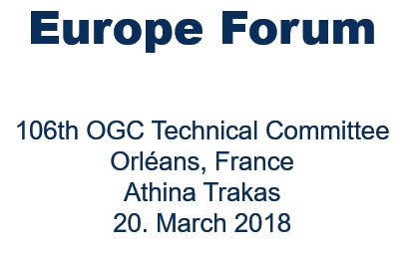
Example Activities – European Forum

Slide 6
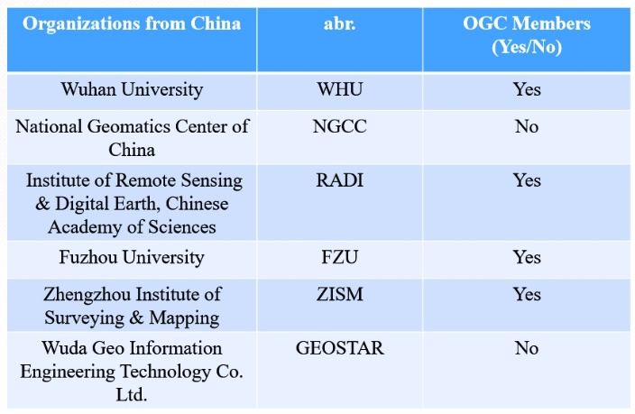
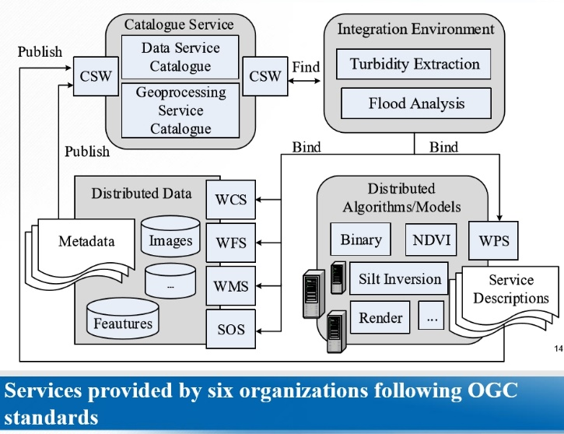
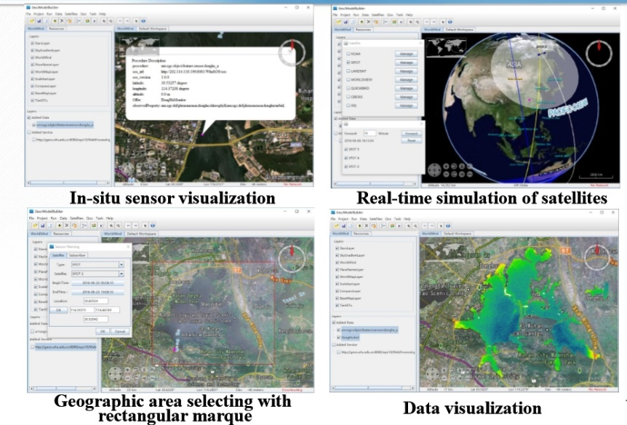
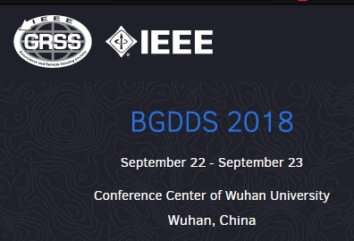
Example Activities – China Forum

Slide 7
Purpose
Collaboration and Consensus : Inclusive - All stakeholders - people, technologies, policies, governance, market development
Issues: Refine priority issues to guide innovation in Canada through collective action.
Awareness: Increase awareness of the benefits of using open geospatial standards and technologies for all sectors, especially new and emerging sectors and markets
Innovation : Define value chains in various thematic domains (e.g. Survey and Mapping, Environmental Monitoring, Agriculture, Maritime, Energy and Utilities) and explore means to better connect multiple communities of practice to reduce duplications, increase efficiency and improve the return on investment,
Capacity : Increase Canadian geomatics expertise and contribute to Canada’s future geospatial capacities and market presence , globally
Remote Communities: Empower remote Canadian communities through online collaborations.
Provide a sustainable platform to reduce fragmentation of Pan Canadian efforts!
:

Slide 8
Charter Members
AE Inc.
CAE
Computer Research Institute of Montreal (CRIM)
Compusult Ltd.
Cubewerx Inc.
Ecere Corp.
Environment and Climate Change Canada (ECCC)
Esri Canada Ltd.
Fisheries and Marine Institute (Memorial University of Newfoundland)
Mohawk Council Kahnawake
Mount Royal University
Natural Resources Canada (NRCan)
Internal Services Department - Geographic Information Services (Province of Nova Scotia)
NewfoundView
the PYXIS innovation
SensorUP
Silvacom
Teledyne CARIS
Tesera Systems Inc.
University of Calgary

Slide 9
Structure
Co-chairs and Sector Focus
Government/Indigenous
Cameron Wilson, NRCan, ON
Bradford Dean, Mohawk Council of Kahnawake, PQ
Commercial
Aurelian Constantinescu, CAE Inc, PQ
Andy Hoggarth, Teledyne – CARIS, NB
Research/Academic
Tom Landry, CRIM, PQ
Facilitator
Trevor Taylor, OGC, ON
Meets a minimum of Monthly ( First Wednesday of Every month)
Looking to expand the group to better represent regional requirements and the Academic Community

Slide 10
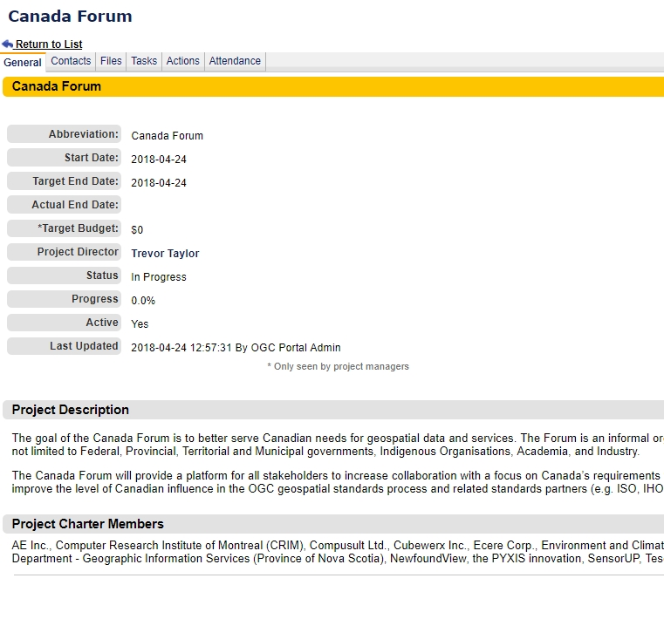
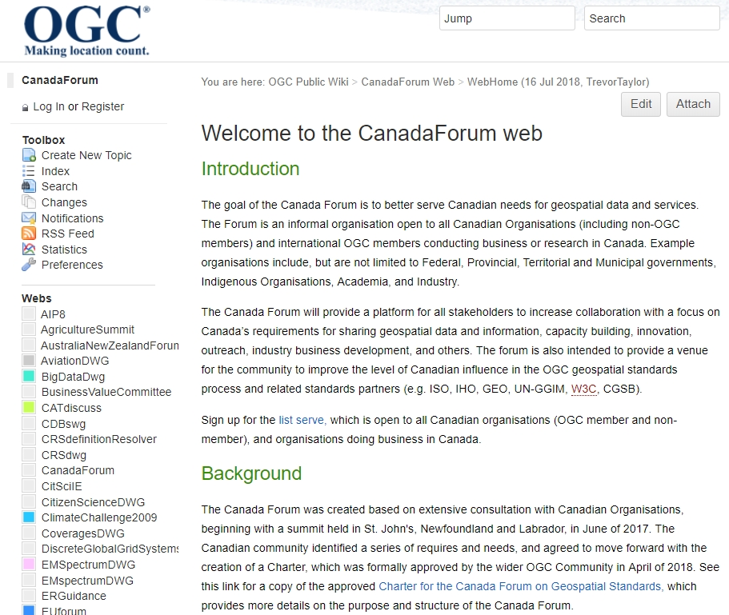
What OGC Resources are Available ?
Public Wiki
OGC Portal Project
Plus OGC Staff Support for Forum Activities

Slide 11
Launch
Formal Launch of the Forum
Indigenous Mapping Workshop, Montreal ( completed Aug 23rd)
CCOG /SDI Summit
GeoAlberta
Geomatics Atlantic
Réseau Québec maritime

Slide 12
Next Steps
Work Plan Development – Needs Your Input !
Looking to identify common issues, potential activities that cross cut sectors
Must Include Work Items Relevant to all Sectors
Intended to minimize the requirements for new resource application (e.g. include items all ready in member’s workplans)
Graphic Source https://sslinvest.com/2018/03/04/conditions-ideal-growth-market-2018/

Slide 13
Why is this important ?
Canadian SDIs are relatively mature (with variations) but are a work in progress due to;
evolving technology
changing demands from society
Web of data
Increase in data
A need to improve cross domain and community interoperability
Graphic Source; Geonovum white paper Geo standards, March, 2018

Slide 14
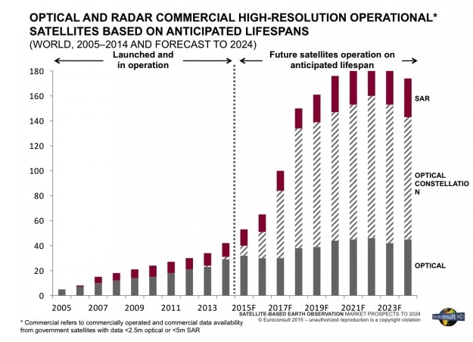
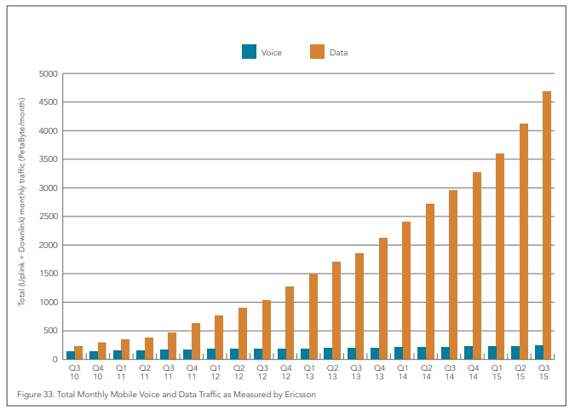
A Few Characteristics
The Rise of Mobile Data
Continuing increase Space based High Resolution Data

Slide 15
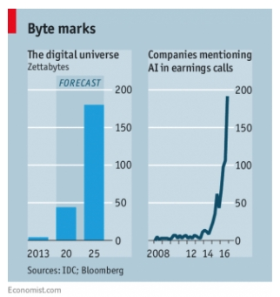
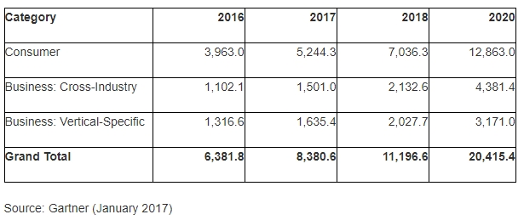
A Few Characteristics
IOT Predicated Install base in Billions- In Situ data is exploding!
Bigdata Data and AI

Slide 16
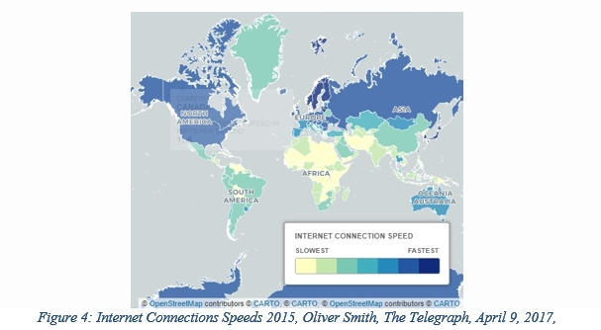
A Few Characteristics
Internet speeds , bandwidth and the Digital Divide
Unmanned and Remotely operating systems

Slide 17
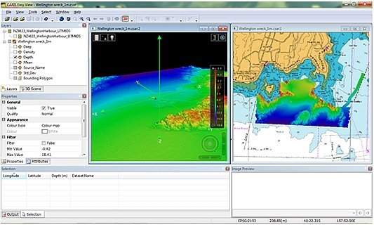
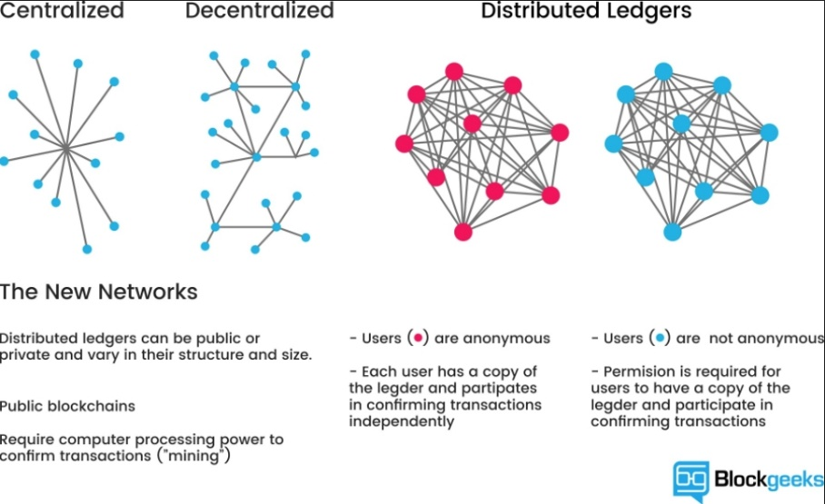
A Few Characteristics
Point Clouds/Cross Domain harmonisation
Distributed Ledgers and Location

Slide 18
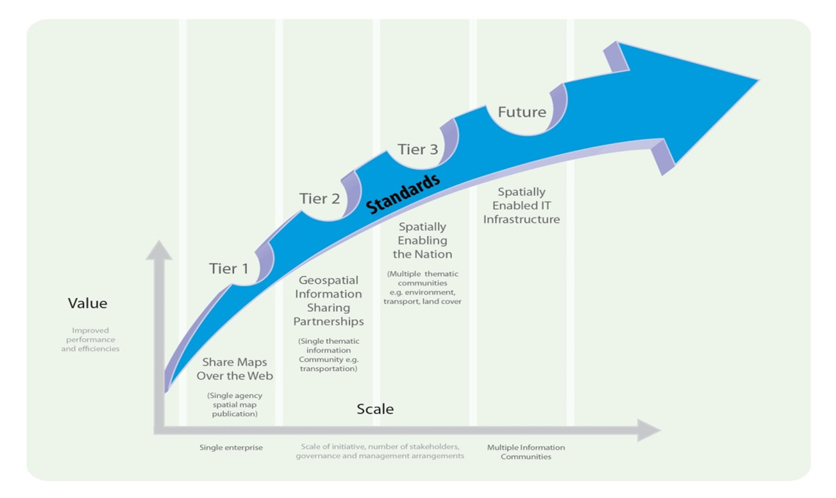
Increased Collaboration
Understanding what is next requires increased collaboration and innovation
UN-GGIM SDI Standardisation Maturity Model

Slide 19
In the context of evolving SDI…
My SDI is here
But we want to be here
As a Community,
how do we get “There”
UN-GGIM SDI Standardisation Maturity Model

Slide 20
….And all Things Open and Proprietary
users
metadata
standards
Open / Secure Data
web services
applications
Open Source
and
Proprietary
OGC, ISO,
others

Slide 21
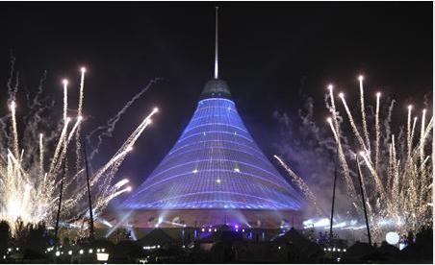
It’s a Big (and Expanding) Tent – Room for all!

Slide 22
Thank You
Trevor Taylor, Director, Member Services, Asia and the Americas, OGC, ttaylor@opengeospatial.org

