Slide 1
OGC Spatial Standards for Smart Cities to Urban Planning DWG
92nd OGC Technical Committee
Calgary Canada
George Percivall
15 September 2014

Slide 2
Smart Cities are rich in “where” information
As of 2008:
More than half of the world population lives in cities
Mobile access to the Internet exceeded fixed access
Devices connected to Internet exceeds people
Townsend, Smart Cities, 2013

Slide 3
Unifying Themes
Smart Cities are high-density generators of innovation and information
Location information is a major enabler of Smart Cities
Open standards are needed for interoperability
Spatial Architecture for Smart Cities valuable

Slide 4
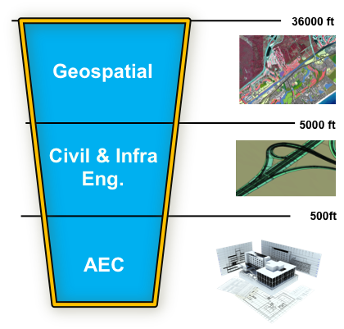
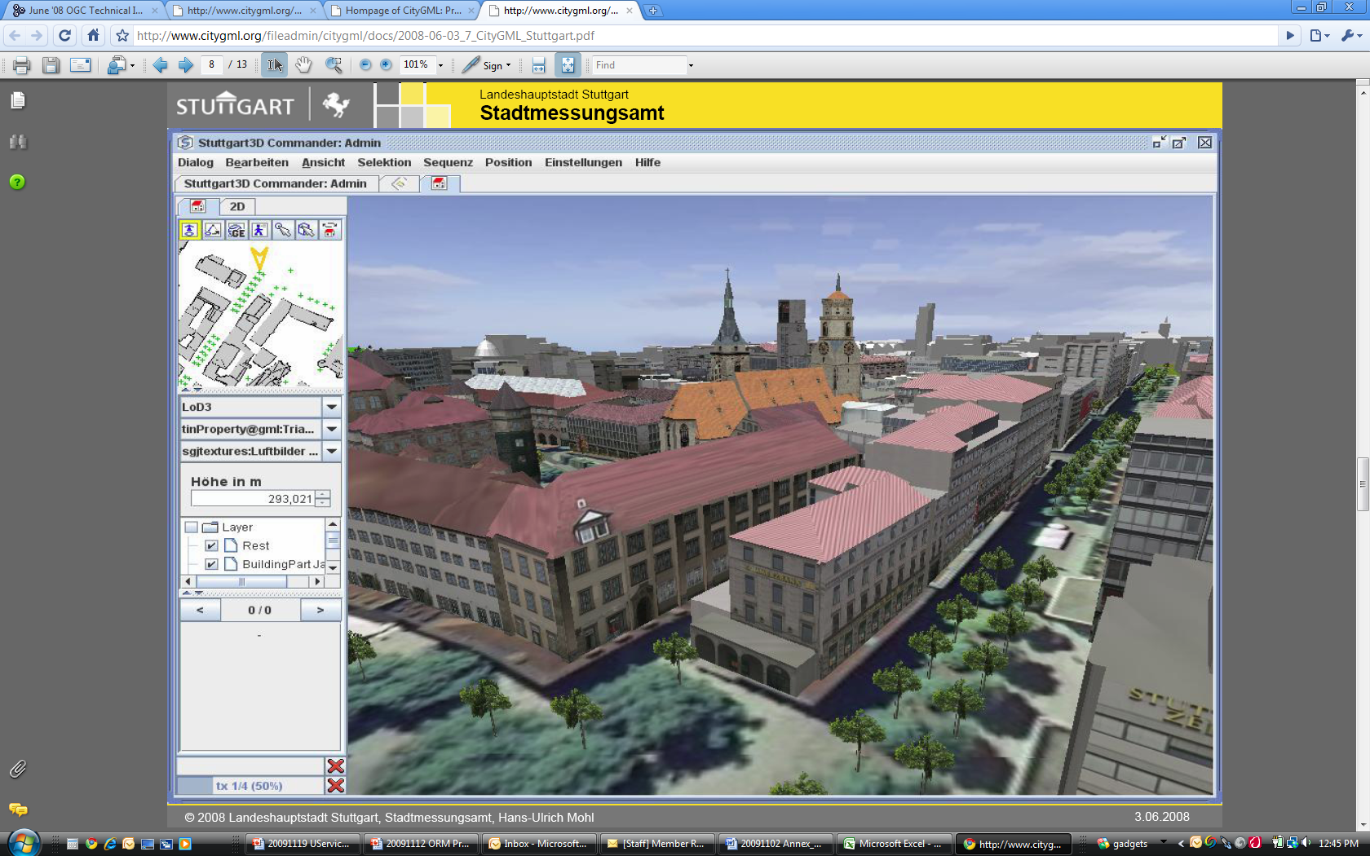
Location Services for Smart Cities
Citizen Services
Location-aware municipal services using open data and standards
Energy and Utilities management
Smart Energy
Smart Water Management
Disaster and Emergency Response
Common Operational Picture
Urban Maps
3D City Models
Indoor Venue Maps
Interoperability with BIM
Sensor Webs
Situational awareness from fusion of sensor observations
Source; Thomas Kolbe, Berlin TU

Slide 6
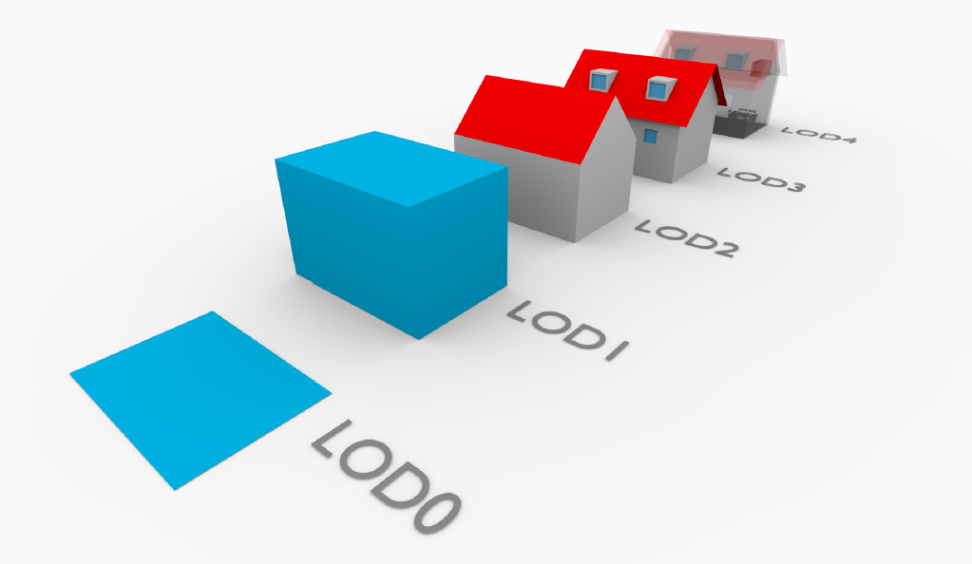
CityGML
Levels of Detail
Diagram:
Filip Biljecki,
TU Delft

Slide 7
CityGML: A data integration platform
Environm. Protection
Cadastre & Mapping
Architect. + Urban planning
Real Estate Management
City GML
Training simulators
Urban FM
Tourism
Navigation
Notes:
CityGML often seen as a format for 3D building/city data, but developed to integrate data. That’s what it really is.
CityGML developed for this purpose. This si really aligned with bringing data together in smart cities.

Slide 8
Integrated Outdoor / Indoor Information
OGC IndoorGML
© 2014 Open Geospatial Consortium

Slide 9
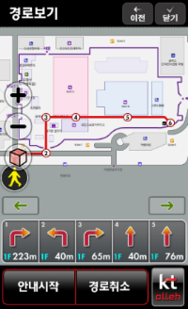
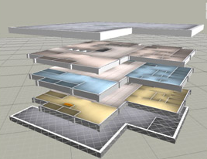
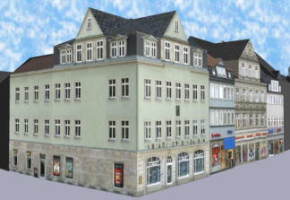
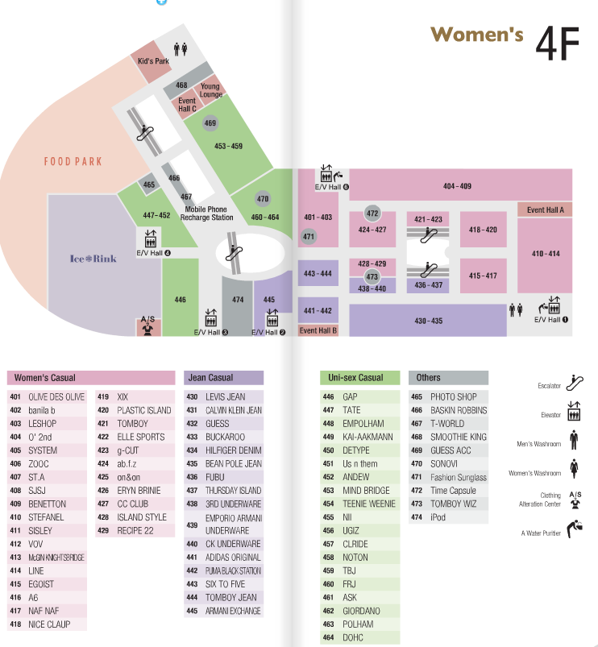
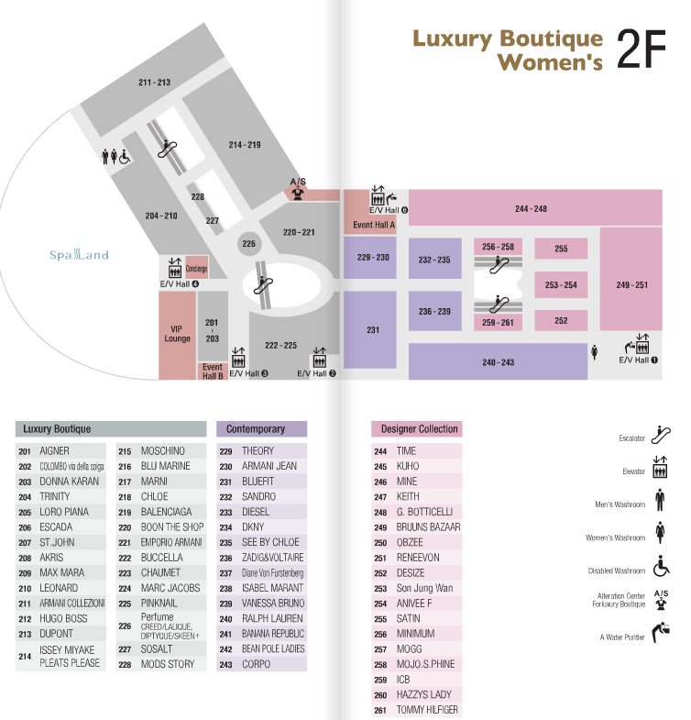
IndoorGML - from structured data to applications
IndoorGML
Cruise Ship
- Cellular Space Model
- Indoor Network
- Multi-Layered Space Model
Hospital
Indoor LBS
Services for handicapped persons
IFC
KML
Application
Emergency Control
CityGML
2D Indoor Floor Plan
Indoor Robot
Indoor mCommerce

Slide 10
Emergence of the Internet of Things
Temperature: 29 C
Humidity: 29%
Windspeed: 11 km/h
CO: 0.23 ppm
NO: 0.22 ppm
Temperature: 29 C
Humidity: 29%
Windspeed: 11 km/h
CO: 0.23 ppm
NO: 0.22 ppm
Temperature: 29 C
Humidity: 29%
Windspeed: 11 km/h
CO: 0.23 ppm
NO: 0.22 ppm
Temperature: 29 C
Humidity: 29%
Windspeed: 11 km/h
CO: 0.23 ppm
NO: 0.22 ppm
Temperature: 29 C
Humidity: 29%
Windspeed: 11 km/h
CO: 0.23 ppm
NO: 0.22 ppm
Temperature: 29 C
Humidity: 29%
Windspeed: 11 km/h
CO: 0.23 ppm
NO: 0.22 ppm
Temperature: 29 C
Humidity: 29%
Windspeed: 11 km/h
CO: 0.23 ppm
NO: 0.22 ppm
Temperature: 29 C
Humidity: 29%
Windspeed: 11 km/h
CO: 0.23 ppm
NO: 0.22 ppm
Temperature: 29 C
Humidity: 29%
Windspeed: 11 km/h
CO: 0.23 ppm
NO: 0.22 ppm
Temperature: 29 C
Humidity: 29%
Windspeed: 11 km/h
CO: 0.23 ppm
NO: 0.22 ppm
Temperature: 29 C
Humidity: 29%
Windspeed: 11 km/h
CO: 0.23 ppm
NO: 0.22 ppm
Temperature: 29 C
Humidity: 29%
Windspeed: 11 km/h
CO: 0.23 ppm
NO: 0.22 ppm
Graphic from Dr. Steve Liang
Associate Professor / AITF-Microsoft Industry Chair OGC SensorThings SWG Chair

Slide 12
OGC SensorThings API
Based on OGC Sensor Web Enablement
Efficient REST-like API and JSON encoding
Support standard-based location encodings
indoor/outdoor, mobile/stationary
Linked Data ready (JSON-LD)
Pub-Sub ready (MQTT)

Slide 13
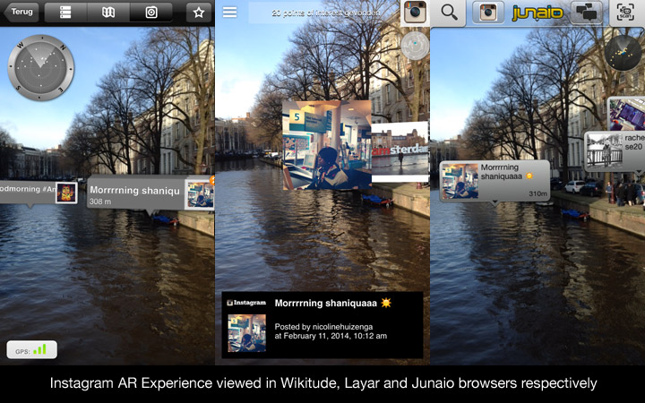
First multi-vendor Augmented Reality Open Interoperability Demonstration
+
=
>50 Million users
+
AR content encoded in OGC ARML 2.0 draft standard
Organized by AR Standards
Community
Demonstrated at Mobile World Congress 2014
http://www.opengeospatial.org/pressroom/pressreleases/1967
http://www.wired.com/beyond_the_beyond/2014/02/augmented-reality-interoperability-demo/

Slide 14
National/regional geospatial standards profile
Smart service 1
Smart service 2
Domain specific model 1
Domain specific model 2
Future extension
Specifications (►QIE)
National/City Data Model
ISO/BSI
OGC
INSPIRE
IHO/ICAO/WMO/....
ISO 19152 - LADM
Network Model
CityGML
S-57/ S-100
Buildings
ISO 19156 – O&M
SWE Common
AIXM 5.1
Addresses
PAS Smart Cities
GML Coverages
BIM
........
ISO 19103
ISO 19107
ISO 19108
ISO 19111
ISO 19115
ISO 19123
ISO 19136/19139
XML

Slide 15
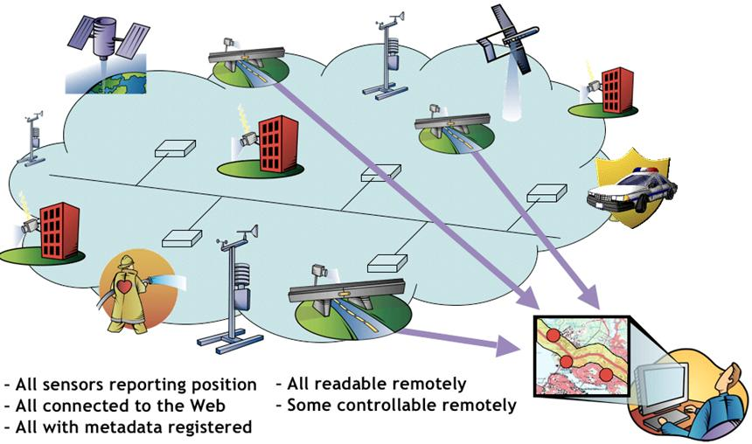
Spatial Architecture for Smart Cities
Integration of Geo-information, Sensor Webs, Built Environment using open standards
Interoperability of independent software implementations in an open framework
Market opportunities through innovations in open standards
Vendor-neutral best practice reusable in any Smart City
OGC Sensor Web Enablement
Contact: George Percivall (gpercivall@opengeospatial.org)
CityGML graphic source; Thomas Kolbe, Berlin TU

Slide 16
Smart Cities are More Engaged Cities
Command and control is a common theme in smart cities
Control of devices is a technological question, control of societies is political
A Smart City is one that makes better choices
“Bringing Jane Jacobs into the 21st Century” Alexandros Washburn in Dawn of the New City
Escalators in São Paulo, courtesy of Flickr user Leo Eloy in
Dawn of the Smart City, Wilson Center, 2014

Slide 17
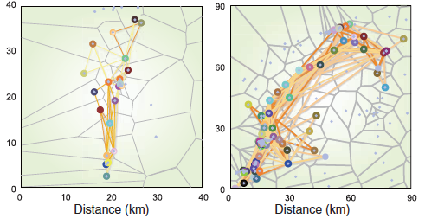
Is human mobility tracking a good idea?
Tracking is effective:
“93% predictability in user mobility”
Limits of Predictability in Human Mobility” C. Song et al. Science 327, 1018 (2010);
Balance of Issues
Immense social and monetary value in this technology
Potential for government malfeasance and corporate abuse
“Is human mobility tracking a good idea?”,
Daniel Soper, Communications of the ACM,
V.55 Issue 4, April 2012
Notes:
"On the one hand, concerned citizens and privacy advocates recognize the immense potential for government malfeasance and corporate abuse of this technology…
....On the other hand, many scientists, corporations, and individual consumers see immense social and monetary value in this technology.
- “Is human mobility tracking a good idea?”, Daniel Soper, Communications of the ACM, V.55 Issue 4, April 2012

Slide 18
Technologies can make cities smarter
ECONOMIC:
Better spatial organization through new forms of production
CIVIC:
Better spatial organization through better participation tools:
POLITICAL:
Better spatial organization with better governance/leadership tools
THEORETICAL:
New boundaries for a new ‘polis’
São Paulo: The Search for a Spatially Smarter City
^{Phillip Yang, President URBEM}

Slide 19
How to get involved in OGC Smart Cities
Location Powers: Smart Cities Summit
Tokyo, December 2014
With OGC Meetings
OGC Testbed 11
Urban Resilience and Climate Resilience themes
Call for Participation October 2014
Kickoff January 2015
OGC Smart City Pilot
Reusable framework for cities
Deployed in multiple cities in 2015

Slide 20
TB11: Urban Resilience for Smart Cities
Monitoring and response to impacts on Infrastructure – IoT Sensors
Real-time video monitoring from Geocoded CCTVs
Social media for public safety information collection, analysis, response
Security on the networks (sensors and infrastructure)
Use of
Open GeoSMS
GeoPackage
Publish and subscribe

Slide 21
OGC Liaisons for Smart City Standards
NIST Global City Teams Challenge
European Innovation Partnership (EIP) on Smart Cities and Communities
Smart Cities Council
Int'l Society of City and Regional Planners - ISOCARP

Slide 22
Location Powers
A new summit series by OGC tackling the global issues and innovations in sharing and accessing location information
Join us for our first summit on
Smart Cities
Tuesday 2nd December 2014
Tokyo, Japan
Registrations of interest for presenting, panellist or attendance please contact
dmckenzie@opengeospatial.org
Notes:
The first in a new summit series being offered by OGC. The Location Powers Summits are about tackling the major issues and innovations in the location technology world and looking at how we collaborate to realise the full potential of using location information. This first summit will be held as part of the final OGC Technical Committee meetings in Tokyo and will focus on the location information technology standards needed to help build and realise a ‘Smart City’. To register interest in attending or participating as a presentor or panellist please contact OGC’s head of Communications Denise McKenzie at dmckenzie@opengeospatial.org. Further details of the summit and will be announced in the next month.

