Slide 1
WMS 1.3 Ensemble Layers
AFWA uses WMS to visualize value added products derived from statistical analysis of all ensemble members from either
Global Ensemble Prediction Suite
Mesoscale Ensemble Prediction Suite
AFWA’s current approach relies upon:
Layer Name
Layer Title
Temporal dimensions “Run” and “Forecast” (plan to change to comply with OGC Best Practice for using Web Map Services (WMS) with Time-Dependent or Elevation-Dependent Data approach using “Time” and “Reference_Time”)
Styles to choose among predetermined threshold values (e.g. probability of windspeed exceeding 25 knots vs 35 knots)
LegendURL for optional display of graphic legend
GetFeatureInfo to interrogate values at individual map points

Slide 2
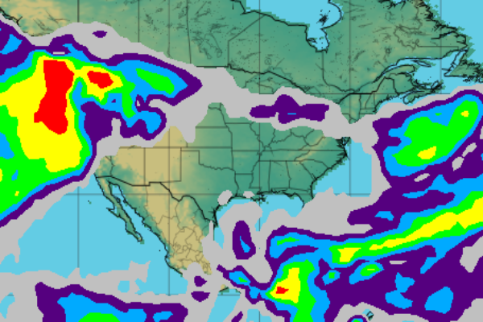
AFW-WEBS Sample
WMS GetMap call to get map layer:
https://weather.af.mil/services/WMS?SERVICE=WMS&VERSION=1.3.0&REQUEST=GetMap&WIDTH=600&HEIGHT=400&CRS=CRS:84&DIM_FORECAST=PT48H&DIM_RUN=2015-02-06T00:00:00Z&FORMAT=image/png&LAYERS=OROGRAPHY,BOUNDARIES,ENS_GLOBAL_Prob_Precip_by_Type&BBOX=-133,11,-53,59&TRANSPARENT=TRUE&STYLE=default
WMS GetLegendGraphic call to get legend:
https://weather.af.mil/services/WMS?SERVICE=WMS&VERSION=1.3.0&REQUEST=GetLegendGraphic&LAYER=ENS_GLOBAL_Prob_Precip_by_Type&STYLE=default&FORMAT=image/png;%20mode=8bit&CRS=CRS:84
Notes:
5

Slide 3
Pros and Cons
Pros
WMS 1.3 compliant
Minimal use of extended dimensions
Simple
Cons
Heavy dependency on layer names and titles assumes users understand the terms used
Little use of abstracts, keywords, or dimensions to allow for better search and discovery in GetCapabilities document
Lack of controlled vocabulary; inconsistency hampers discovery
Overloading of “style” between visualization approach and data content/meaning

