Slide 1
Interoperable Mapping of
Health Information during pandemic and inter-pandemic periods
Eddie Oldfield – March 20th, 2012
Presentation at the OGC TC, to the OGC ESSDWG
Appointed Member, Resilient Communities Working Group
National Platform for Disaster Risk Reduction (Canada)
Director www.nbhub.org at www.nb.lung.ca
Senior Advisor www.questcanada.org
Tel: 506-453-0887, Email eoldfield@questcanada.org

Slide 2
Lung Disease
General Statistics
6 million Canadians with lung disease
$15b annual cost to Canadians
3 million cope with Asthma (especially children)
Lung cancer in women has tripled since 1977
First Nations, Inuit and Metis people disproportionately affected
Poor air quality affects the health of all Canadians
- leading cause of emergency room visits, hospitalization and death
Migrating populations and foreign hot-spots are not considered in the analysis of threats to respiratory health (e.g. Tuberculosis)
Notes:
General Statistics
6 million Canadians with Lung Disease
$15B Annual Cost to Canadians
3 million cope with Asthma (especially children)
Lung Cancer in women has tripled since 1977
First Nations, Inuit and Metis people disproportionately affected
Poor Air Quality Affects the Health of Canadians and is a
leading cause of emergency room visits, hospitalization and death
Migrating populations and Foreign Hot-Spots are not considered
in the analysis of threats to respiratory health (e.g. Tuberculosis)

Slide 3
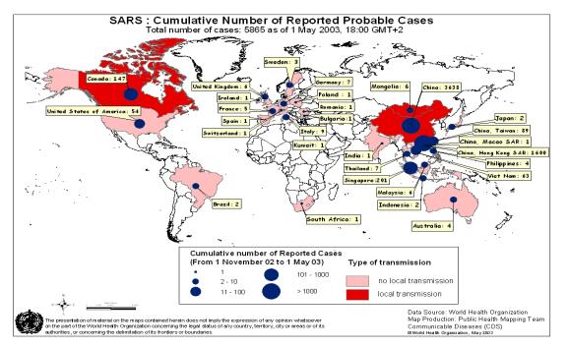
SARS - Lessons Learned
The National Advisory Committee on SARS and Public Health identified many systemic deficiencies in responding to SARS in Canada. Among these were:
  absence of protocols for sharing information,
  poor coordination among health authorities at national, provincial, local levels,
  delays in identification of unknown virus,
  poor understanding of disease etiology and transmission vectors.

Slide 4


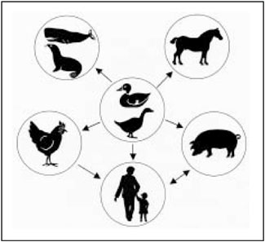
Spatial Disease Epidemiology
Baseline Influenza vs Pandemic Indicators (influenza sub-types)
Transmissibility / Vectors / Spread
Prevalence / Progression / Morbidity
Vulnerable Populations
Access to Health Care
Vaccine Distribution
Capacity / Demand Surge
Affected Health Care Workers
Social Impacts / Critical Infrastructure
electron microscope image of the Avian Flu Virus
From Micro
To Macro
1918
Notes:
For those of you familiar with Florence Nightingale

Slide 5
Public Health Policy and Decision Making
Research
Provincial
Policy
Public awareness
Prevention
(Legislation, Behaviour Change, Exposure Reduction, Risk Communication)
Health care
(Detection/Diagnosis Primary care, Community Support, Emergency Preparedness)
Regional
Partnerships
Health outcomes
National &
International
Surveillance, Monitoring
Determinants of Health

Slide 6

Maps Can Help Us Make the Links
Heat Stress
Air Quality
Syndromic Surveillance
Hospitalization Costs
Public Health Resources
Health Indicators
Notes:
Maps can help us Make the Links
Determinants of Health: Social, economic, environmental exposures, demography, geography/location
Respiratory Health: Morbidity and mortality trends
Heat Stress: Heat stress resulting from change in average temperatures / weather
Air Quality: Local, regional, and transboundary; smog advisories, early warning and public health response systems
Population: Demographic shifts, ageing population, and social mobility
Health Care: unequal access barriers – economic, social, cultural, regional, rural
6

Slide 7
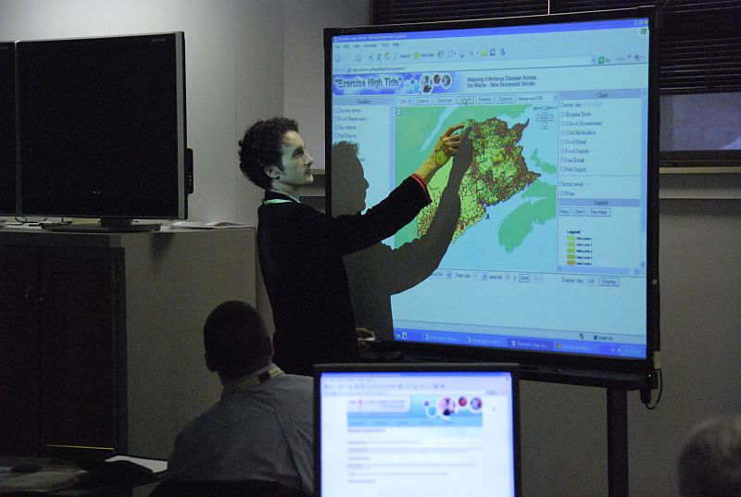
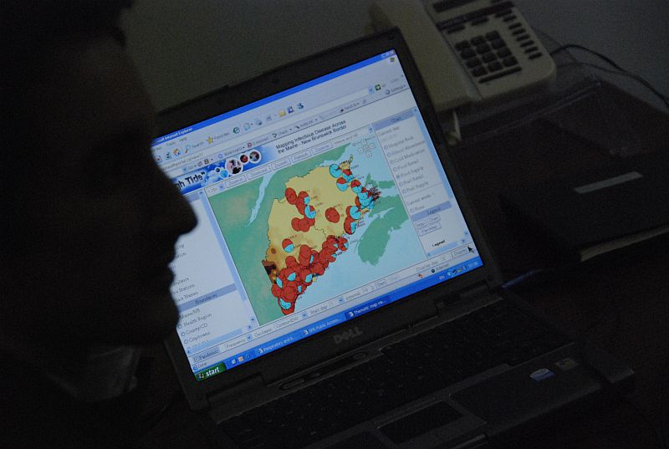
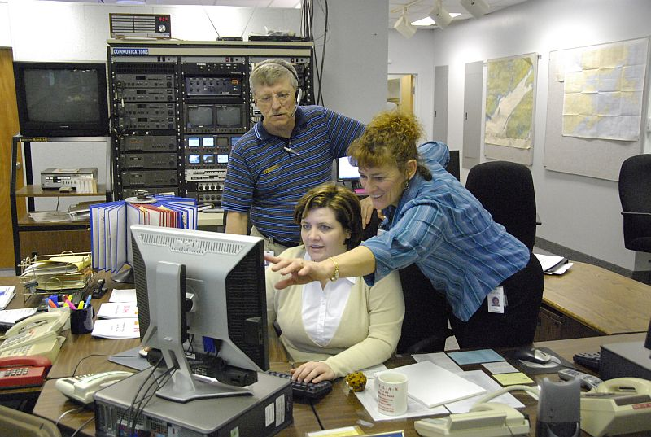

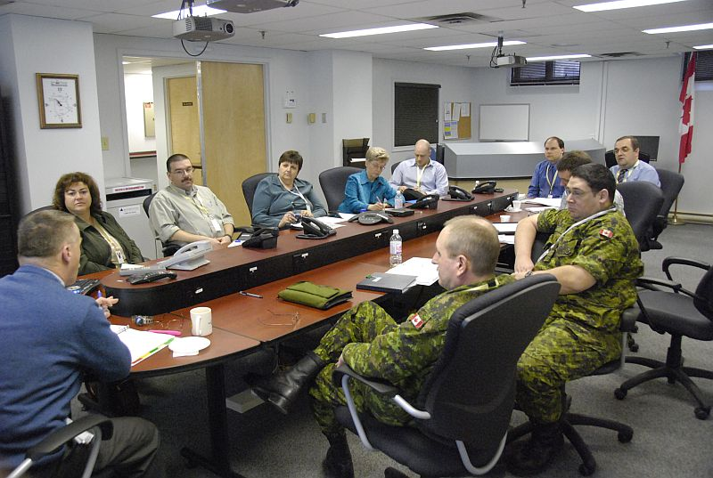

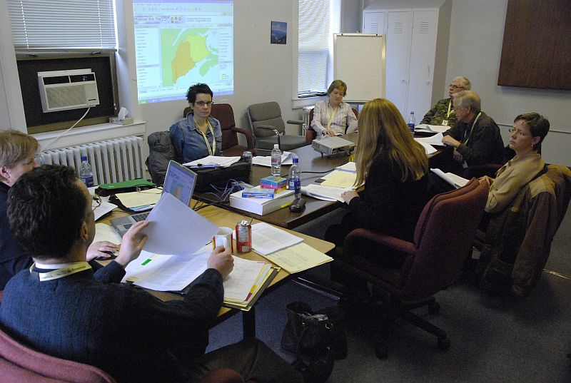
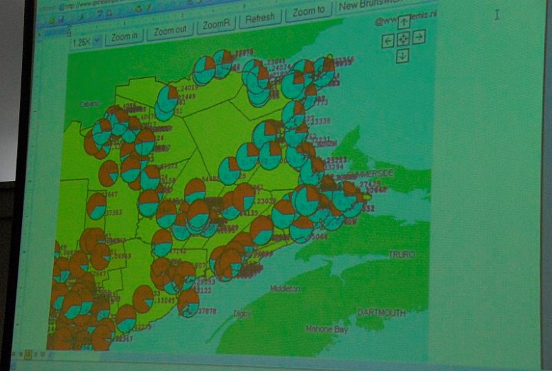
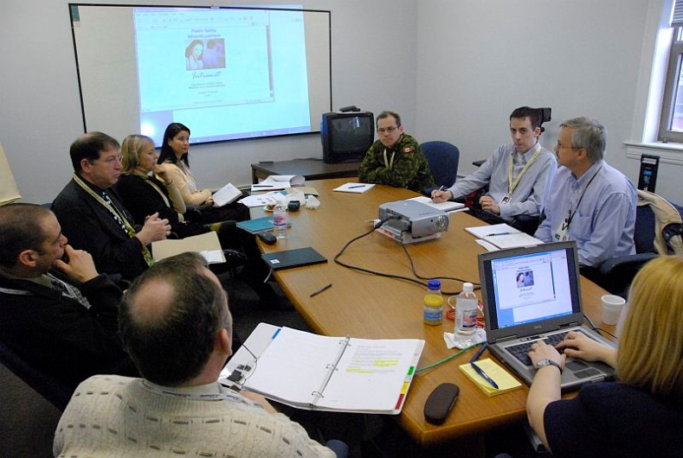
What health data will be available?
What health indicators will be available?
What specific end-products will result?
How will this benefit decision-making?

Slide 8

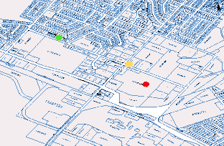
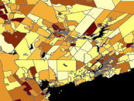
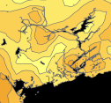
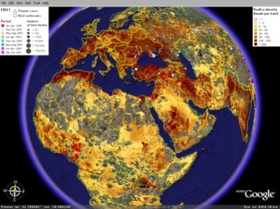
Data Integration
From Data to Maps
Data Licenses
Data Privacy
Data Models
Data Trends
Data Access
Notes:
Data Licenses
Obtained (zipcode / 6-digit postal code – stripped of all other personal identifiers)
Data privacy
Data privacy is maintained at all times (I.e. never redistributed – only used in the creation of maps with statistical values and thematic masking)
Data Models
Data can be modeled at Multiple Geographic Scales: Dissemination Area, Census Area, County, Health Region, Province / State
Data Trends
Trends / Values – represented in color classification, charts and graphs.
Permission Access
Application is Permission Based (at point of entry, for map views, for attribute data retrieval, for queries, and for scale of visualization)
8

Slide 9
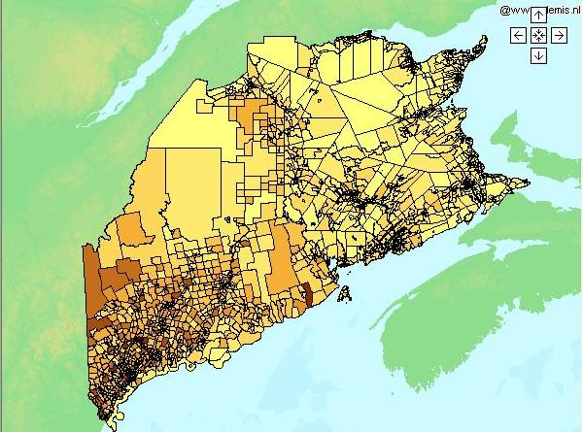
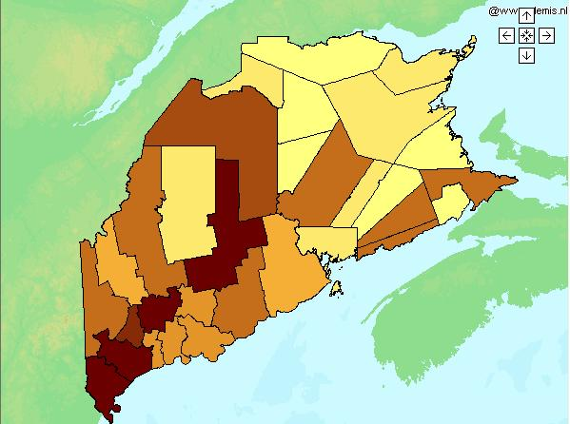
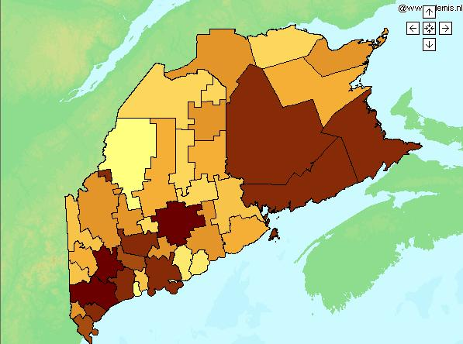
Mapping Methods
Hierarchy in Web Feature Service
Cell distribution
  Frequency, cumulative, Normative distribution methods
  Four geolayers: Province, Health Region, County, Dissemination Area
Notes:
The following sequence illustrates the Cell distribution for frequency values, Gaussian and Poisson distribution methods. Note the under-representation of cell values for the frequency method, and the over-representation of cell values for the Poisson method.

Slide 10
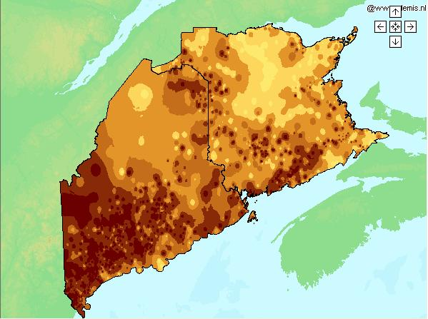
Mapping Methods
Mapping Methods
Hierarchy in Web Feature Service
Contour distribution
  Inverse Distance Weighting method
  One geolayer: Province/State; with 4 boundary overlays (Health Region, County, Metropolitan, and DAUID levels)

Slide 11
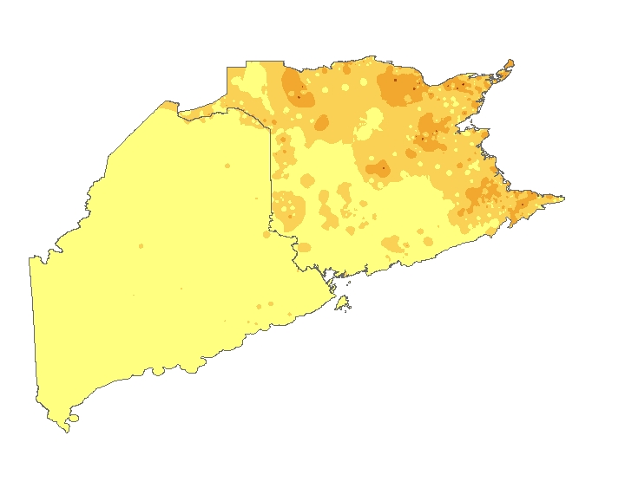
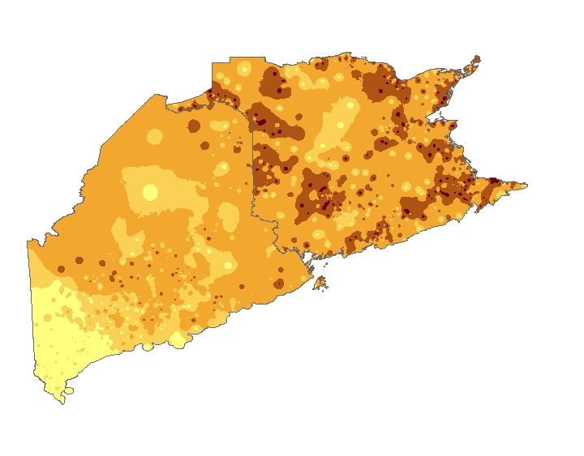
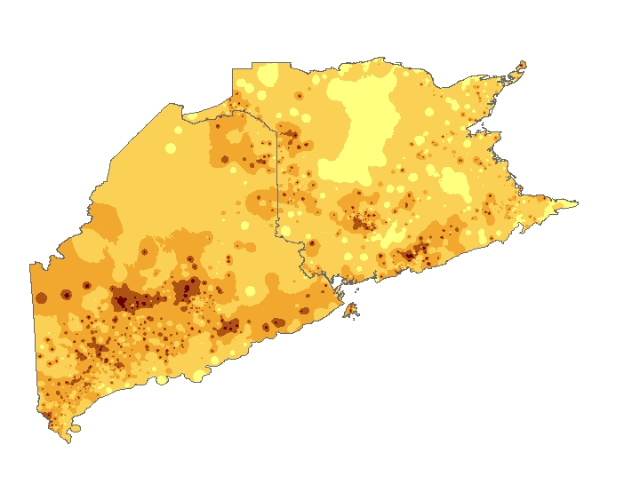
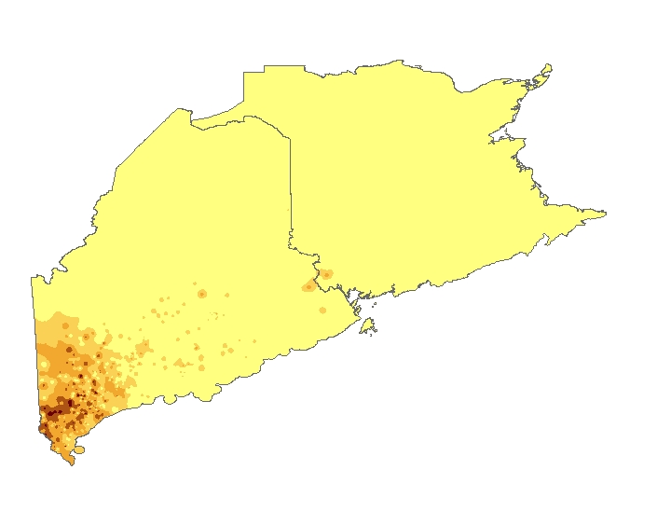
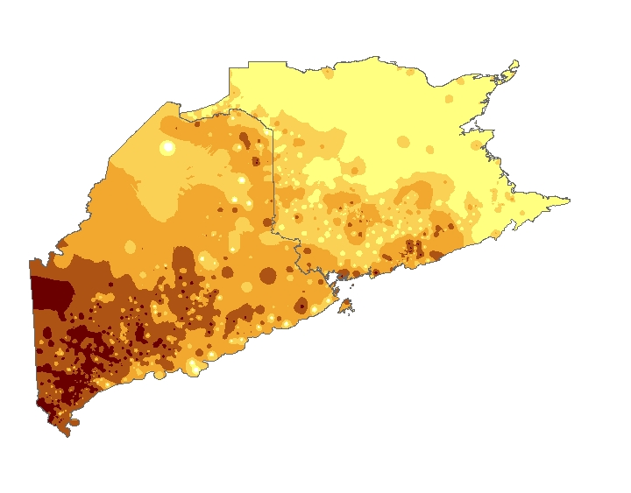
Time series automation with time-tag in WMS

Slide 12
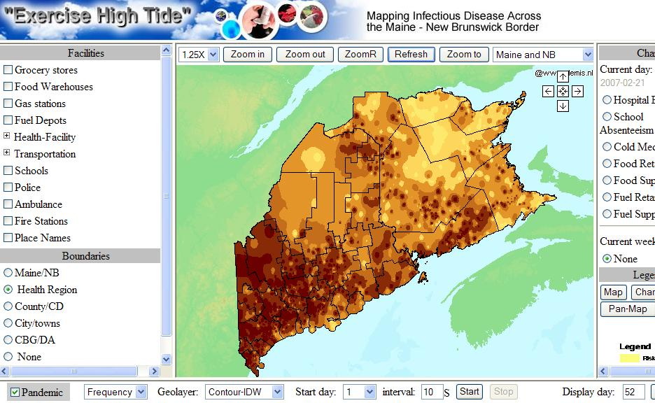
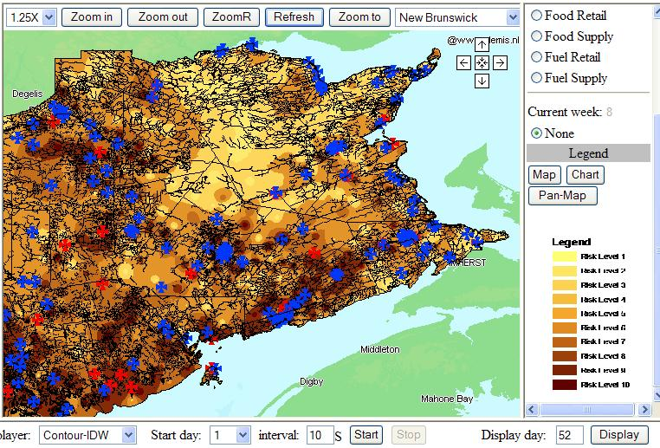
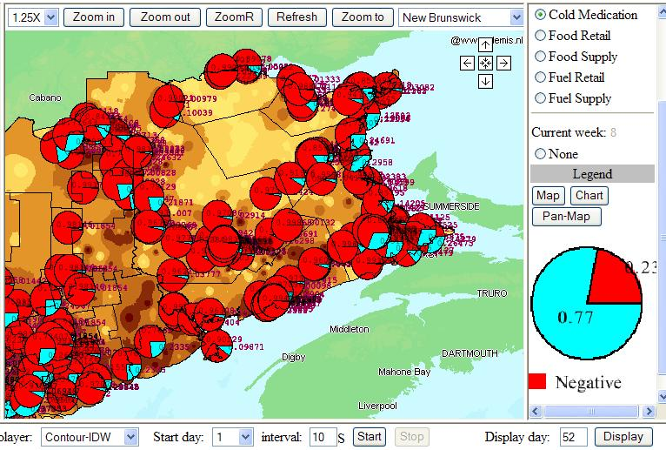
Quick Web Map Viewer (to consume WMS, WFS, WPS)
Operations Center / Remote Participants
Time series automation with time-tag in WMS

Slide 13
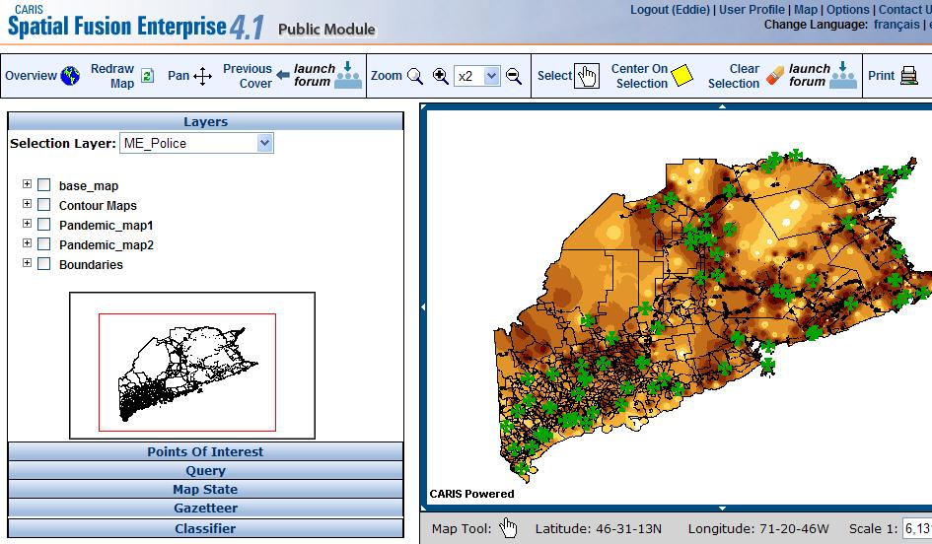
CARIS Spatial Fusion Enterprise

Slide 14
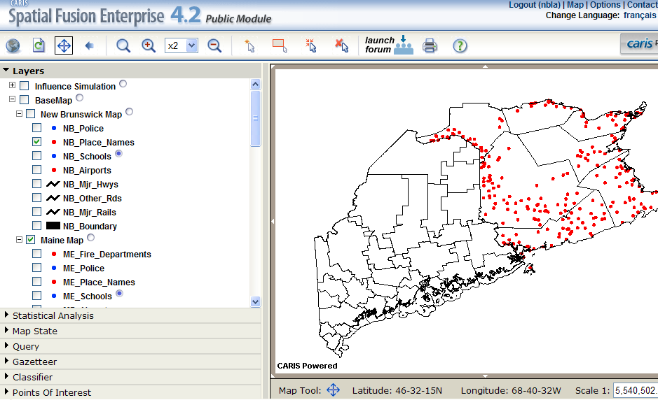
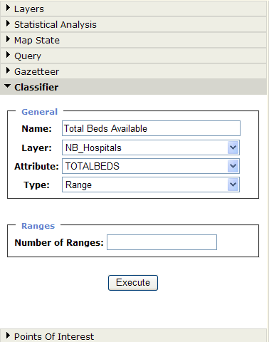
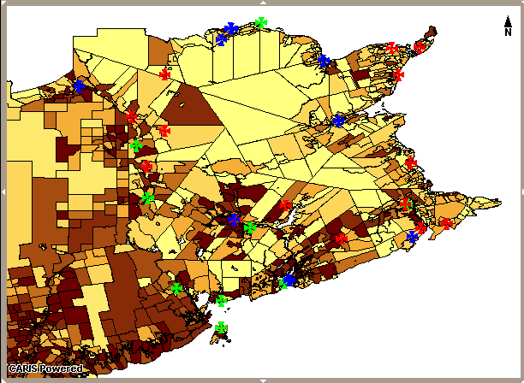
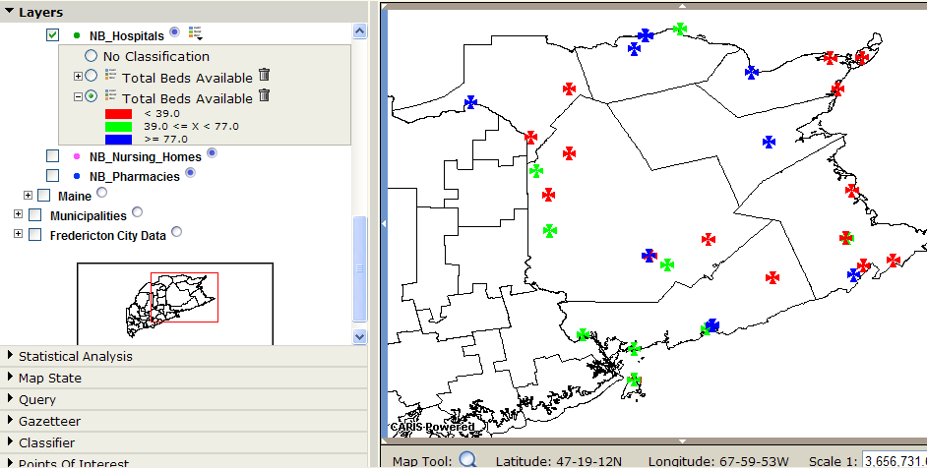
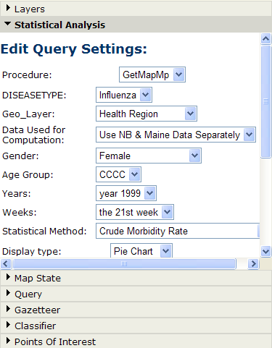
NBLA Web Mapping Portal
OGC compliant web-mapping application provides access to credible, closest to source, health, population, and environmental indicators in support of decision-making

Slide 15
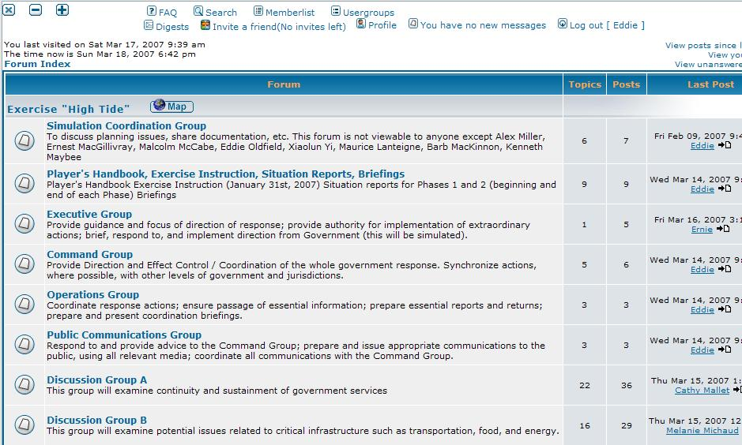
Collaboration Forum

Slide 16
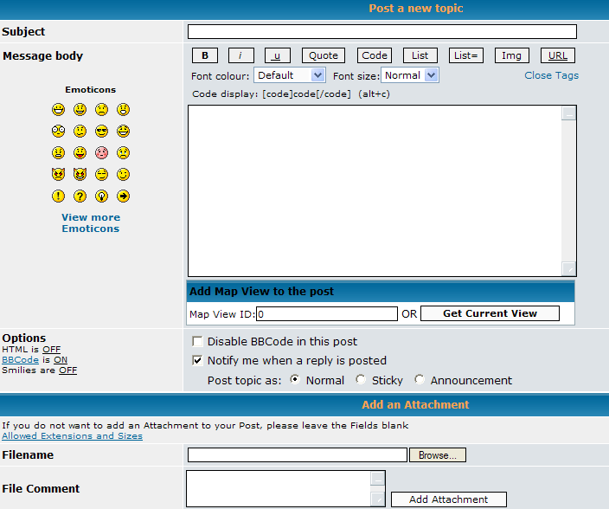
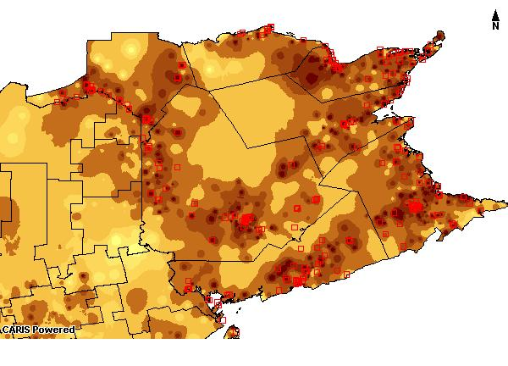

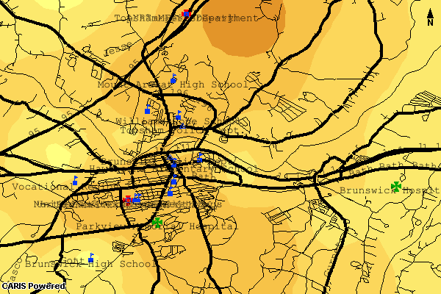
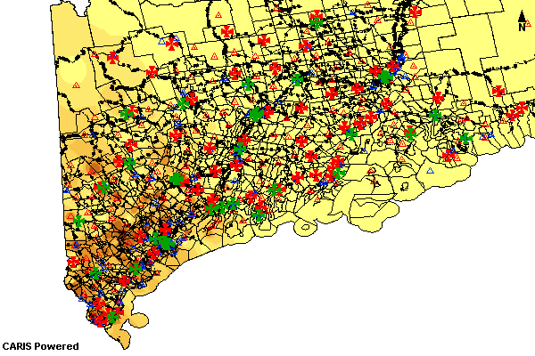
Share Map Views / POIs
Real Time collaboration…

Slide 17
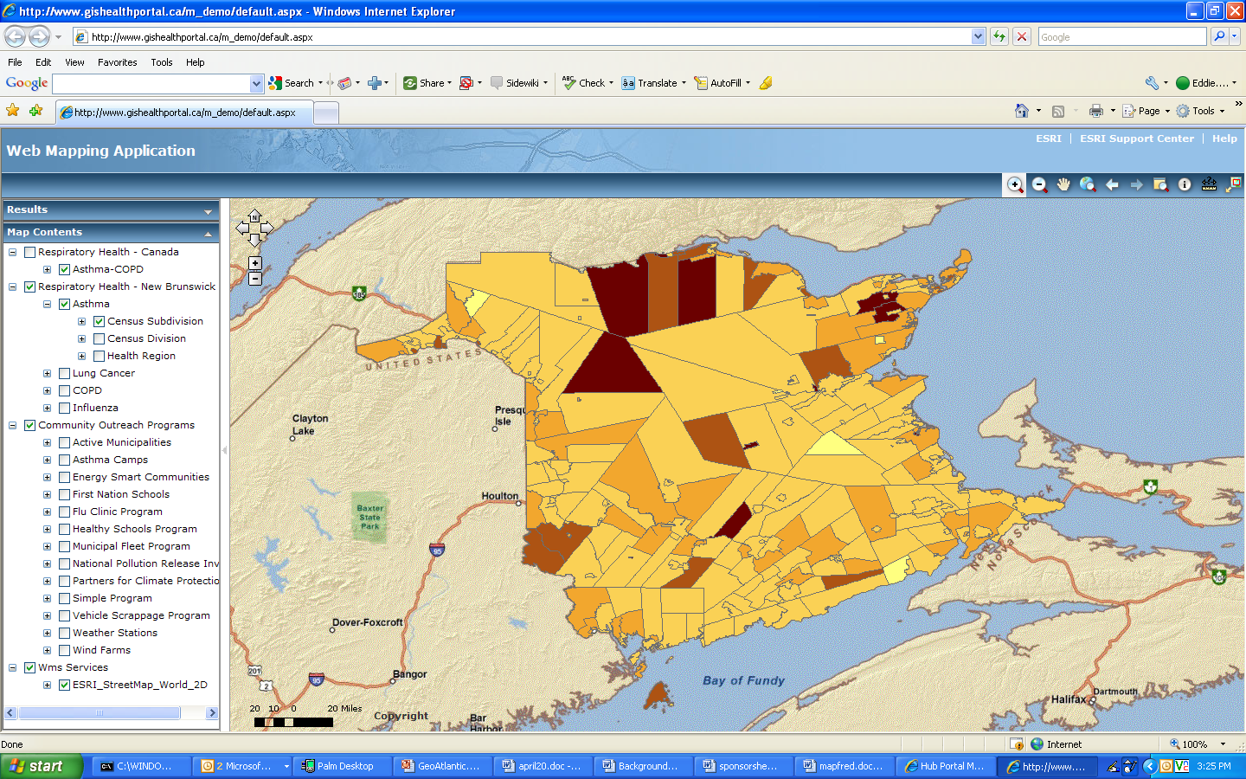
ArcGIS Server .net
These Sample Maps Are Health Maps from Previous Geospatial Projects (2003-2008)

Slide 18
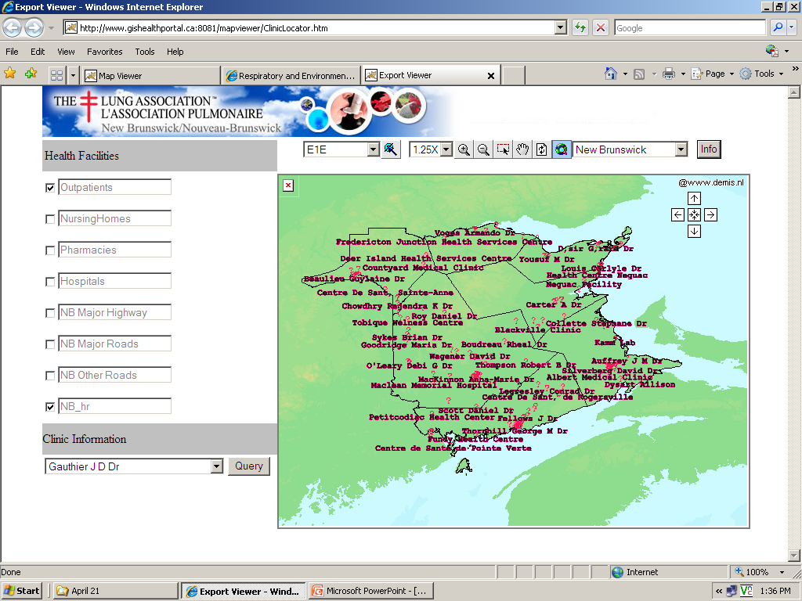
Flu Clinic Locator
NB Lung’s Flu Clinic Locator enables a public user to search for the nearest flu clinic in their Forward Sortation Area (first three alphanumeric characters in the 6-digit postal code).

Slide 19
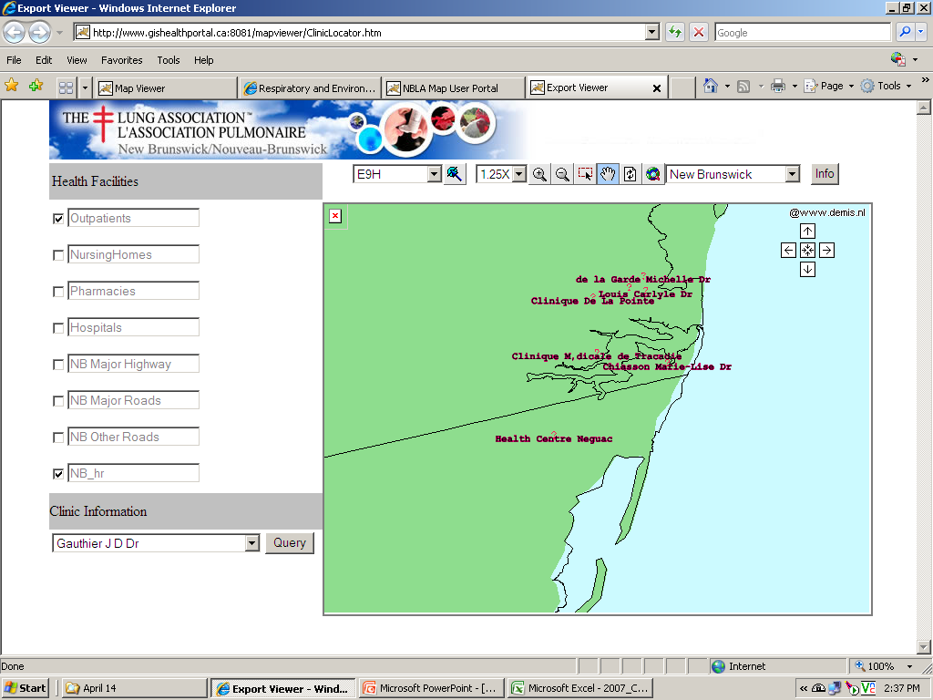
Flu Clinic Locator
The map will refresh on the FSA location chosen, with points indicating the location of nearby clinics.

Slide 20
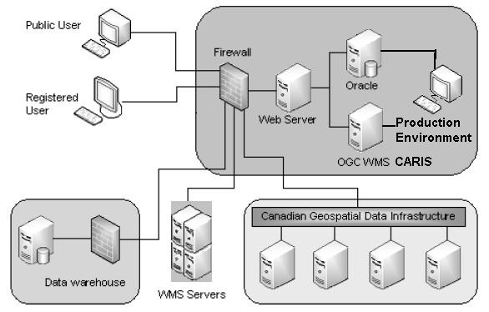
Development Process
User Needs Identification
Cross-Border Data Assessment – Dictionary
Database Design: Relational, Hierarchical, Temporal (triggers / procedures)
Statistical Design: Historical Prevalence of Influenza; Pandemic Simulation; other surveillance data
WMS, WFS, WPS Design Specifications
Client Interface Design
Development + Implementation
Pandemic Exercise (using distributed WMS, WFS, WPS; to produce maps for mobile, easy and advanced map viewers on the web)
Evaluation
Key innovations:
Health Web Mapping Architecture (Ontology, Spatial and Temporal data driven);
HXML (for Health data mapping, data exchange);
PPGIS in health planning and emergency management;
Web & Mobile viewers (ability to invoke OWS, submit location based environmental or health data, retrieve maps and feature data), export results, etc.

Slide 21
CGDI and OWS Implementation
We consumed services in the CGDI:
Web Map Services
Gazetteer / Coverage Services
Lookup services for Postal Code, Watershed, NTS Mapsheet
Spatial Reference System Dictionaries
CGDI Resource Registry Service
Event Notification Services
(Styled Layer Descriptor)

Slide 22
We Implemented OWS architecture for Health Mapping:
WMS (with time tag), WFS (hierarchical model), WPS (web process services), SLD…
Health XML (HXML) data model schema, enabling any health authority to publish into Web Map Services or National Atlas
Health Mapping relational data schema, Hierarchical schema (for Maine, New Brunswick, all of Canada), Statistical DB automation and visualization for health or environmental data
Application integration and mashup (consumed OWS, tools/features, availability through browsers, web and mobile)
Custom map viewer and features which enabled users to submit query parameters for WPS – interact with the map – find and classify data – add points of interest, and export results.
Custom map viewer for wrapping processes in dynamic interface that could be deployed on any website or desktop
Publication of maps and features in CARIS Spatial Fusion and ESRI ArcGIS Server (FLEX and .net)
Custom map viewer (Quick Map) for pandemic exercise
Collaboration Forum including web map exchange (permissions based)
Pandemic simulation (moderate style, 550,000 records, 12 weeks)
1,600 map layers published in CGDI
Configuration and Administration modules, to publish or consume WMS/WFS, manage user/content permissions
Use authentication handled in the application (though we envisioned DRM at service level), and services provisioned behind firewall, to high-speed fiber network

Slide 23
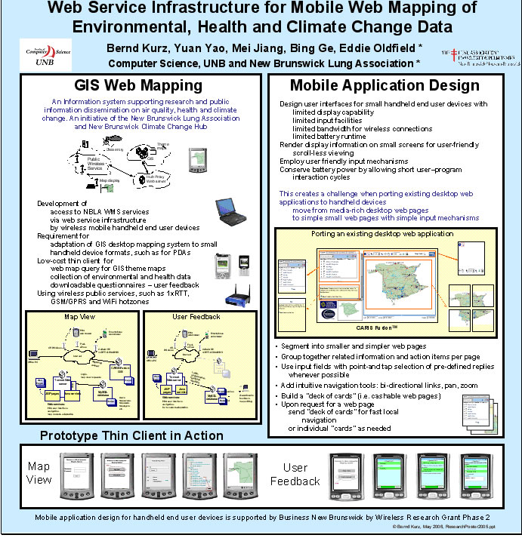
View Environmental Health Information
Add
Environmental Health Information

Slide 24
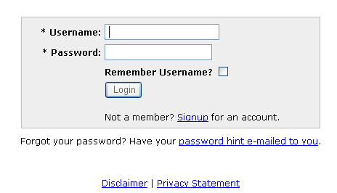
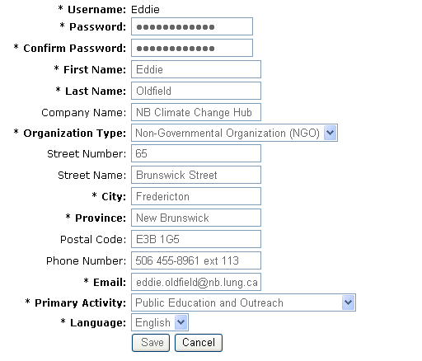
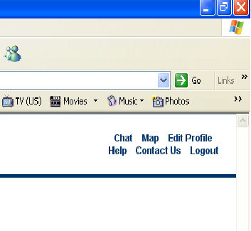
Introducing Your Profile
New User Registration
Edit your profile
Map Views are
assigned to your Profile

Slide 25
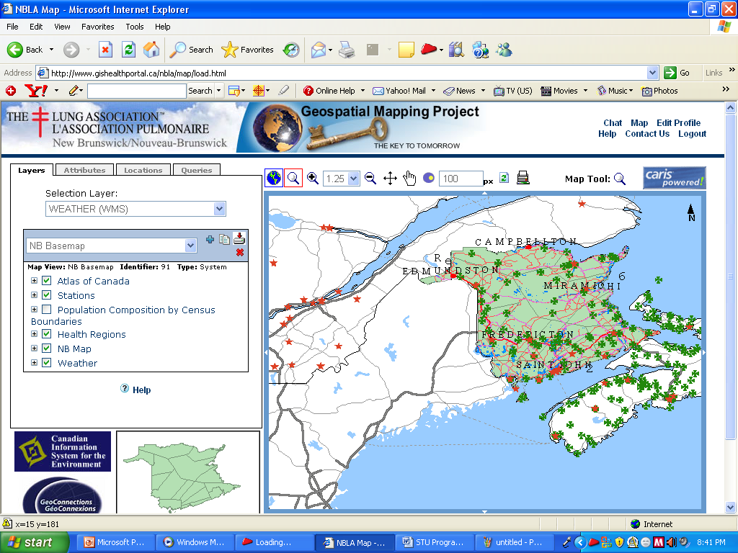

Map Views
Your
Copy, Create, Delete Map Views
Select Map View
Turn Map Layers on / off, view layer card

Slide 26
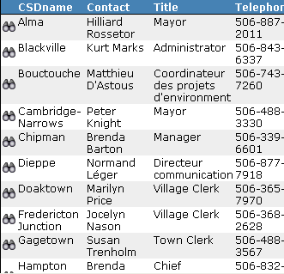
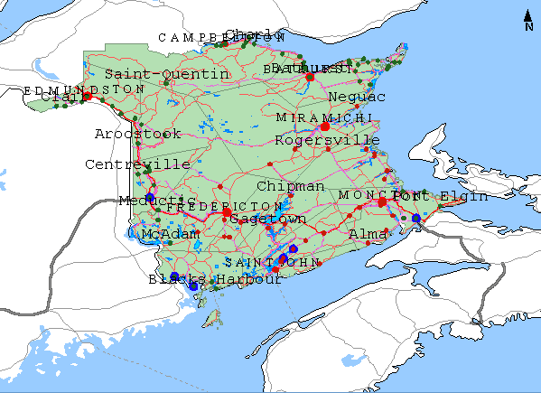
Map Views
Your
Choose Selection Layer

Slide 27
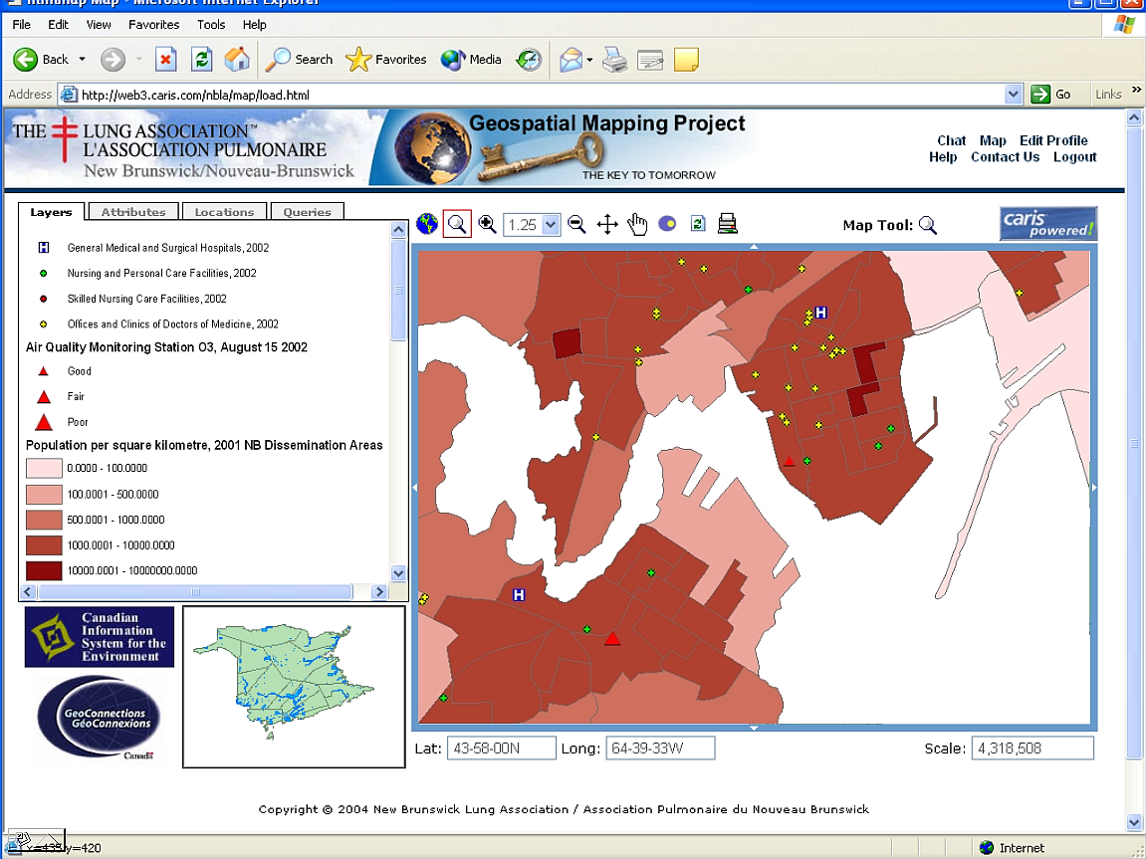

Slide 28
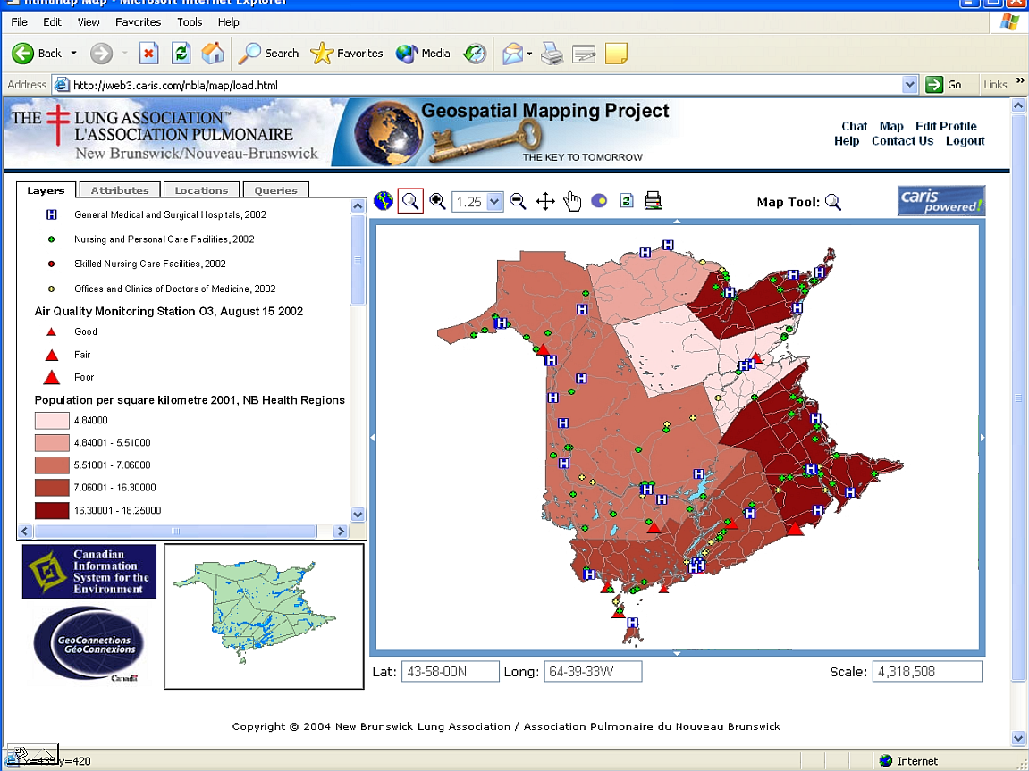

Slide 29
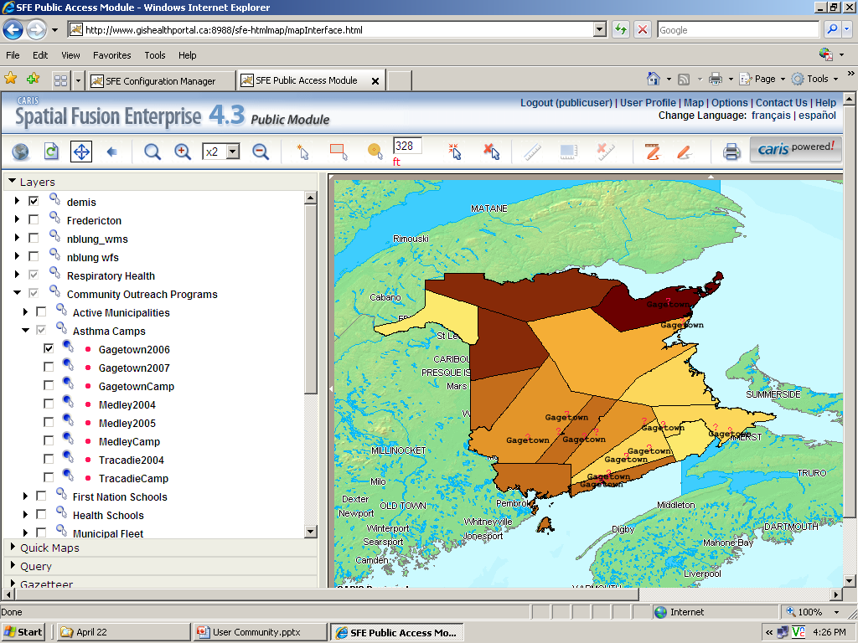
Asthma Camps
One of our Community Outreach Programs,
Asthma Camps, is designed to assist children with chronic asthma, their guardians, healthcare providers, peers and the general public to recognize, assist and respond to the many issues surrounding this debilitating disease.

Slide 30

Asthma Camps
When the spatial distribution of Asthma Camp participants’ origins overlays the spatial distribution of Asthma hospitalization outcomes, our program directors, project funders, healthcare planners and providers are readily able to determine significant historical gaps and future opportunities for the Program.

Slide 31




Beta WMS, Environment Canada

Slide 32
User requirements survey for National Portal, Health Canada

Slide 33
Key Data Sources
Framework data – GeoBase, NTS, Public Health Agency of Canada (Map and Data Exchange)
Licensed data from NB Department of Health, Canadian Institute for Health Information, Public Health Agency of Canada
New Brunswick Lung Association Map Layers (community outreach programs)
Heat event public health alerting – 2011 pilot in 4 cities (including Fredericton) – expanding in 2012, Health Canada
Humidity, Temperature, Precipitation, Air Quality Data: Meteorological Service Canada (e.g. via WMS – Beta phase)
Regional Downscale Climate Scenarios for Atlantic Canada – (e.g. future WMS & WCS) Weather (WXXM, GRIB, DBF)
Air Quality Health Index – Ozone reporting / Health Index
Atlantic Region Air Monitoring Sites: http://atlantic-web1.ns.ec.gc.ca/airmons/index_e.cfm (no longer available)
National Air Pollutant Survey (NAPS) – Environment Canada, published in CEC Atlas
National Pollutant Release Inventory (NPRI) – Environment Canada, published in CEC Atlas
MODIS – NASA: http://modis.gsfc.nasa.gov/data/dataprod/index.php
Canada: Geogratis: http://geogratis.cgdi.gc.ca/download/EO_Data/MODIS/ / http://geogratis.cgdi.gc.ca/download/
Service New Brunswick – building the NB Shared Data Infrastructure (http://geonb.snb.ca/geonb/ viewer)
NB Department of Environment: monitoring stations, flood & watershed data, water quality, EIAs
Flood Modeling – useful for health outcomes related to molds / mosquito populations / West Nile
Forestry Service – species distribution, health, and disease
Statistics Canada – many health indicator data sets
Sea Level Rise – Environment Canada

Slide 34
Other data sets of interest
Ambient Particulate Matter .5, 2.5, 10
  New Brunswick Lung Association conducts studies in partnership with health authorities to determine exposure to ozone, PM, and other air pollutants
  monitoring real time exposures & emissions of Particulate Matter
Fleet & Traffic-related pollution
Residential and Commercial radon concentrations
Airborne Fungal Concentrations in Public Schools
Sulfur dioxide concentration from petroleum processing plants
Extreme Weather Data / Forecasts
Forest Fires / Smog Alerts
Geographic and temporal distribution of polycyclic aromatic hydrocarbons
Pest / Insect Infestations
Rabies

Slide 35
GisHealthPortal
Map Viewer Interface

Slide 36

Map Viewer Interface
Our custom Map Viewer Interface enabled the user to combine:
Web Processing Services
Web Feature Services
Web Mapping Services
into a multilayer seamless view exportable to the user’s desktop workstation.

Slide 37

Web Processing Service
The User defines which combination of values to obtain for geometry, respiratory disease, gender, age, admission years, statistical methods, classification methods, legend range, etc.

Slide 38

Web Processing Service
When satisfied with the value settings, the User submits a call to the Web Processing Service to obtain these values from the Oracle server and, simultaneously, a call to the Web Feature Service to obtain the spatial geometry.

Slide 39

Web Feature Service (WFS)
Call being made by our custom MapInterface to our Geoserver via the Web Feature Service (WFS) GetCapabilities operation.

Slide 40

Web Processing Service
When the Web Feature Service (WFS) GetCapabilities operation returns the spatial geometry, the Web Processing Service maps the cell values obtained from our Oracle server to the spatial geometry.

Slide 41

Map Export
User is then able to export the map view to their desktop for further analysis, or import the view into a web page. The exported map view has the same GIS functionalities as the original Map Viewer Interface (Pan, Zoom, Layer toggle, etc).

Slide 42

Web Processing Service
Through the Web Processing Service, the User also has the ability to verify the statistical quality of the cell values being mapped to the spatial geometry.

Slide 43



Users can select parameters for statistical querying and map visualization
Population Distribution by Health Region
Notes:
Maps showing population density / size, and age distribution
Population Distribution by Health Regions (Census 2001)
Map Source: New Brunswick Lung Association (2008)
43

Slide 44
Phone: 1-506-453-0887
Email: eoldfield@bellaliant.net

