Slide 1
MINnD UC8-GT : Geotechnical data standardization and management for BIM and Smart Cities
108th OGC Technical Committee, Joint IDBE / Smart Cities / LandInfra session
Stuttgart, Germany
Mickaël Beaufils (BRGM), on behalf of the MINnD UC8-GT team
11 September 2018

Slide 2
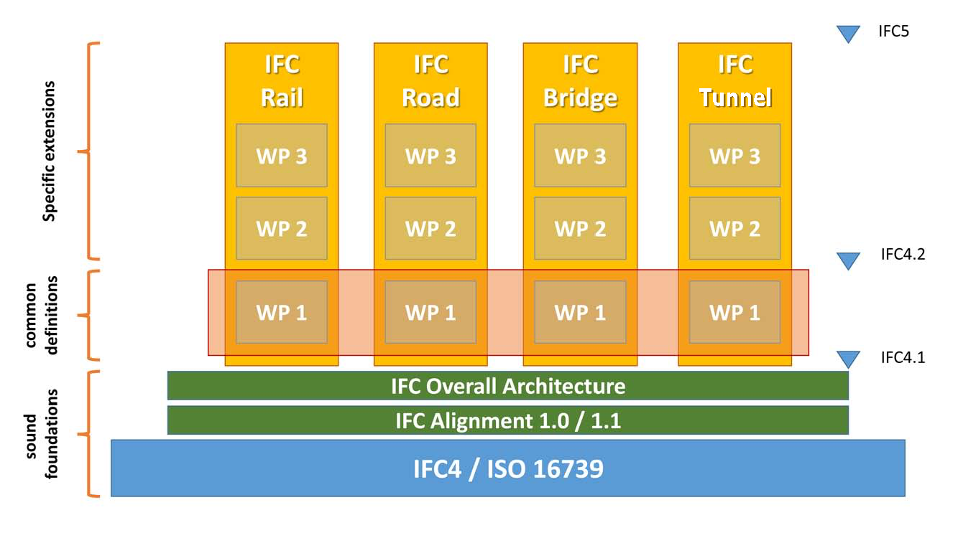
Context: MINnD
MINnD (2014-2018 > 2020)
A French collaborative program to extend BIM methods and standards from building to infrastructure modeling
In connection with buildingSmartFrance (MediaConstruct)
70 partners
Soil
Vulcanology
Mineral resources
Geophysics
Mine
Geology
Oil
& Gas
Sismology
HydroGeology
Underground construction
GeoScienceDWG

Slide 3
Context: MINnD UC8
MINnD UC8: Underground Infrastructures (mid 2017-2018)
Focus on tunnels, underground spaces
Focus on the design part (not construction and exploitation of the infrastructure)
14 partners involved
Two teams:
GC: describe construction and equipments
GT: describe environment and interaction with construction

Slide 4
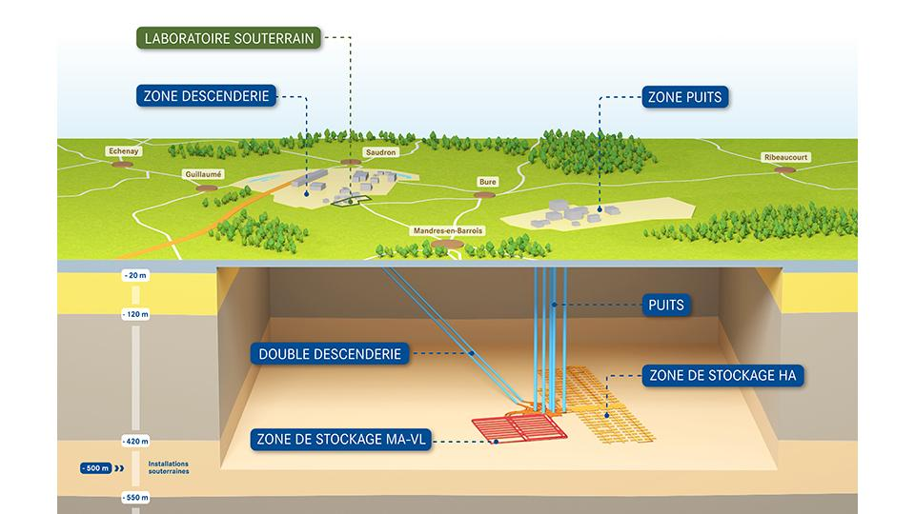
Context: MINnD UC8-GT
Concrete applications / feedback
Lyon-Turin (rail)
Grand Paris Express (rail)
CIGEO project (rail)
Long term and deep storage of radioactive waste
Several connected tunnels
Objective
Sustainable organization of data to ensure smooth transition between design, construction and maintenance
Being able to retrieve data in 100 years

Slide 5
Challenges
A very cross-frontier topic
Geoscience / Civil Engineering
GIS / BIM (+ geomodelling tools!)
OGC / bSI
« Which kind of interoperability do we want? »
Extending IFC with geo* concept (An, 2017), (China BIM alliance, 2015)?
Integrating BIM data into earth models? city models including subsurface, natural + anthropic?
Something else?
Think outside the (project) box
Data maintenance, reuse > the last «Ds» of BIM
From smartbuilding and infrastructures to smart cities
1111000101101
10011101100010
Geoengineering
team
Civil engineering
team

Slide 6
Tasks of the MINnD UC8-GT group
Information Delivery Manual (IDM)
Explicit the geoengineering activity
Conceptual model / Data Dictionnary
Propose data organization
Define semantics
Model View Definition (MVD) Data management
How to fullfill the exchange requirements?
How to get / update data
Determine which data are exchanged
…in connection with the other group (GC)
…and in connection with the current dynamics

Slide 7
A definition of geoengineering activity
A very mis-used term. A lot of confusion with geology, hydrogeology.
Geoengineers aim at characterizing subsurface to help civil engineers to define how to build (if it is possible)
Thus:
They propose infrastructure sizing
They propose construction methods
They assess risks of the project and impacts on:
Surrounding constructions and existing utility networks,
Environment (pollution, excavated materials to evacuate)

Slide 8
Comprehension of the geoengineering activity
GEOL, HYDRO, GTCH
AVOI, ENVI, RISK
9 main topics
Model(s)
Designation | Id
Structure sizing and definition of the geotechnical influence zone | CALC
Construction methods | MECO
Risk and uncertainty assessment | RISK
Anthropic environment impact | AVOI
Environmental impact | ENVI
Geological modeling | GEOL
Hydrogeological modeling | HYDR
Geotechnical modeling | GTCH
Observations and Measurements | RECO
Combine data
to build an interpretation of a phenomenon
Use model(s) to define
« How to build »
Observation(s)
Preconisation(s)
RECO
CALC
MECO
Get data
from the field
or feedback
Build
following preconisations
Real world

Slide 9
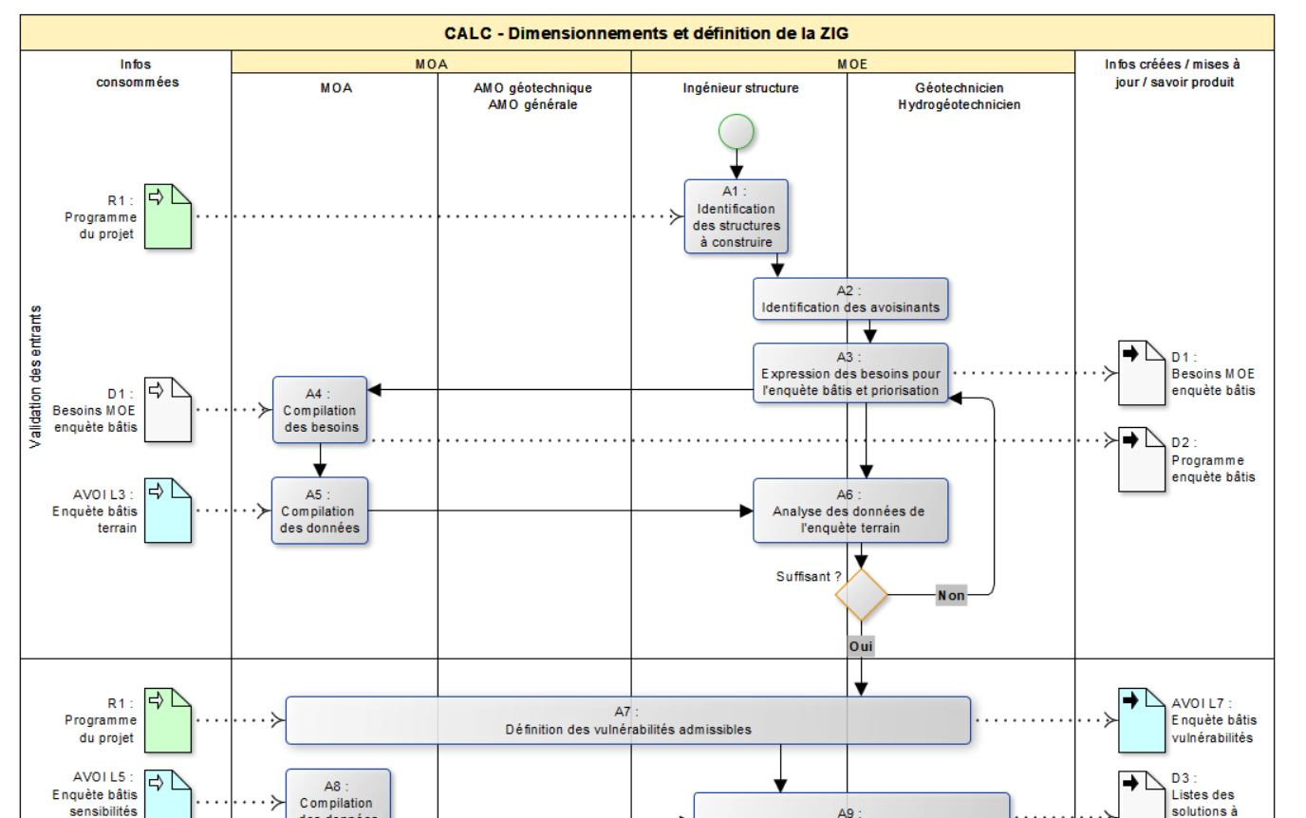
Expliciting the geotechnical activity proceses
Information Delivery Manual (IDM)
Workflow description
ISO 29481-1:2016
1 per subject
Highlight basics
Who does what?
Which data?
Which results?
Focus on knowledge construction
Not methods and tools
Actors
Processes
Input data
Output data

Slide 10
Some feedback from the geoengineering activity study
Several kind of geoscientsts involved in a project
Geologist, hydrogeologist, geoengineer, driller, geodata manager, …
Sometimes two roles can be addressed by only one person
Tools heterogeneity
Each actor may have its own kind of tool
Several software / editors for the same kind of tool
Semantic heterogeneity
Importance of common vocabs (eg. IUGS-CGI)
3D geomodelling is only 5% of the projects

Slide 11
Proposition of mapping with OGC + INSPIRE data models
Concepts to address | Helpful existing models
Observations on the field | ISO O&M / OGC GeoSciML Outcrop
Measurements | ISO O&M
Results of calculus / estimations | ISO O&M
Lab analysis | OGC GeoSciML
Geology logs | OGC GroundWaterML2
Boreholes | Borehole IE (on going activity)
GeologicUnit / GeologicStructure and specializations | OGC GeoSciML
Aquifer, fluid bodies, void, flows | OGC GroundWaterML2
Existing buildings | OGC CityGML / INSPIRE BU ?
Existing networks | OGC CityGML with UtilityNetwork ADE
Risk zones | INSPIRE NZ
Survey / Campaign | INSPIRE Geology>Geophysics>Campaign
Geomodel | OGC GeoSciML>Geophysics package (O&M)

Slide 12
Lyon-Turin tunnel hydrogeological modeling
Cross-section view along the project axis
Geological model as the base for the hydrogeological model
Adding refinements (layer merge) to represent homogeneous area regarding hydrogeological parameters
Additionnal data according to hydrogeological « issues » that can be faced along the axis of the project
Ex : aggressive water presence,hot water presence

Slide 13
Other propositions from the group
Attaching geotechnical information to the alignment
Being able to know what « geo » issue can be faced at each step on the tunnel axis
Risk concerning hydrogeology: hot water, aggressive water,
Risk concerning geologic formation property change
Risk concerning geologic structure: fault presence
Risk concerning surrounding construction
Risk concerning pollution on environment
API to get those information from geomodels on demand?
Define which IFC properties of an element can be impacted by each « geo » particularity
Eg. Expected speed of the train have an impact on the alignement geometry
Some geotechnical property may have direct impact on choice of some equipments

Slide 14
Summary
Geoengineering is not (only) provision of « map » of the subsurface
It goes further with the proposition of structure sizing, construction methods and risk assessment
At least, a lot of O&M to deal with
Several (if not all) needed concepts are already in a OGC / INSPIRE data model
Relying on them would facilitate compatibility between geoscience data for constructions and other geoscience data
It would also help aggregation of geodata
Activities of geoscience data harmonization are already on the run (BoreholeIE)
A very cross-frontier topic
To be addressed by bSI and OGC together, targetting common conceptual models
Thursday 13th Expert panel on geotechnics for BIM organised by bSI

Slide 15
Thanks for your attention!
Questions ?
Contact:
m.beaufils@brgm.fr
Useful links:
MIN^{n}D website : http://www.minnd.fr/en/
GeoScienceDWG home page : http://external.opengis.org/twiki_public/GeoScienceDWG/WebHome

