Slide 1

Setting interoperability between BIM and Geomodelling
106th OGC Technical Committee, GeoScience DWG session
Orléans, France
Mickaël Beaufils (BRGM), on behalf of the UC8-GT team
22 March 2018

Slide 2
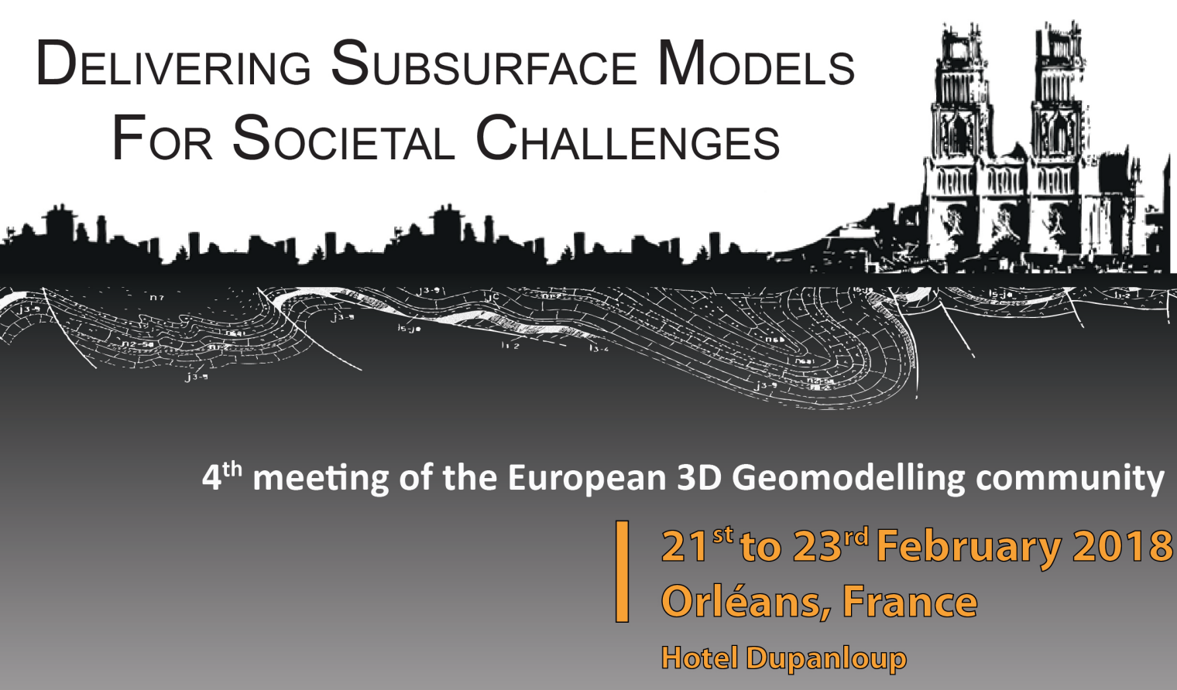




Foreword
Building Information Modeling (BIM) is a hot topic
Connection to BIM is part of geological surveys strategy
How to do that connection?

Slide 3
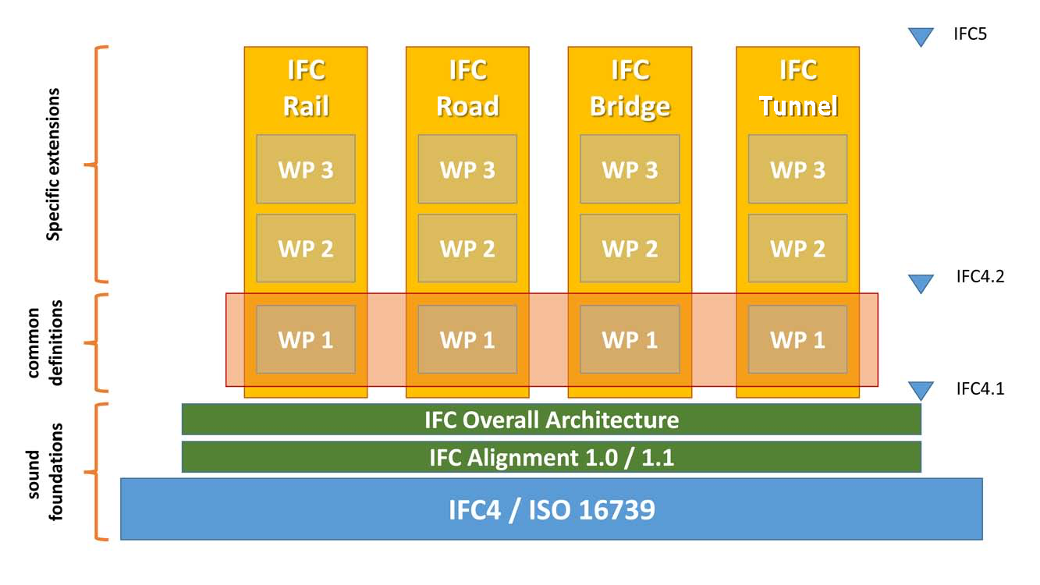


Context : The MIN^{N}D project
3
http://www.minnd.fr/en/
Interoperable Information Model for Sustainable Infrastructures
A French collaborative program to extend BIM methods and standards from building to infrastructure modeling
  67 partners
  Several use cases (type of infra) and themes (cross-domain)
Objectives
  Propose extensions to bSI and OGC standards
  Set Memorandums of Understanding: MIN^{N}D-bSI / MIN^{N}D-OGC
  ISO/CEN Normalization
Soil
Vulcanology
Mineral
resources
Geophysics
Mine
Geology
Oil
& Gas
Sismology
HydroGeology
Underground
construction
GeoScienceDWG
20/03/2018
OGC TC Orléans - IDBE session

Slide 4



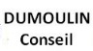









Context : MIN^{N}D UC8
4
Use Case dedicated to Underground Infrastructure modeling
18 month project: June 2017 – September 2018
14 partners :
2 groups :
  Group GC : Building part modeling
  Group GT : Environmental part modeling
UC8-GT : First tentative in MIN^{N}D to study geomodelling connection with BIM
20/03/2018
OGC TC Orléans - IDBE session

Slide 5
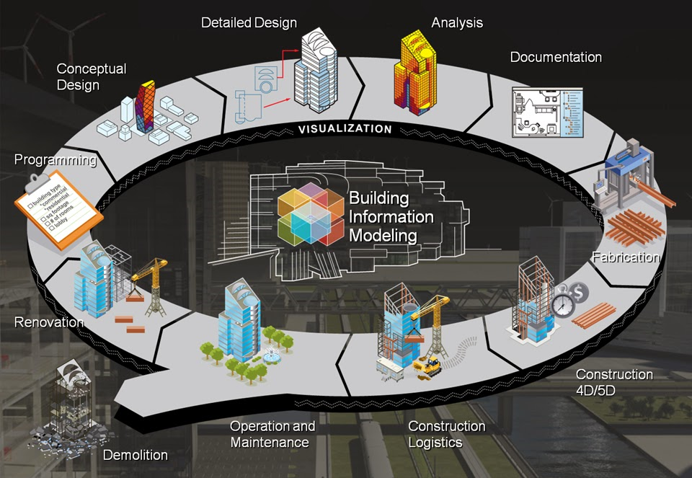
What is BIM?
Building Information Modeling is a philosophy
  It is about having a model that mimic
  the real building / infrastructure
  at each moment of its life
Applying BIM philosophy to geomodelling
  It is about building an interoperable information system able to store / provide / link geoscience data and results
  To indicate on which data and interpretation infrastructure are built
Key challenges are information description, lineage and update
22/03/2018
OGC TC Orléans - GeoScience DWG session

Slide 6
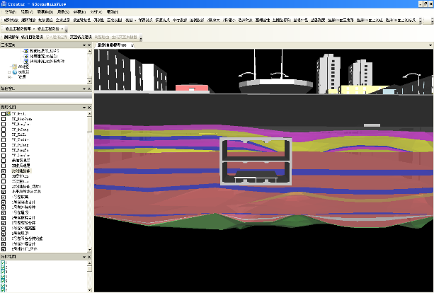
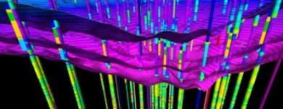
What do we have in MIN^{N}D?
Using standards
  To be able to reuse and aggregate projects data
  To be able to build sustainable Integrated City Models
Enhancing geomodelling from BIM data…
GeoScienceDWG
Geomodel
BIM project
BIM project
BIM project
Integrated City Model
Providing subsurface knowledge to BIM…
22/03/2018
OGC TC Orléans - GeoScience DWG session

Slide 7
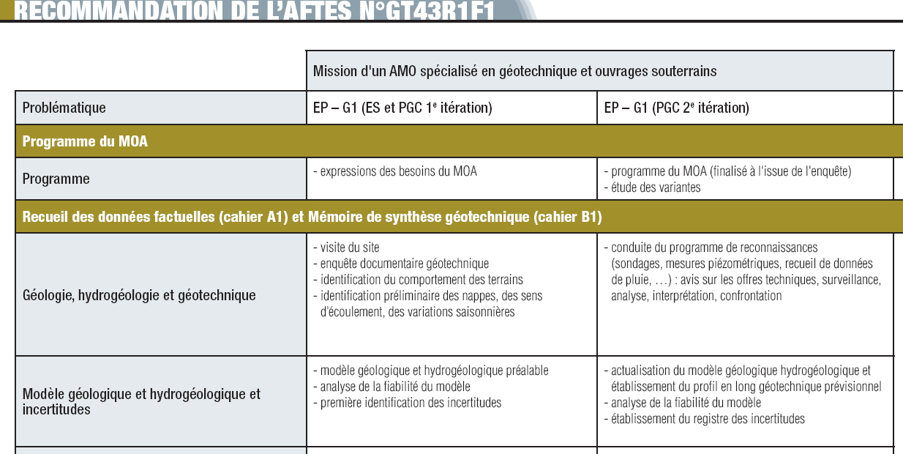
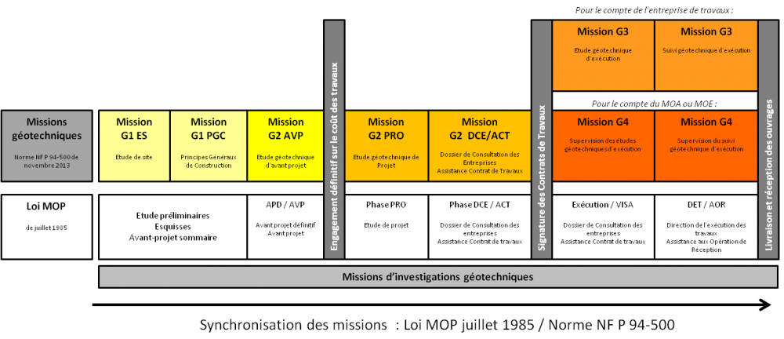
Starting point
Bibliography
  AFNOR Standard: NF P 94-500:2013 on Standardization of Geotechnician Missions
  AFTES recommandations (GT43) on NF P 94-500:2013 application
  Partners experience
20/03/2018
OGC TC Orléans - IDBE session

Slide 8
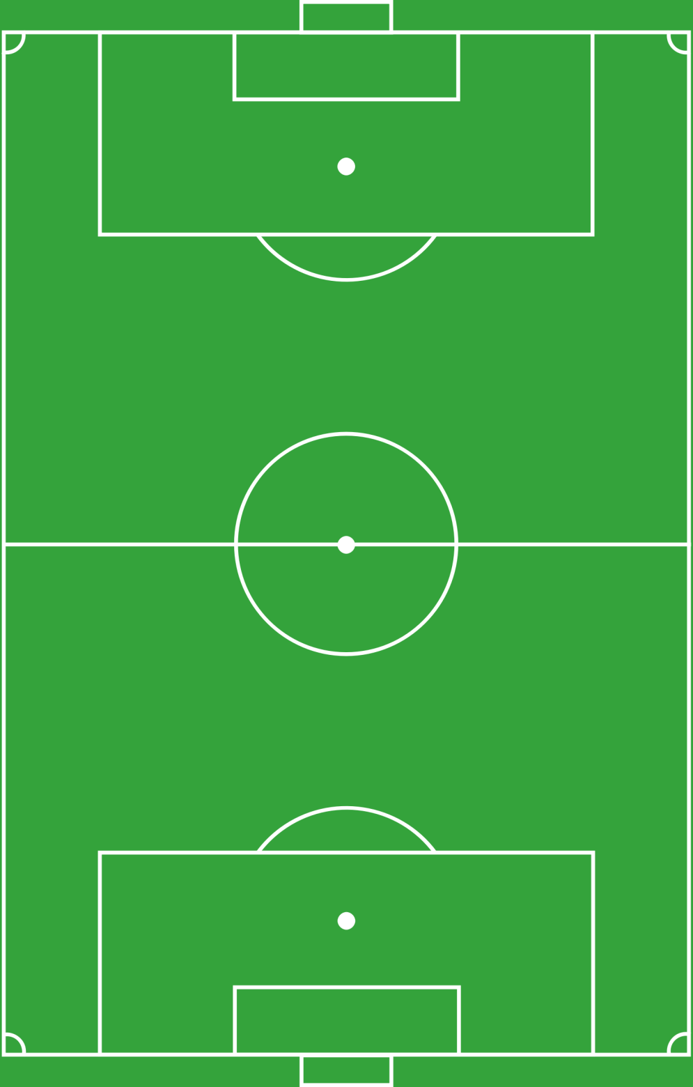
Overview of geo* people activities in a construction project
Designation | Id
Structure sizing and definition of the geotechnical influence zone | CALC
Construction methods | MECO
Contractual documents | MRCH
Risk and uncertainty assessment | RISK
Observations and Measurements | RECO
Geological modeling | GEOL
Hydrogeological modeling | HYDR
Geotechnical modeling | GTCH
Anthropic environment impact | AVOI
Environmental impact | ENVI
MRCH
What builders
want to get
MECO
CALC
ENVI
GTCH
What results
are based on
AVOI
GEOL
HYDR
RECO
Constraints
RISK
22/03/2018
OGC TC Orléans - GeoScience DWG session

Slide 9
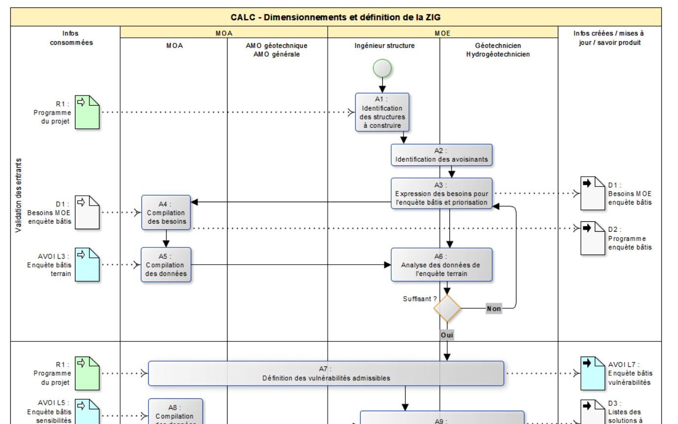
Describing how geotechnical knowledge is built
Information Delivery Manual (IDM)
  Workflow description
  ISO 29481-1:2016
  1 per subject
Highlight basics
    Who does what?
    Which data?
    Which results?
Focus on knowledge construction
  Not methods and tools
Actors
Processes
Input data
Output data
22/03/2018
OGC TC Orléans - GeoScience DWG session

Slide 10
Cold facts
Many infrastructures projects does not rely on 3D geomodels… but sections
Some 3D geomodels are not designed with geomodeling tools… but with CAD
« No clear consensus on geomodel definition »
Building community do not expressly ask for (3D) geomodels
They mainly expect answers to their questions
  Can I build here?
  How much would it cost? Considering risk / uncertainty management
For them, geomodels are (just) « media » to build the answers
« How can we put some standardization in this? »
22/03/2018
OGC TC Orléans - GeoScience DWG session

Slide 11
Consensus on geotechnical knowledge construction
 | RECO Surveys | HYDR Hydrogeological Modelling | GEOL Geological modelling | GTCH Geotechnical modelling
Expression of recommended surveys |  | x | x | x
Definition of survey program | x
Description of the survey (borehole, onfield observation, laboratory analysis, geophysics) | x
Raw result expression | x
First interpretation of result | x
Analysis or reinterpretation of the result |  | x | x | x
Compilation and model scale interpretation |  | x | x | x
Model building (with geomodelling software) |  | x | x | x
« A serie of linked observations / measurements / interpretations »
> We have OGC standards for this!
22/03/2018
OGC TC Orléans - GeoScience DWG session

Slide 12
Work in progress
Conceptual Model building tentative based on OGC standards
  Observations & Measurements
    For surveys data, and sucessive interpretations
    For results of infrastructure sizing, risk assessment
    To describe geomodels themselves
  GeoSciML and GroundWaterML
    To provide appropriate semantics
    Identify potential needs for extensions to describe geotechnics
Some GroundWaterML 2.2 concepts
22/03/2018
OGC TC Orléans - GeoScience DWG session

Slide 13

Conclusion: What we do in MIN^{N}D
MIN^{n}D is not focusing on integrating buildings in geomodels (or vice versa)
  It is mostly about increasing geoscience data quality and interoperability to make it reusable
3D geomodels are not systematically built during infrastructure construction
  Not the first thing to standardize
Consensus on geotechnical knowledge construction
  We will work on lineage
  Finally a linked data topic
Cities want to know what they have below their feet
  cf Underground Infrastructure Pilot projet
  Being able to collect high data quality from building community would greatly contribute to build 3D urban geomodels, and maintain them!
  Opportunities of collaboration between cities, construction community and geological surveys
22/03/2018
OGC TC Orléans - GeoScience DWG session

Slide 14
Thanks for your attention!
Contact:
  m.beaufils@brgm.fr
Useful links:
  MIN^{n}D website : http://www.minnd.fr/en/
  GeoScienceDWG home page : http://external.opengis.org/twiki_public/GeoScienceDWG/WebHome

