Slide 1
Geoscience Terminology Working Group
Mark Rattenbury
GNS Science, New Zealand
Chair, GTWG
Presentation for the Joint Research Centre, European Commission, Ispra, Italy: 28 October 2015

Slide 2
Geoscience Terminology Working Group
Supports geoscience information interoperability through terminology development
Develops and enables vocabularies for geoscience information systems
Liaises with semantic interoperability groups in related communities
Members are information modelling specialists, technical experts in all areas of geoscience, regional geological experts
Currently 26 members from Australia, Canada, China, Denmark, Finland, France, Germany, Great Britain, Italy, New Zealand, Russia, Slovenia, Sweden and USA
Wider participation through other CGI working groups and OneGeology communications
Annual face-to-face meetings (St Petersburg, Tucson, Ispra) and through shared Google Group folders and email list

Slide 3
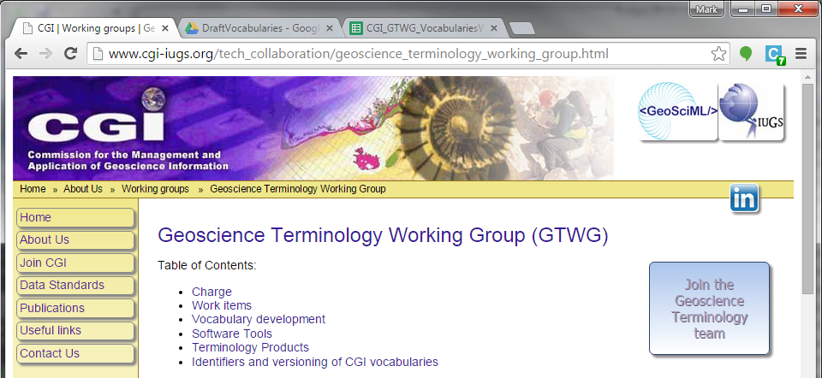
IUGS-CGI: Commission for the Management and Application of Geoscience Information
Multi-lingual Thesaurus Working Group (est. 2003)
Concept Definition Task Group (est. 2007)
2013

Slide 4
GeoSciML
geology model development,
OGC Standards Working Group
EarthResource ML
mineral resource model development, CGI Working Group
Geoscience Terminology Working Group
vocabulary development
Multi-lingual versioning
Other groups requiring semantic interoperability for geoscience themes

Slide 5
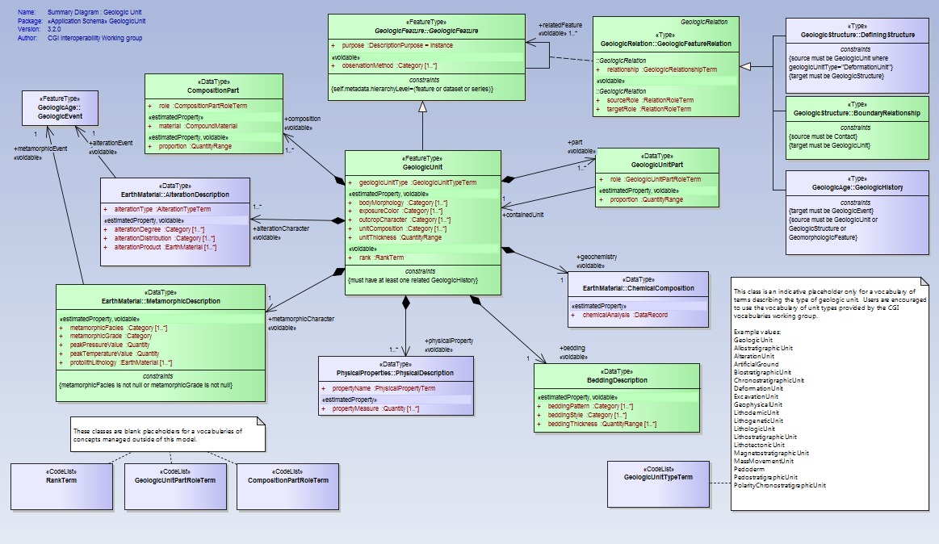
Vocabularies driven by data interoperability requirements e.g. GeoSciML, ERML

Slide 6
classificationMethodUsedValue
commodityCodeValue
earthResourceExpressionValue
earthResourceFormValue
earthResourceMaterialRoleValue
earthResourceShapeValue
endusePotentialValue
environmentalImpactValue
explorationActivityTypeValue
explorationResultValue
geologicHistoryRelationshipTerm
importanceValue
linearDirectedCode
mineralOccurrenceTypeValue
mineStatusValue
miningActivityTypeValue
processingActivityTypeValue
rawMaterialRoleValue
reserveCategoryValue
resourceCategoryValue
samplingFrame
UNFC_Value_2009
wasteStorageTypeValue
alterationTypeTerm
compositionCategory
compoundMaterialConstituentPartRoleTerm
consolidationDegree
contactCharacter
contactTypeTerm
conventionCode
descriptionPurpose
determinationMethod
eventEnvironment
eventProcessTerm
faultDeformationStyle
faultMovementSenseTerm
faultMovementTypeTerm
faultTypeTerm
featureObservationMethod
foliationTypeTerm
geneticCategory
geologicalTimescale
geologicUnitMorphology
geologicUnitPartRoleTerm
geologicUnitTypeTerm
lineationTypeTerm
lithologyConcept
mappedFeatureObservationMethod
metamorphicFacies
metamorphicGrade
orientationDeterminationMethod
particleAspectRatio
particleShape
particleTypeTerm
proportionTerm
simpleLithologyTerm
sorting
stratigraphicRankTerm
strikeDipMeasurementReportig
valueQualifier
vocabularyRelationTerm
importanceSize
mineralDepositType
miningWasterType
mineralDepositGroupValue
In review
Adopted
(pre 2011)
alterationDegree
alterationDistribution
analyticalMethodTerm
anthropogenicGeomorphologicalFeatureTypeTerm
associationType
boundaryRelationshipTerm
compositionPartRole
continuity
definingElement
definingElement
definingStructureRelationshipTerm
deformationStyleTerm
exposureColor
extractionMethod
foldProfileTypeTerm
geneticModel
geochronologicEraRank
geologicSamplingMethodTerm
geologicSpecimenPreprationTerm
geologic unit lithology categories
geomorphologicRelationshipTerm
hingeLineCurvature
hingeShape
instrumentTypeTerm
interLimbAngle
limbShape
materialRelationshipType
nameOfMeasureTerm
nonDirectionalStructureTypeTerm
physicalPropertyTerm
relationRoleTerm
samplingFeatureRelation
statisticalMethodTerm
supergeneProcessType
symmetry
Adopted
(since 2012)
Proposed and/or required
ageEvent
ageSystem
beddingPattern
beddingStyle
boreholeDrillingMethodCode
boreholeInclinationCode
boreholePurposeCode
boreholeStartPointCode
colour
fabricTypeTerm
foliationIntensity
isotopicEventType
isotopicSystemName
lineationIntensity
materialClass
mineralDepositGroupValue
mineralDepositTypeValue
naturalGeomorphologicalFeatureTypeTerm
outcropCharacter
planarPolarityCode
productValue
regionalLithUnit
samplingMethod
specimenType
Draft

Slide 7
Vocabulary process
Identify/propose &
assign shepherd
Seek and research usage
Amend, improve
Create draft vocabulary
Adopt and publish
Invite review
Incorporate changes

Slide 8
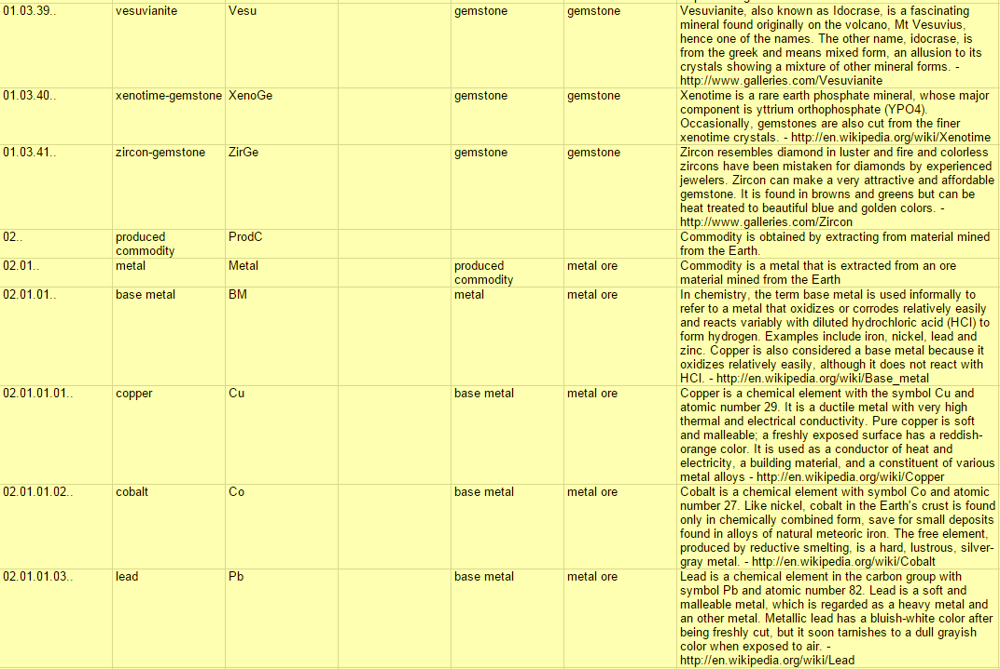
commodityCode : hierarchical earth resource commodity types

Slide 9
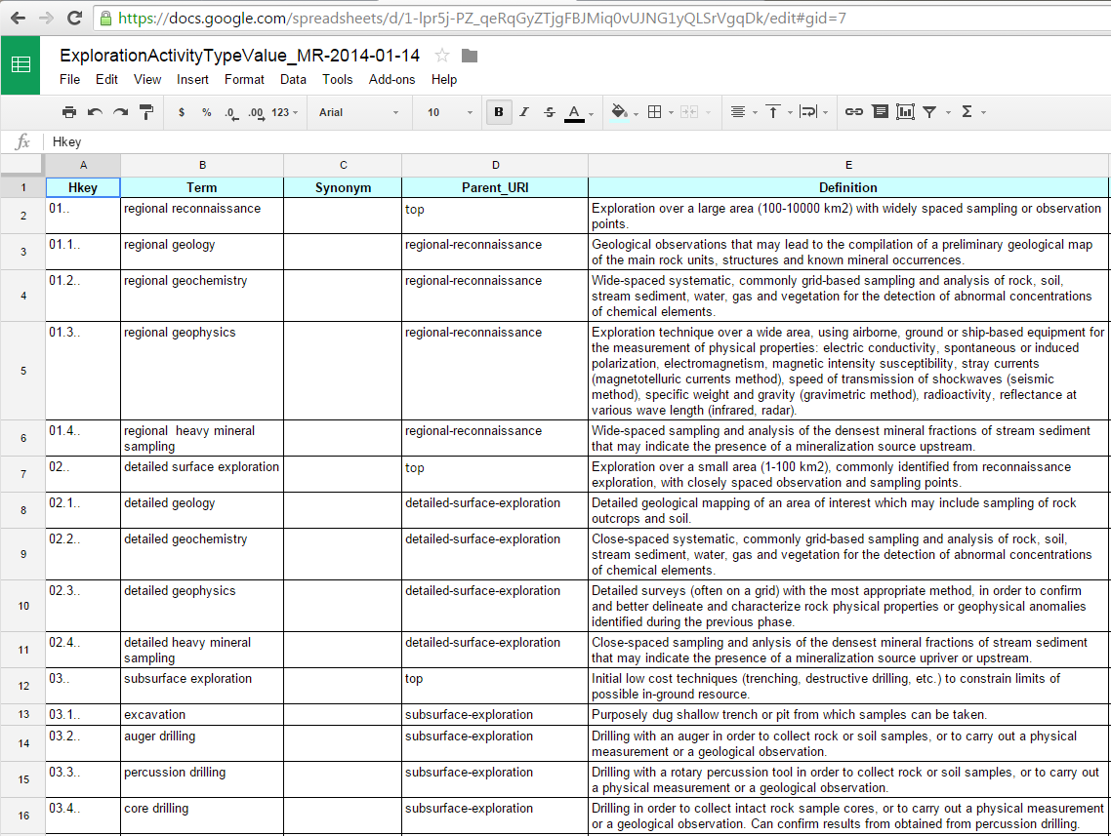

Slide 10
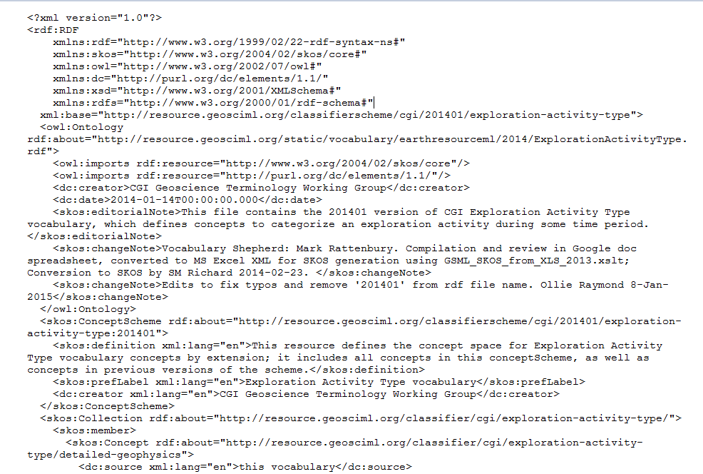
SKOS-encoded RDF formatted file

Slide 11
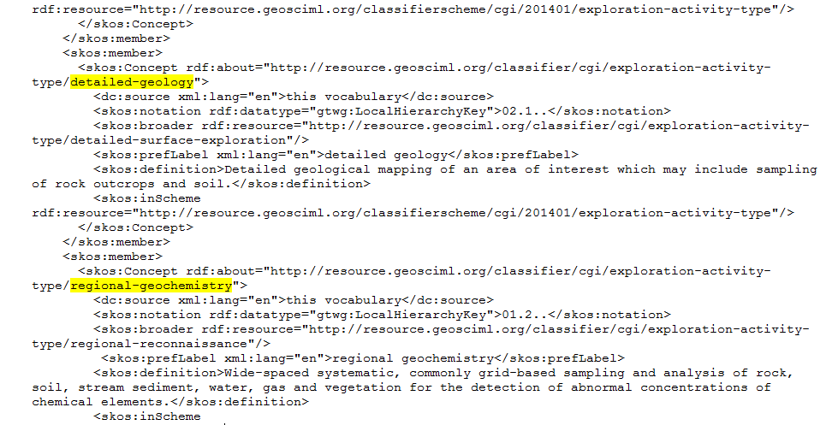

Slide 12
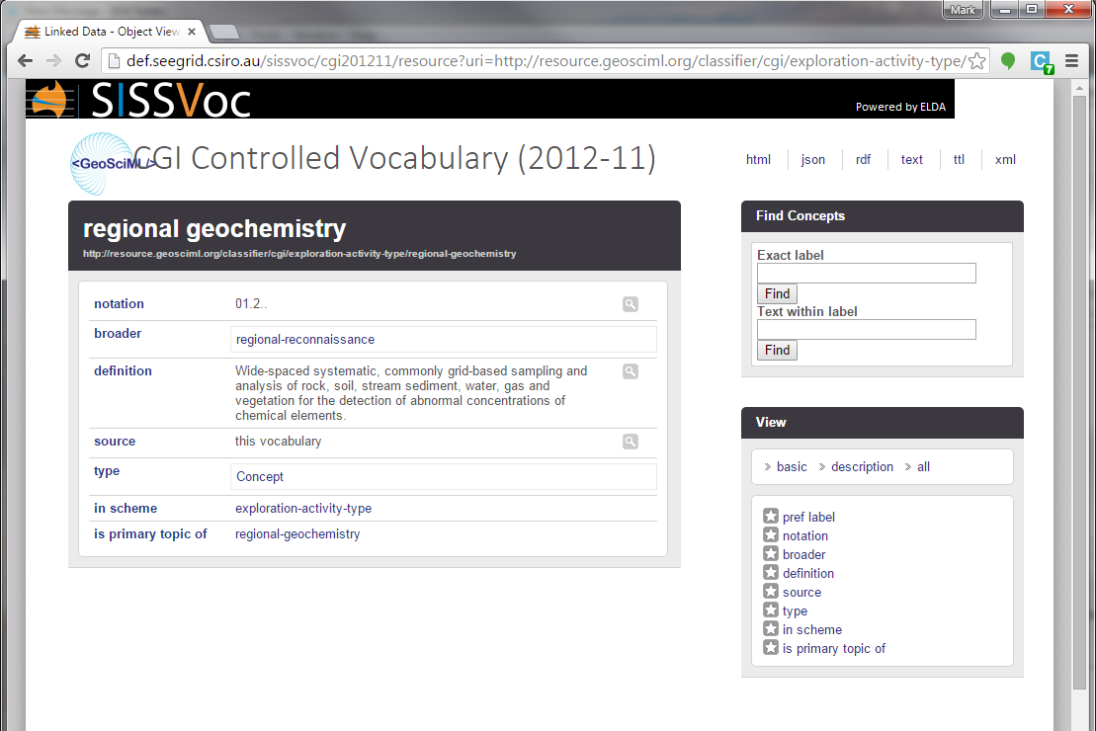
http://resource.geosciml.org/classifier/cgi/exploration-activity-type/regional-geochemistry

Slide 13
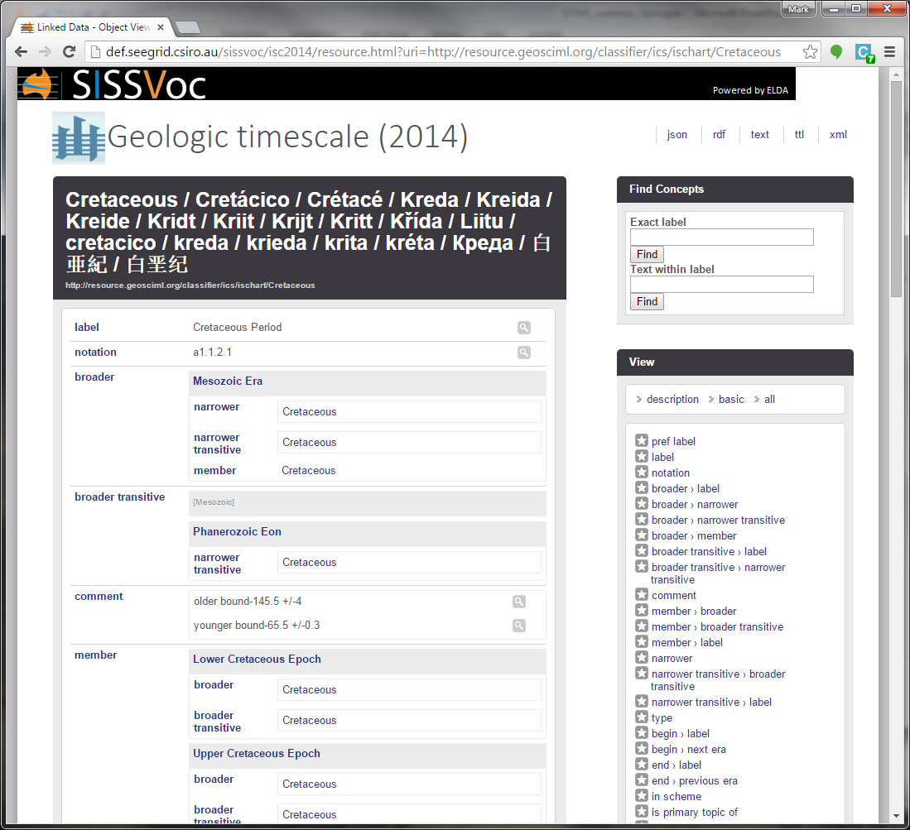
multi-lingual
hierarchical
defined

Slide 14
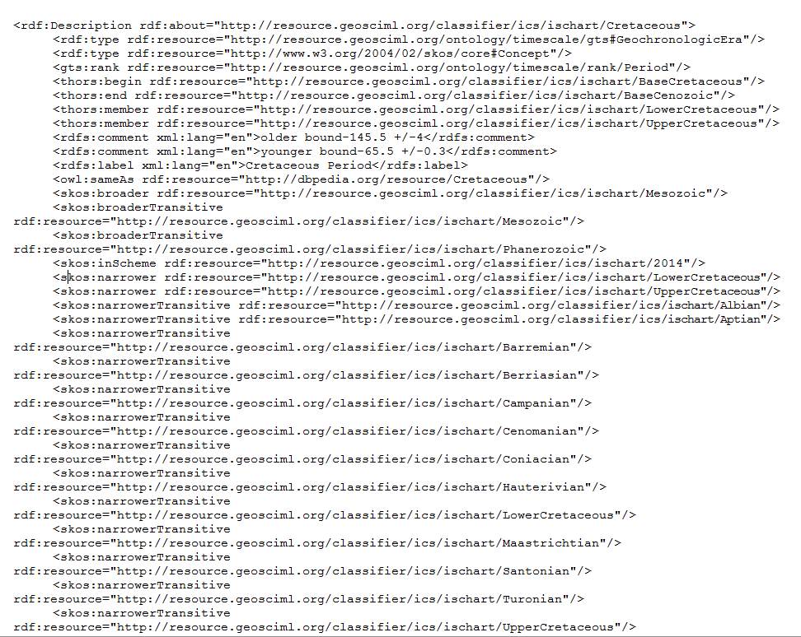
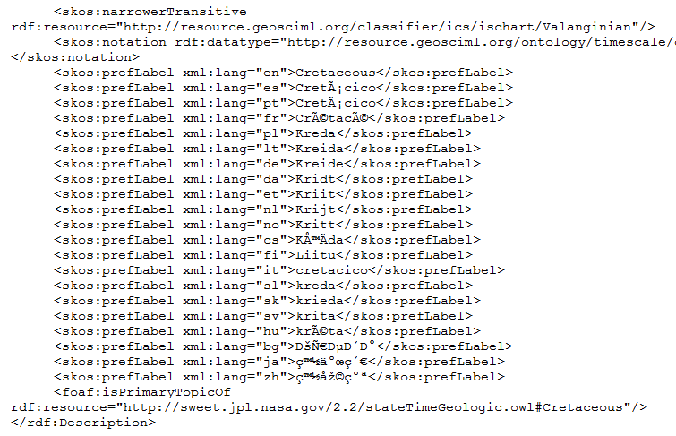

Slide 15
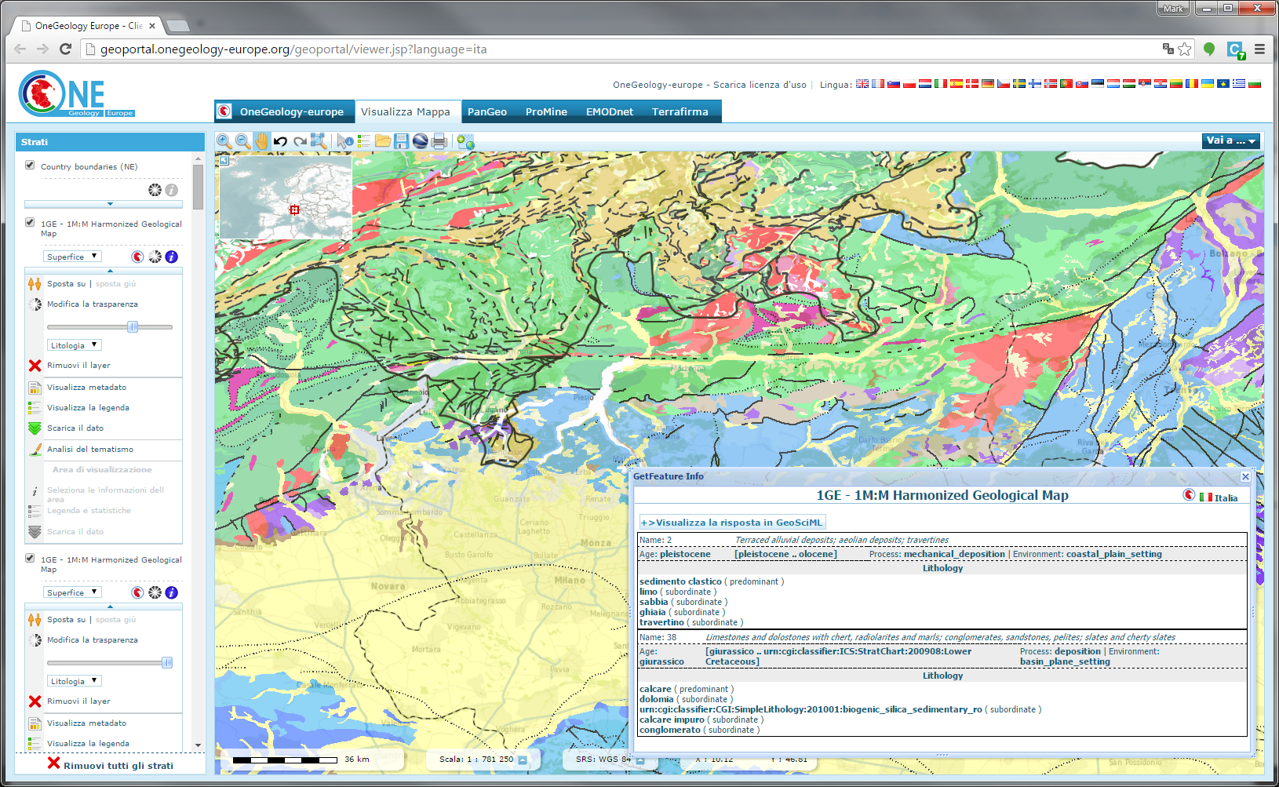

Slide 16
Geoscience Terminology Working Group
GeoSciML
geology model development,
OGC Standards Working Group
EarthResource ML
mineral resource model development, CGI Working Group
Geoscience Terminology Working Group
vocabulary development
Multi-lingual versioning
Other groups requiring semantic interoperability for geoscience themes

