Slide 1
Launch Workshop CoP 3: Interoperability and standards for citizen observatories
Pre-kicking off the first Cit Sci Interoperability pilot.
Joan Masó | CREAF
Pavillon Mail (the long narrow building) Tram 15 stops at “Mail“ Uni Mail
GoToMeeting: 321 982 654

Slide 2
Outline slide
Kick off [plenary]
Introduction: what is WeObserve, and why are we here?
Co-defining CoP objectives
Play [round-tables]
CoP principles and tools
Incentives to participate
Communication strategy
Roles & responsibilities
First activity
IPR / GDPR
Finale! [plenary]
Report back: what did we come up with?
Timeline
AOB
Wrap up

Slide 3
Welcoming Remarks

Slide 4
Introducing WeObserve
WeObserve
An Ecosystem of Citizen Observatories for Environmental Monitoring
Tackling 3 key challenges: awareness, acceptability and sustainability
Improve coordination & help to move citizen science into the mainstream
H2020 funded (2017-2020), Coord. Steffen Fritz, IIASA

Slide 5
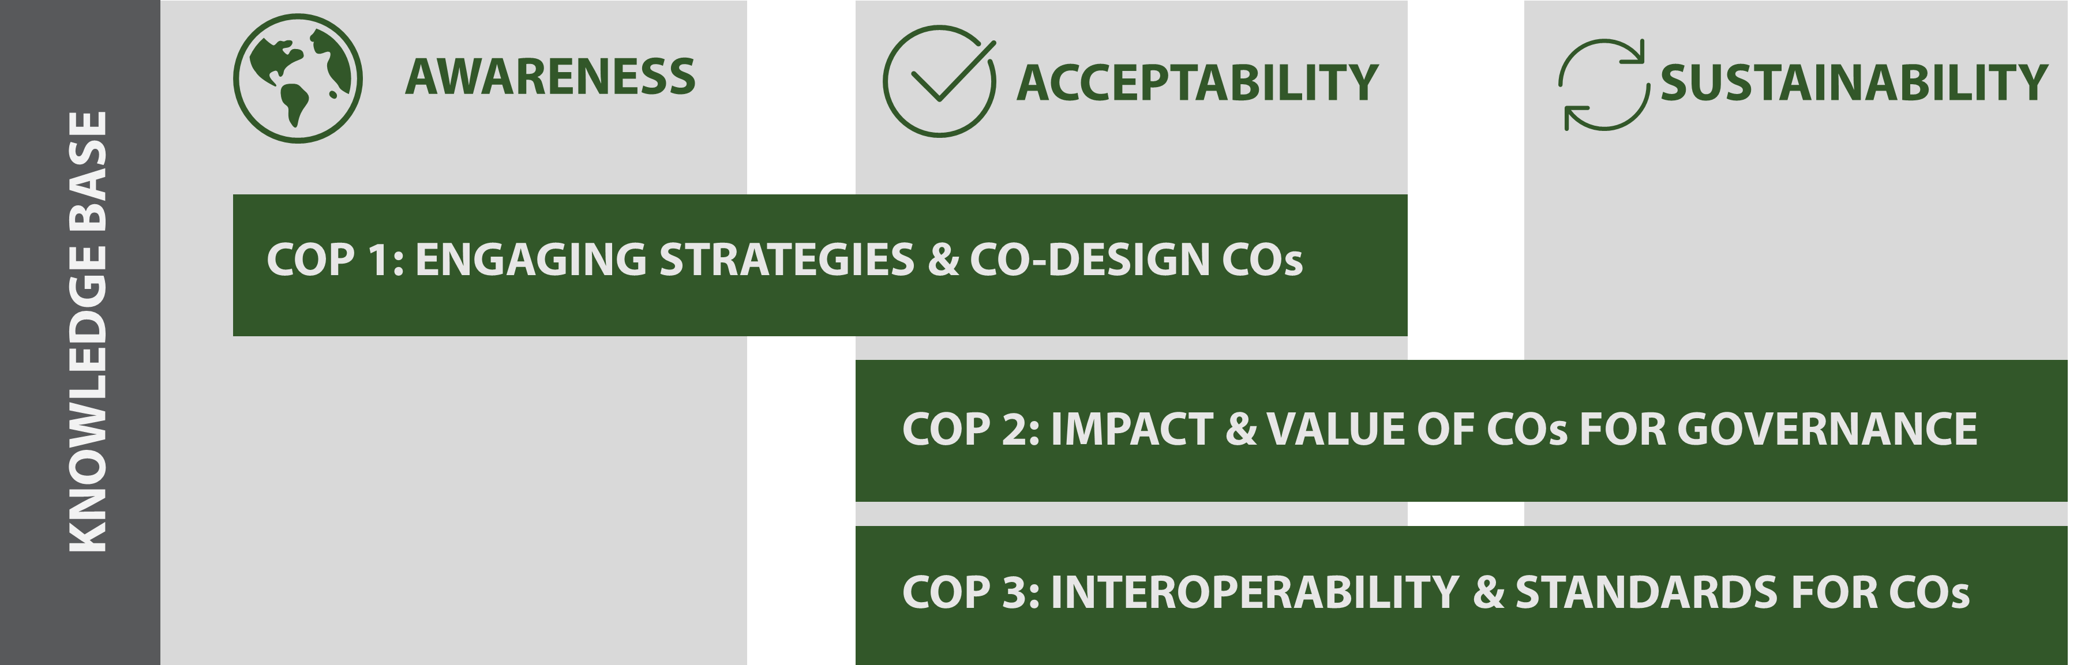
Introducing WeObserve

Slide 6
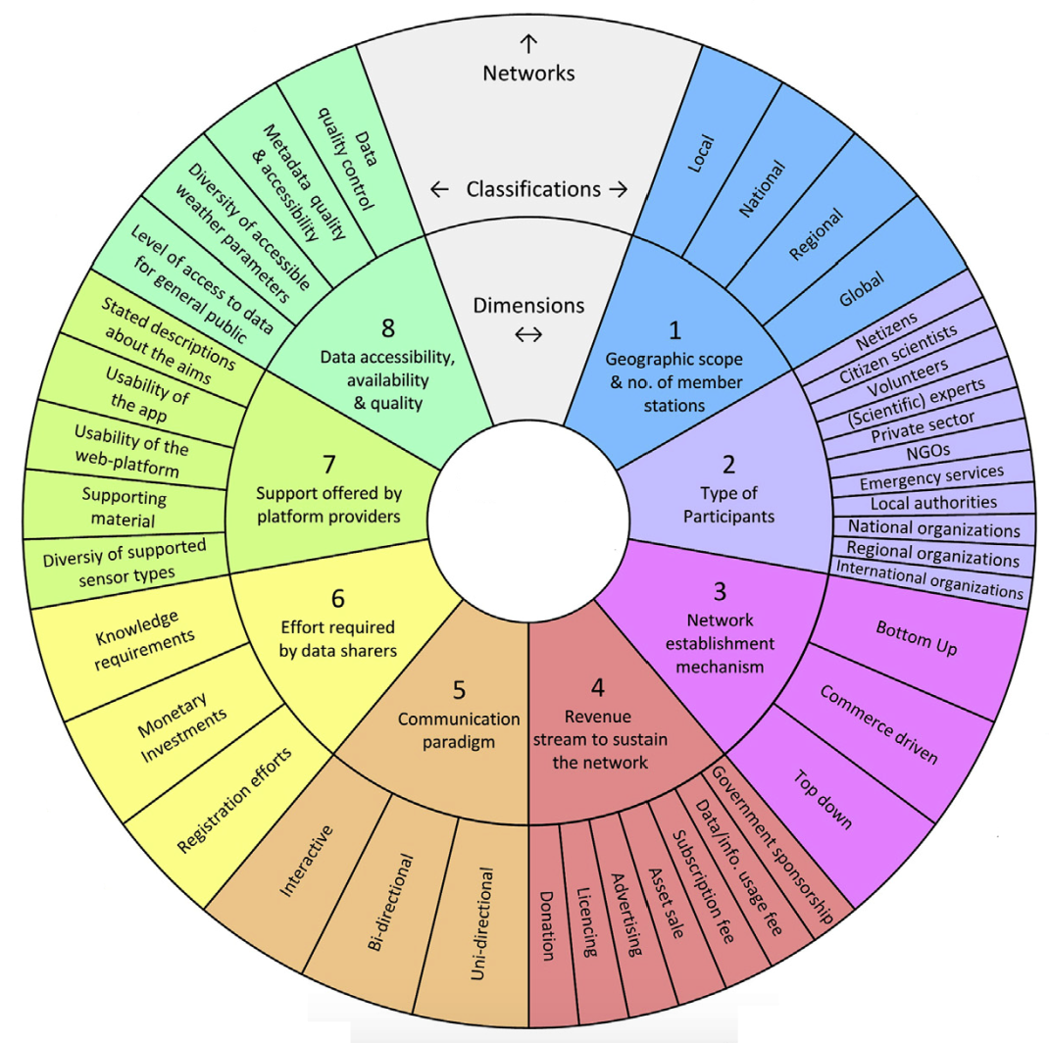
Landscape Report
Mapping the EU landscape of existing Citizen Observatory initiatives, relevant communities and their interactions
Geographic scope
Type of participants
Network establishment mechanism
Revenue stream
Communication Paradigm
Effort required
Platform support
Data accessibility, availability & quality
Source: Gharesifard,
Wehn and van der Zaag (2016)

Slide 7
Introducing WeObserve CoPs
CoP = Domain + Community + Practice
To assess, strengthen and extend knowledge base
To support implementation of best practices and standards
To demonstrate the added value of COs
To promote uptake of information and foster business innovation

Slide 8
Introducing WeObserve Communities of Practice
Source: Yusuf et al. (2011)
CoP = Domain + Community + Practice

Slide 9
Topic of CoP
CoP 1 Co-creating citizen observatories and engaging citizens | addressing incentives and barriers for participation, engagement strategies and citizen- science ethics (led by IHE Delft)
CoP 2 Impact and value of citizen observatories for governance | defining socio-economic and environmental impacts of community-based environmental monitoring for public authorities and decision makers including risk evaluation (led by IHE Delft)
CoP 3 Interoperability and standards for citizen observatories | adopting data quality, curation and preservation of citizen-science data, and addressing privacy and licensing for CO sustainability (led by CREAF).

Slide 10
Introducing WeObserve Communities of Practice
General objectives of the CoPs
To assess, strengthen and extend the CO knowledge base
To support implementation of best practices and standards
To demonstrate the added value of COs
To promote uptake of information and foster business innovation

Slide 11
CoP ToR
WeObserve Communities of Practice can undertake one or more of the following:
Thematic knowledge co-creation: create new knowledge related to the CoP’s focal theme, with the aim of generating lessons learned for other CO initiatives.
Generating new solutions or agreeing on how to use existing ones e.g. interoperability experiments and generating technical recommendations.
Knowledge sharing activities (meetings, events, conferences etc): wide dissemination, communication and diffusion of information, enabled also by the WeObserve platform.

Slide 12
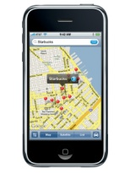
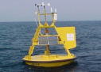
Standards Baseline as a Services Architecture
GeoAPI
Visualization / Decision Tools and Applications
OpenLS
Data Models and Encodings
GML
IndoorGML
NetCDF
GMLJP2
GeoSparql
SLD
KML
WMC
CityGML
WaterML
GeoXACML
FE
SE
OpenGeoSMS
GeoPackage
Other Services
Workflow, Alerts, Security
Processing Services
Discovery Services
TJS
WPS
WCPS
OpenMI
CSW
OpenSearch Geo
ebRIM
Access Services
Sensor Web Enablement
WFS
WMTS
SPS
SensorML
O&M
SOS
Geospatially Enabled
Metadata
Simple
Features
Access
WMS
WCS
Discover
Task
Access
Geospatial
Feature Data
Geospatial Browse/Maps
Puck
Geospatial Coverage Data
Other
Data
Sensors
Notes:
Acronym List:
Catalog Web Service (CSW) - Support the ability to publish and search collections of descriptive information (metadata) for data, services, and related information objects.
Web Map Service (WMS) - XML encoding for the transport and storage of geographic information modeled according to the conceptual modeling framework including both the spatial and non-spatial properties of geographic features.
Web Map Tile Service (WMTS) - Serves digital maps using predefined image tiles and complements the existing Web Map Service providing flexibility in the client request enabling clients to obtain the precise final image required.
Web Coverage Service (WCS) – Provides access to detailed and rich sets of geospatial information in forms that are useful for client-side rendering, multi-valued coverages, and input into scientific models and other clients.
Web Coverage Service Transactional (WCS-T) - Enables clients to add, modify, and delete grid coverages that are available from a WCS server.
Web Feature Service (WFS) – Defines the interfaces for data access and manipulation operations on geographic features, feature information behind a map image.
Web Feature Service Transactional (WFS-T) - Enables clients to add, modify, and delete feature data that are available from a WFS server.
Sensor Planning Service (SPS) - Enables a client to determine collection feasibility for a desired set of collection requests for sensors and directly task those sensors.
Sensor Observation Service (SOS) - Interface for requesting, filtering, and retrieving observations and sensor system information.
Sensor Model Language (SML) - Enables users to access sensors; their location, their capabilities, and the data they acquire along with the ability to process the data through a standards-based, non-proprietary web interface.
Observation & Measurements (O&M) - Specifies the core model, framework, and encoding for measurements and observations.
Observation & Measurements XML (O&M XML) - XML schemas for observations, and for features involved in sampling when making observations.
Geo eXtended Access Control Markup Language (GeoXACML) - An extension to the eXtensible Access Control Markup Language (XACML) Policy Language that supports the declaration and enforcement of access restrictions on geographic information.
Styled Layer Descriptor (SLD) – Provides analysts control of the visual portrayal of the data with which they work.
Symbology Encoding (SE) - an XML language to encode user-defined styling information that can be applied to digital Feature and Coverage data.
Geography Markup Language (GML) - XML encoding for the transport and storage of geographic information modeled according to the conceptual modeling framework.
KeyHole Markup Language (KML) - XML language focused on geographic visualization and used to encode and transport representations of geographic data for display in web browser, including annotation of maps and images.
Filter Encoding (FE) - an XML encoding of the OGC Common Catalog Query Language (CQL) as a system neutral query representation.
Web Map Context (WMC) - XML schemas for observations, and for features involved in sampling when making observations.
Table Join Service (TJS) –Provides a mechanism to expose corporate tabular data, with geographic identifiers so that it can be discovered, accessed, and merged with spatial data to enable mapping or geospatial analysis.
Table Join Service Transactional (TJS-T) - Enables clients to add, modify, and delete tabular data available from a TJS server.
Web Processing Service (WPS) - WPS provides client access across a network to pre-programmed calculations and/or computation models that operate on spatially referenced data.
Geo Short Message Service (GeoSMS) - Facilitate communication of location content between different LBS (Location-Based Service) devices or applications by extending Short Messaging Service (SMS).
GeoSynchronization Service (GeoSynch) - Enables data collectors to submit new data or make modifications to existing data without directly affecting the data in the provider's data store(s) until validation has been applied.

Slide 13
The main objectives
Of the interoperability experiment
The use of OGC standards or (e.g. Sensor Web Enablement (SWE) or IoT) to support data integration among CS projects, and with other sources, esp. authoritative data (e.g by following SWE4CS);
The integration of CS projects/campaigns in Single Sign-On system (SSO) federation;
The relationship(s) between OGC standards and data and metadata standards currently used by CS projects.
Do you miss something important?

Slide 14
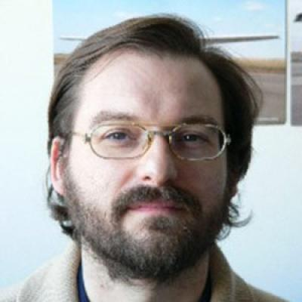
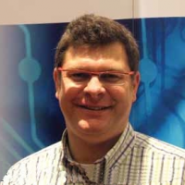
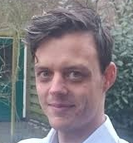
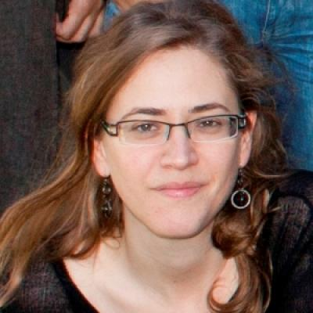
Welcome from the WeObserve CoPTeam
Uta Wehn – IHE Delft
Coordinating the CoPs
Chair of the CoP1 & CoP2
Joan Masó - CREAF Chair of the CoP3
Bart De Lathouwer
Contact with OGC and NextGEOSS
Joeri Naus – IHE Delft CoPs support
Ester Prat – CREAF
Support for CoP3
Christoph Perger – IIASA
Contact with the WeObserve coordinator

Slide 15
Initiators Organizations. THANKS!
The following OGC members are iniciators of the IE:
Universitat Autònoma de Barcelona – CREAF
International Institute for Applied Systems Analysis – IIASA
Joint Research Center (JRC)
European Space Agency (ESA) ?
US Geologicl Survey (USGS) ?
International Institute for Applied Systems Analysis – IIASA and Universitat Autònoma de Barcelona – CREAF are supported by the WeObserve project. WeObserve is funded by the European Union’s Horizon 2020 Research and Innovation Programme under grant agreement No. 776740.

Slide 16
A Debt of Gratitude to the Participants. THANKS!! Can you write down:
Your Name
Your Organization
Participant or Observer
Which of the 3 topics are you going to contribute:
SWE: The use of OGC standards or (e.g. Sensor Web Enablement (SWE) or IoT) to support data integration
SSO: The integration of CS projects/campaigns in Single Sign-On system federation
MD: Metadata standards to describe CS projects
Other: specify

Slide 17
Linked Activities
This activity is promoted and endorsed by the OGC Citizen Science Domain Working Group
Contributes to the Citizen Science Association’s International Working Group on Citizen Science Data and Metadata (http://citizenscience.org/association/about/working-groups/data-and-metadata-working-group/).
Contributes to the Citizen Science COST Action - CA15212: to promote creativity, scientific literacy, and innovation throughout Europe (https://www.cs-eu.net/about/CA15212).
Contributes to the Citizen Science Global Partnership (CSGP) first call for participation (https://www.wilsoncenter.org/article/concept-note-citizen-science-global-partnership).
Contributes to the Earth Observations and Citizen Science Community Activity of the GEO Work Program (http://earthobservations.org/activity.php?id=142).
Contributes to the EuroGEOSS initiative (https://ec.europa.eu/info/research-and-innovation/knowledge-publications-tools-and-data/knowledge-centres-and-data-portals/eurogeoss_en).
Is supported by the H2020 project WeObserve (https://www.weobserve.eu) (CoP3), the H2020 Citizens’ Observatory projects Grow (https://growobservatory.org/), Groudtruth 2.0 (http://gt20.eu/), Landsense (https://landsense.eu/) and Scent (https://scent-project.eu/), and the NextGEOSS project (https://nextgeoss.eu/).

Slide 18
What we want to do?
This workshop will launch CoP3 “Interoperability and standards for citizen observatories" by organizing the kick off of the first Interoperability Experiment.
We need to agree on the focus of the experiments
Who is going to contribute what
How we are going to work together
How can we present what we will do
In terms of demonstrations, videos etc.

Slide 19
Introduction to the CitSciIE OGC 18-031: Activity Plan For An OGC Interoperability Experiment

Slide 20
Types of Initiatives – Agile Prototyping
Number of Participants
0-3
100-200
Testbed
Scope/
Variety
Pilot
Interoperability Experiment
Hackathon
Plugfest
Low TRL
Technology Maturation
High TRL

Slide 21
The desired outcome of this experiment is to
Successfully demonstrate how OGC standards (e.g. SWE) are applicable to Citizen Science, document available supporting tools, identify the challenges of using OGC SWE
Determine the security considerations and the available tools to support a Single Sign On (SSO) federation that helps users in participating in several projects by using a single user account.
Assess the possible relationships of OGC standards (e.g. SensorML) with other existing standards in the field (e.g. Public Participation in Scientific Research (PPSR) - Core, the ontology developed by the COST Action on Citizen Science, and the Citizen Science Definition Service (CS-DS) developed in the NextGEOSS project) to generate metadata to describe CitSci projects and variables measured
Satisfy the necessary requirements to integrate CS into GEOSS by using OGC standards.

Slide 22
Background
The FP7 Citizen Observatory Web (COBWEB) project was the first to propose the use of SWE in CS. This work resulted in an OGC public discussion paper. (Ingo S.)
the Public Participation in Scientific Research PPSR-Core, the ECSA has a working group that recognizes the value of standardization in the CS activities.
However, these activities could benefit from some experimentation
The 'Ecosystem of Citizen Observatories (CO) for Environmental Monitoring' — WeObserve project is a Horizon 2020 funded project focused on improving the coordination between existing COs and related regional, European and international activities.
WeObserve tackles three key challenges that face COs: awareness, acceptability and sustainability in 3 CoPs.
The CoP3 is about Interoperability of Citizen Science projects. WeObserve project – via its CoP activities – represents an opportunity to promote interoperability experiment in collaboration with the OGC.

Slide 23
Linked Activities
This activity is promoted and endorsed by the OGC Citizen Science Domain Working Group
Contributes to the Citizen Science Association’s International Working Group on Citizen Science Data and Metadata (http://citizenscience.org/association/about/working-groups/data-and-metadata-working-group/).
Contributes to the Citizen Science COST Action - CA15212: to promote creativity, scientific literacy, and innovation throughout Europe (https://www.cs-eu.net/about/CA15212).
Contributes to the Citizen Science Global Partnership (CSGP) first call for participation (https://www.wilsoncenter.org/article/concept-note-citizen-science-global-partnership).
Contributes to the Earth Observations and Citizen Science Community Activity of the GEO Work Program (http://earthobservations.org/activity.php?id=142).
Contributes to the EuroGEOSS initiative (https://ec.europa.eu/info/research-and-innovation/knowledge-publications-tools-and-data/knowledge-centres-and-data-portals/eurogeoss_en).
Is supported by the H2020 project WeObserve (https://www.weobserve.eu) (CoP3), the H2020 Citizens’ Observatory projects Grow (https://growobservatory.org/), Groudtruth 2.0 (http://gt20.eu/), Landsense (https://landsense.eu/) and Scent (https://scent-project.eu/), and the NextGEOSS project (https://nextgeoss.eu/).

Slide 24
Use Case
Specific use cases that will be tested in this experiment include, but are not limited to:
Conflation of the datasets from two or more CS projects, which deal with the same data types, into a single new integrated data set.
Assimilation of data from CS projects with complementary authoritative data.
Participation in two or more CS projects using a single user account.
Exposing the outcomes (data) of a CS project as a data provider in GEOSS – ideally as part of the GEOSS-Data Core.

Slide 25
Scenario
Technically speaking, the approach is applicable to any data type that a CS project may collect. During the kick-off meeting, and depending on the resources provided by the participants, a motivational scenario will be defined.
The scenario should propose the merging of CS projects datasets to cover a larger geographic area or coordinate topics in order to satisfy the needs of GEO in terms of providing data necessary to deal with climate change, measure the progress towards the Sustainable Development Goals (SDGs) and disaster management.
As a guiding example, the following motivational scenario could be inspirational. An outbreak of mosquito carried disease both in Spain and in Italy is detected. There is the need to create a global early warning system to monitor the evolution of the outbreak and prevent the contagious spreading of the disease. In the experiment, we discover the existence of some CS projects and we build an integrated database that is published and available through the GEOSS infrastructure.

Slide 26
Experiments
Experiment #1: An expert needs to know the big picture about some topic, such as an outbreak of a mosquito carried disease or invasions of a particular alien invasive species. They know that there is no (or little) authoritative data about the topic available, so they look for alternative CS projects that might provide the required data to analyze the problem at hand.
Experiment #2: A conflated dataset is built based on local or regional CS projects’ data.
Experiment #3: The expert travels to different places to analyze the situation on the ground and then report what they see in two different CS projects apps using the same user account.

Slide 27
Proposed architecture
SSO Federation
(e.g. EuroGEOSS)
authenticates
CS-NA
authenticates
CS prj1 App
authorizes
CS project's inventory (PPSR)
authorizes
CS prj1 App
variable
variable
registers
discovery
registers
CS prj1 API
CS prj1 SOS
CS prj2 SOS
CS prj1 API
harvests
harvests
CS prj1 DB
Conflated DB
CS prj2 DB
Conflated SOS
accesses
registers
GEOSS regional HUB (e.g. EuroGEOSS)
SOS client
discovery

Slide 28
The list of OGC standards and other specifications that may be affected includes (but not limited to):
OGC Sensor Observing Service (SOS)
OGC SensorML
OGC Sensor Things API
OGC SWE4CS
OGC Web Services Security
Citizen Science – Definition Server (SC-DS)
Project description metadata standards
PPSR-Core
W3C Semantic Sensor Network Ontology (SSN)

Slide 29
Initiators Organizations. Thanks for your support letter!
The following OGC members are iniciators of the IE:
International Institute for Applied Systems Analysis – IIASA
Joint Research Center (JRC)
European Space Agency (ESA)
Universitat Autònoma de Barcelona – CREAF
US Geological Survey (USGS) ?
International Institute for Applied Systems Analysis – IIASA and Universitat Autònoma de Barcelona – CREAF are supported by the WeObserve project. WeObserve is funded by the European Union’s Horizon 2020 Research and Innovation Programme under grant agreement No. 776740.

Slide 30
Timeline
Activity | Timing
Startup
Draft activity plan presented to CS DWG: | Mar 19th, 2018
OAB revision and approval: | June 4th, 2018
Call for participation: | June 5th, 2018
Pre-kickoff event ECSA conference in Geneva: | June 6th, 2018
Execution
Official Kickoff after the Stuttgart TC (adding participation of the non present in ECSA conference) (TBC): | September 14th, 2018
Development, testing and bug fixing | September to February 2016
Presentation at GEO plenary in Tokyo | Oct 31st – Nov 11th 2018
Meeting at the Citizen Observatories for Natural Hazards and Water management Conference (Venece) | Nov 27th– Nov 30th 2018
Planned end date: | March, 2019
Wrap-up and Reporting
Technology Demonstration in a OGC TC | March 2019
Final report submission | June 2019

Slide 31
Activity start. Get out of your confort zone!
Joan Masó

Slide 32
Group activity. Please divide in 3 groups to discuss about the objectives
Pilot the use of OGC standards (e.g. Sensor Web Enablement (SWE) or IoT) to support data integration
Implement a Single Sign-On system federation for CitSci projects
Describe projects using metadata standards

Slide 33
How the groups discussion work
Design a scenario that allows you to demonstrate
Determine the necessary components
Identify de components and the gaps
Consider connection to other CoPs
Please select somebody to report back to the plenary.

Slide 34
Discussion on the findings in the groups
Presentations of the 3 groups
How we can harmonize the 3 groups into s single demo.
Devise a strategy for interoperability and standards to feed into CoPs cookbook

Slide 35
Second activity in groups
Harmonize the scenario in a single one.
Other activities that the group could do
Communication and dissemination of the results
Demonstration, video, WeObserve cookbook…
What do you value from this group:
Recognition of your name and organization
Social event for community building
Produce a video of the results
A public demonstration

Slide 36
How the groups discussion work
Discuss your topic
Set up 2 priority levels for your items
Do we need external help/support to achieve this
This time we would like your group to discuss as many topics as you can.
Please select somebody to report back to the plenary.

Slide 37
Discussion on the findings in the groups
Lets collect the ideas generated in the groups about
Harmonize the scenario in a single one.
Lets identify the priorities for
Indentify other activities that are needed outside the Experiment.
Communication and dissemination
What do you value from this group

Slide 38
Management

Slide 39
Principles of Conduct
Extend respect and courtesy to colleagues at all times
Develop and test ideas and insights impartially
Think internationally, devising insights and solutions that meet the needs of diverse cultural contexts and operational environments
Individuals who attend the WeObserve CoP-facilitated meetings are prepared to contribute to the ongoing work of the CoP
Adhere to the agreed rules that protect the IPR of the members and the privacy of their discussions
Adhere to the consensus process for deciding CoP-internally what content will be made public and when

Slide 40
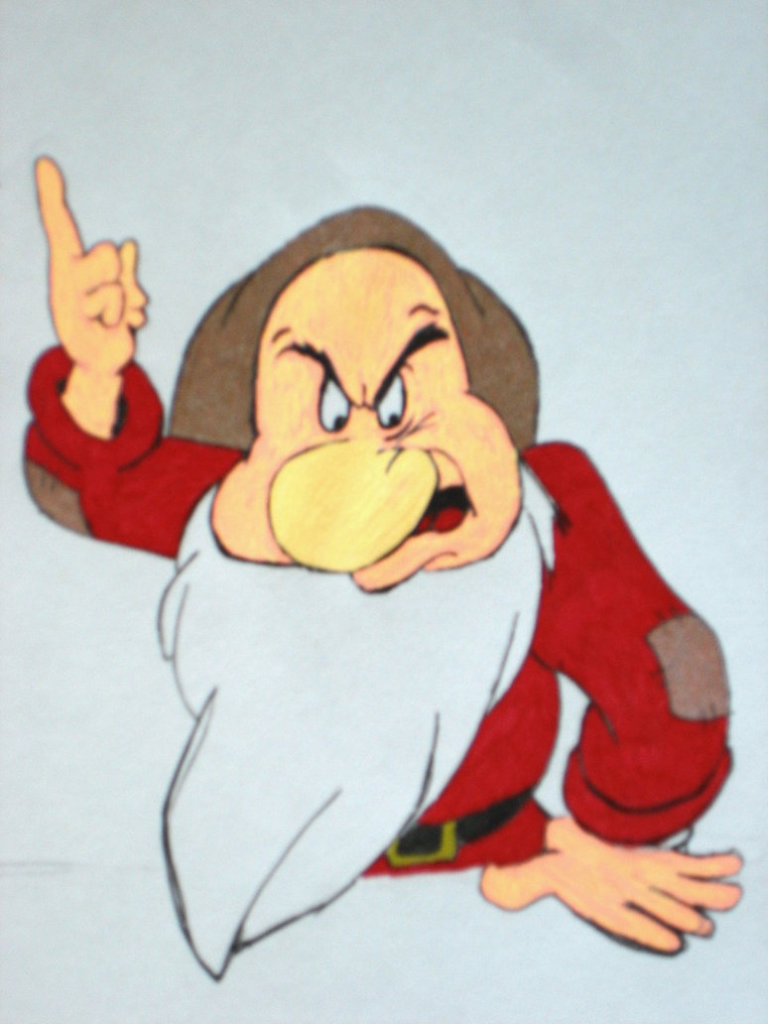
Summary of OGC Principles of Conduct *
Extend respect and courtesy to colleagues at all times
Develop and test ideas impartially
Think globally, devising solutions that meet the needs of diverse technical and operational environments
Individuals who attend OGC facilitated meetings are prepared to contribute to the ongoing work of the membership and the organization
* http://www.opengeospatial.org/ogc/policies/conduct

Slide 41
Summary of Relevant IPR Guidelines
Avoid injecting any copyrighted material into an ER, CR, or any other IE document.
If it's unavoidable, OGC will be granted a usage license
Avoid (design around) introducing any recommendation for a spec that would risk infringing on a patent if implemented.
If unavoidable ("Necessary Claim"), OGC will be granted a usage license.
In any case, even if it's potentially avoidable, notify OGC as soon as possible, and no later than during the Patent Call.
If you become aware that confidential information (CI) has been disclosed to you, avoid sharing it outside the IE.
Disclose CI only when necessary to advance testbed interests.
Avoid making any representations that any preliminary, draft IE findings or recommendations are endorsed by OGC.
Approval will be made later, by TC vote.

Slide 42
Patent Call
Please be aware that this initiative is being conducted under the OGC Policy Regarding Intellectual Property Rights (available at http://www.opengeospatial.org/about/ipr).
At this time, I would ask that anyone in attendance inform me if they are personally aware of any claims under any patent applications or issued patents that would be likely to be infringed by an implementation of the standard or other work product which is the subject of this initiative.
You need not be the inventor of such patent or patent application in order to inform us of its existence, nor will you be held responsible for expressing a belief that turns out to be inaccurate.

Slide 43
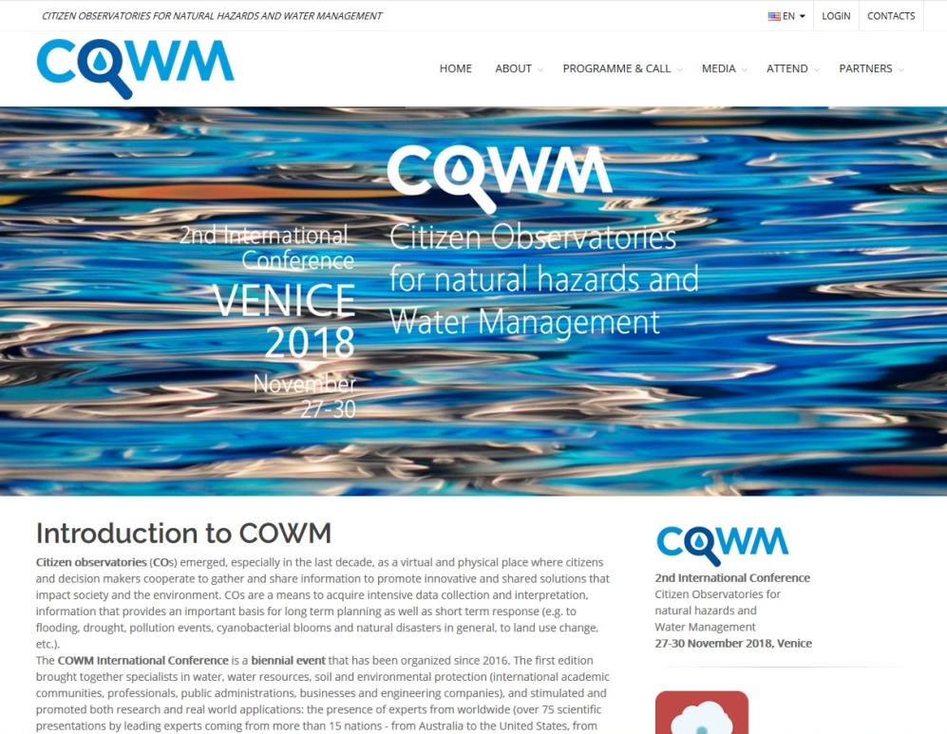
How we are going to work
Email list
Twiki
GitHub & AsciiDoc
Regular telcos each month (is that ok with you?)
Report on progress
Prepare some interoperability tests
Do some demonstrations
Plan ahead
Other?

Slide 44
CoP3 timeline
NEXT F2F MEETING
Venice
FINAL REPORT
02
MEETING
04
DOCUMENT
JULY 2018
1rt IE
APRIL 2019
2nd IE
NOVEMBER 2018
SEPTEMBER 2020
01
DOCUMENT
COP INCEPTION REPORT (objectives, tasks & methodology, potential impacts)
03
DOCUMENT
08
DOCUMENT
MID-TERM REPORT

Slide 45
Timeline
Activity | Timing
Startup
Draft activity plan presented to CS DWG: | Mar 19th, 2018
OAB revision and approval: | June 4th, 2018
Call for participation: | June 5th, 2018
Pre-kickoff event ECSA conference in Geneva: | June 6th, 2018
Execution
Official Kickoff after the Stuttgart TC (adding participation of the non present in ECSA conference) (TBC): | September 14th, 2018
Development, testing and bug fixing | September to February 2016
Presentation at GEO plenary in Kyoto | Oct 31st – Nov 11th 2018
Meeting at the Citizen Observatories for Natural Hazards and Water management Conference | Nov 27th– Nov 30th 2018
Planned end date: | March, 2019
Wrap-up and Reporting
Technology Demonstration in a OGC TC | March 2019
Final report submission | June 2019

Slide 46
Any other business
[add points]
…

Slide 47
Joan Masó
Researcher, CREAF
joan.maso@uab.cat

Slide 48
IPR - Creative Commons licensing
Six types of licenses:
Attribution - CC BY: lets others distribute, remix, tweak, and build upon your work, even commercially, as long as they credit you for the original creation. Most accommodating of licenses offered. Recommended for maximum dissemination and use of licensed materials.
Attribution-ShareAlike - CC BY-SA: lets others remix, tweak, and build upon your work even for commercial purposes, as long as they credit you and license their new creations under the identical terms. Often compared to “copyleft” free and open source software licenses. All new works based on yours will carry the same license, so any derivatives will also allow commercial use. Used by Wikipedia, and recommended for materials that would benefit from incorporating content from Wikipedia and similarly licensed projects.
Attribution-NoDerivs - CC BY-ND: allows for redistribution, commercial and non-commercial, as long as it is passed along unchanged and in whole, with credit to you.
Attribution-NonCommercial - CC BY-NC: lets others remix, tweak, and build upon your work non-commercially, and although their new works must also acknowledge you and be non-commercial, they don’t have to license their derivative works on the same terms.
Attribution-NonCommercial-ShareAlike - CC BY-NC-SA: lets others remix, tweak, and build upon your work non-commercially, as long as they credit you and license their new creations under the identical terms.
Attribution-NonCommercial-NoDerivs - CC BY-NC-ND: most restrictive of main licenses, only allowing others to download your works and share them with others as long as they credit you, but they can’t change them in any way or use them commercially.

